Slide 1
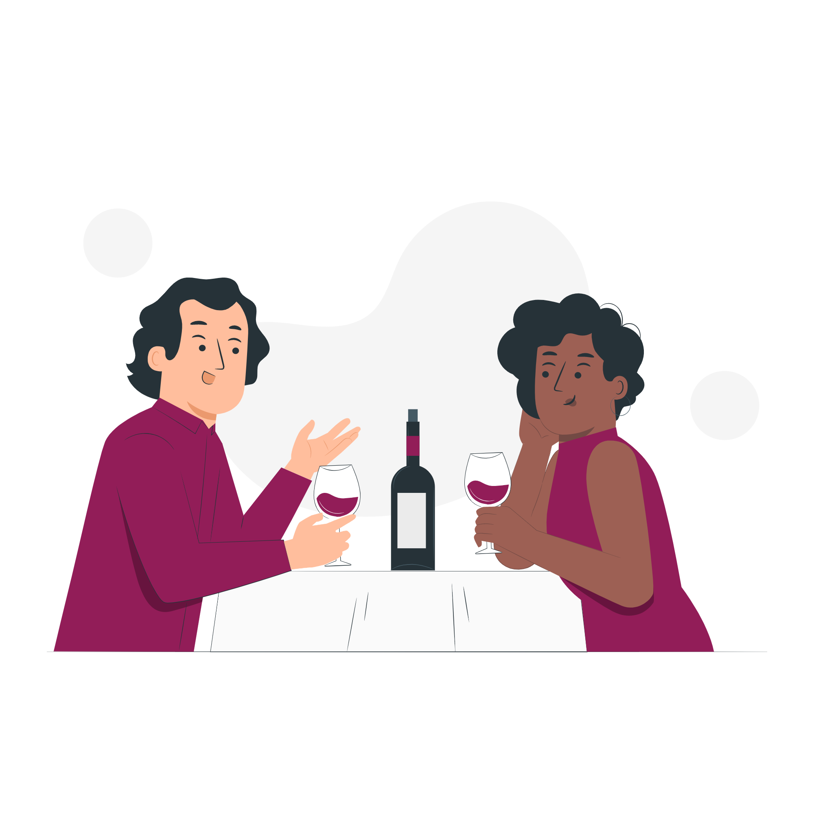
PREVIEW DISCUSSION
What do you think are some good ways to make a good first impression on a date?
?
▶
VIEWING ACTIVITY

