Slide 1
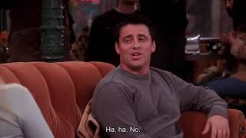

PART 1
Discuss/Write short answers below according to the information.
1: What happened on Joey’s first date with Sarah? 0:18
2: How does Joey feel about their first date? What does he say about it? 0:48
Refer back to Preview, Part 3. How similar was your date story to Joey’s?
PART 2
VIEWING ACTIVITY

