Slide 1
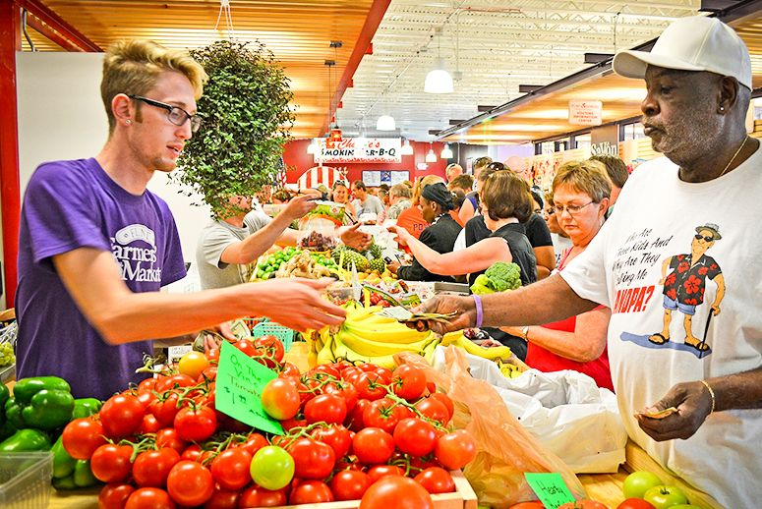

MARKET AROUND US CHAPTER-6
This Photo by Unknown author is licensed under CC BY.

