Slide 1
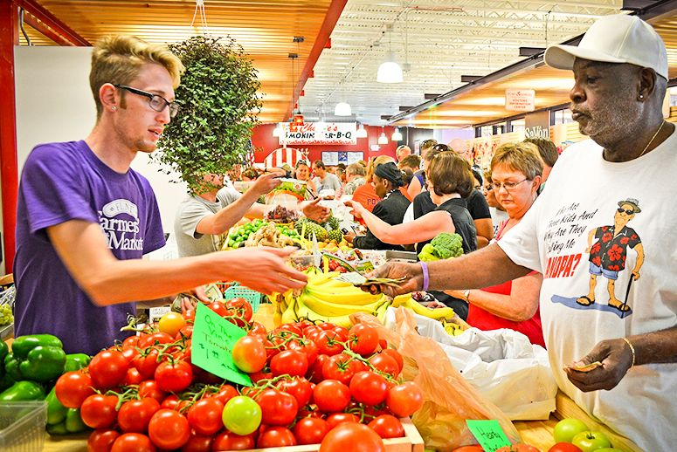

MARKET AROUND US CHAPTER-6

