Slide 1
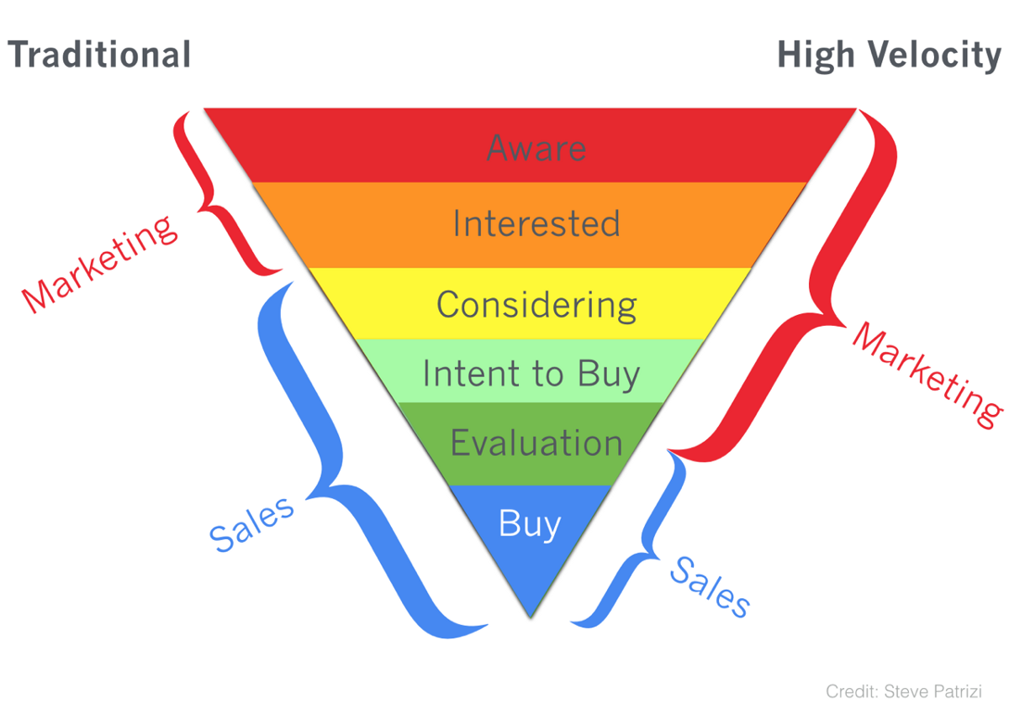

Traditional
Credit: Steve Parizi

