Slide 1
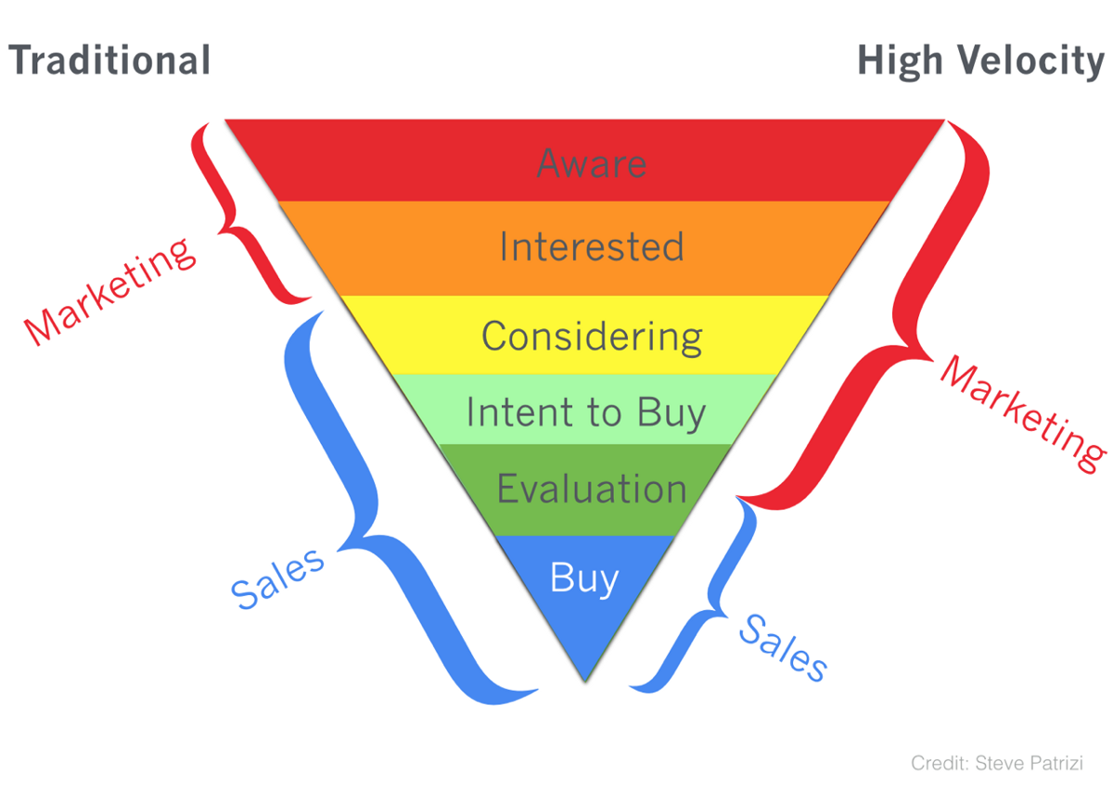

Sales
Credit: Steve Parizi

