Slide 1
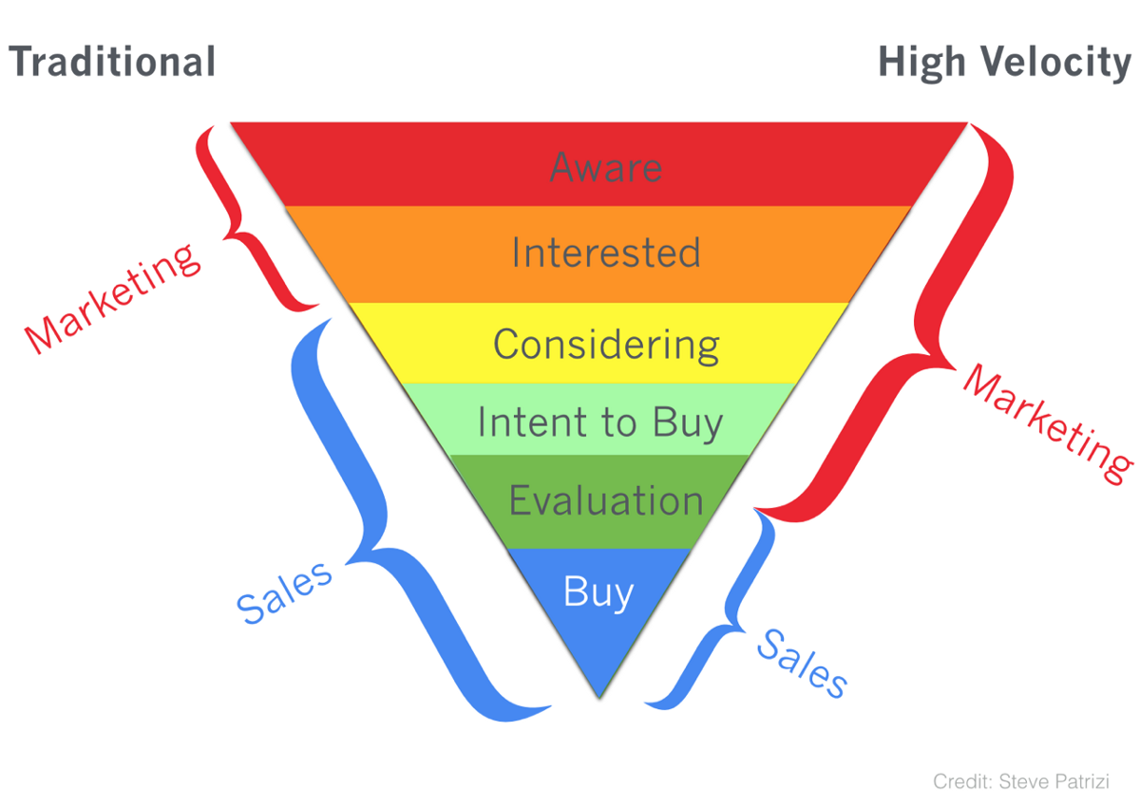

Credit: Steve Parizi

