Slide 1
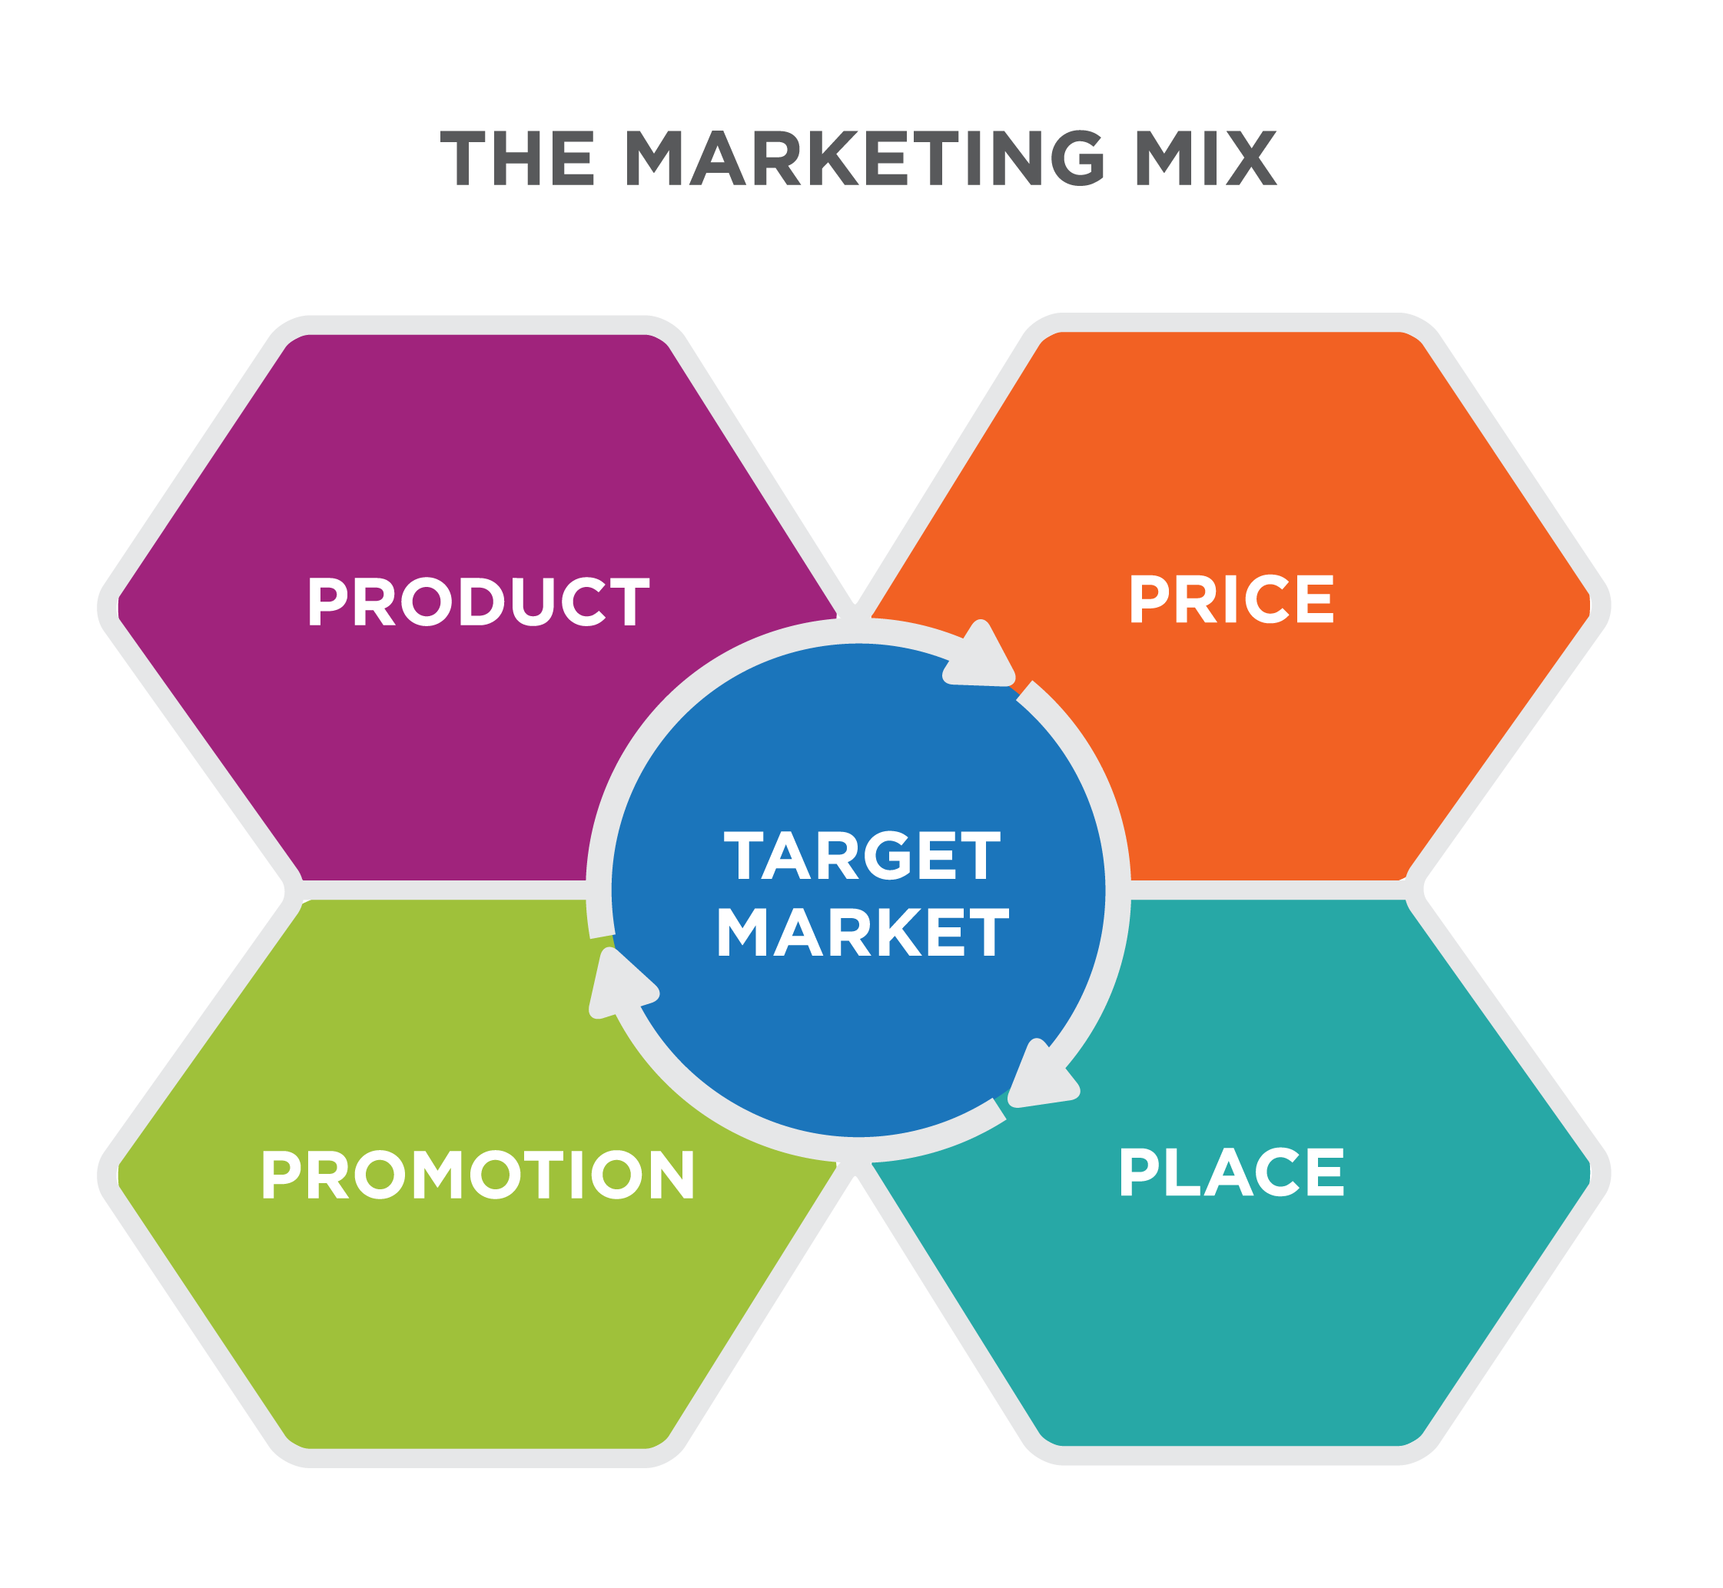
THE MARKETING MIX
PRODUCT
PRICE
Marketing
PROMOTION
PLACE

