Slide 1
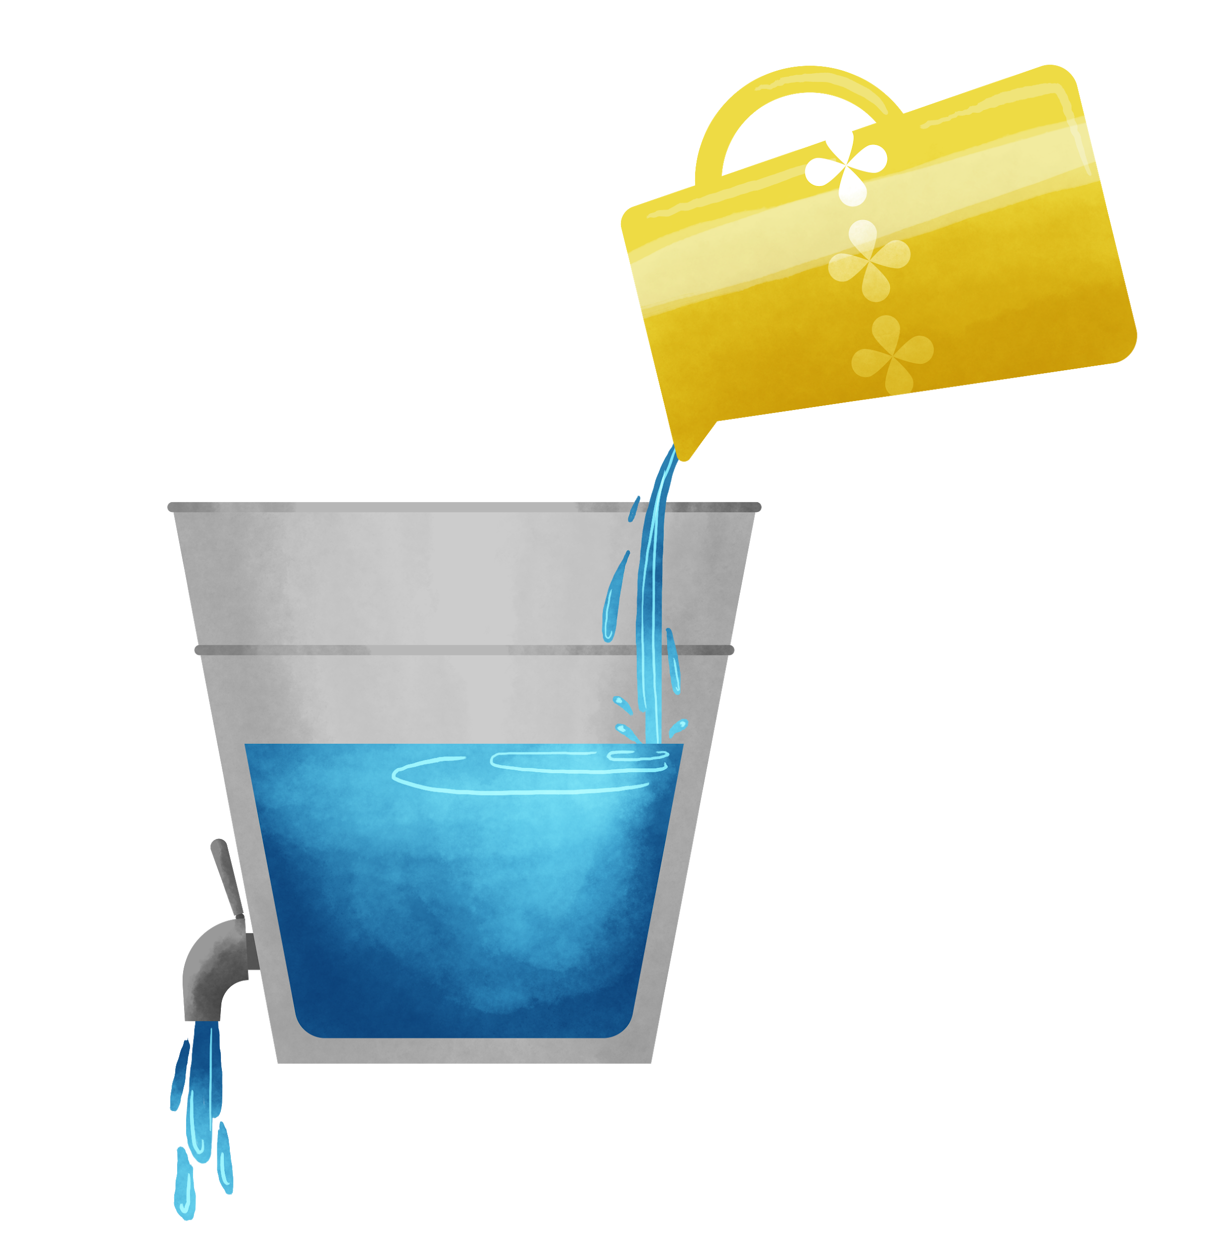
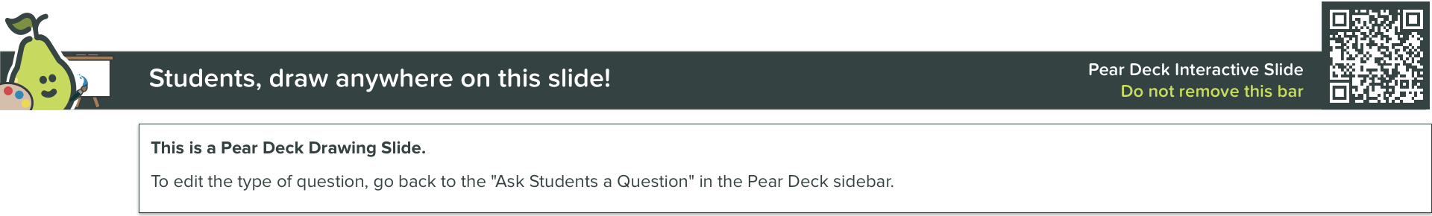
What is Filling Your Bucket Today and What’s Draining It?
Filling
Draining

