Slide 1


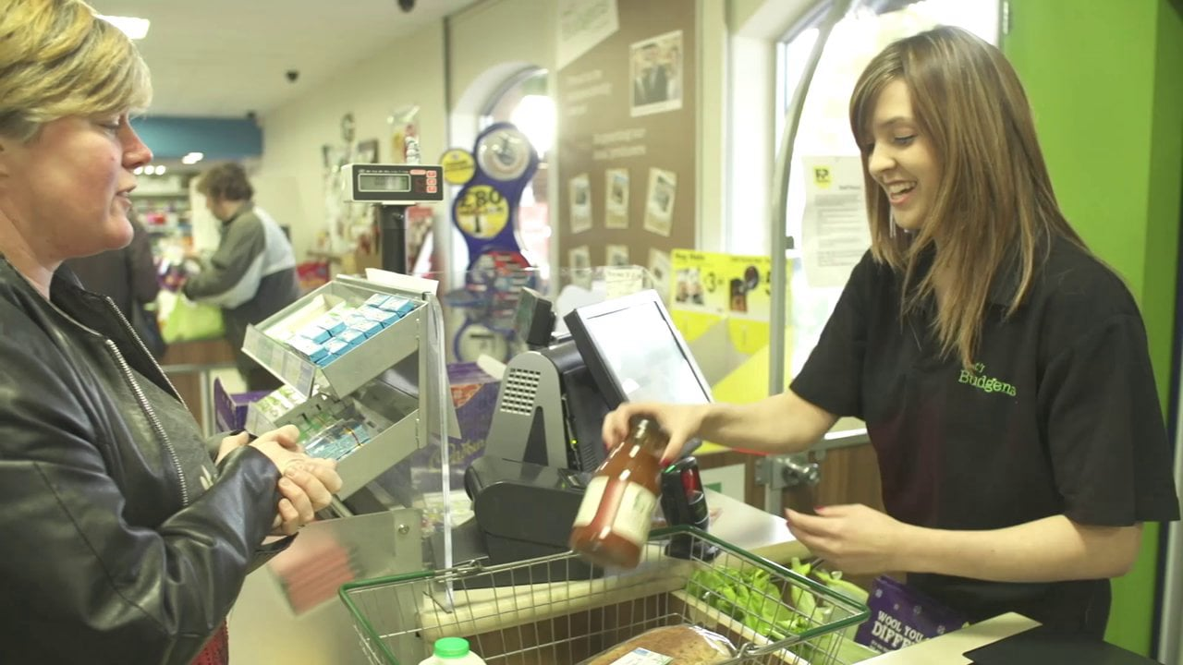
After Sales Services
This Photo by Unknown author is licensed under CC BY-SA-NC
This Photo by Unknown author is licensed under CC BY-SA-NC
This Photo by Unknown author is licensed under CC BY

