Slide 1
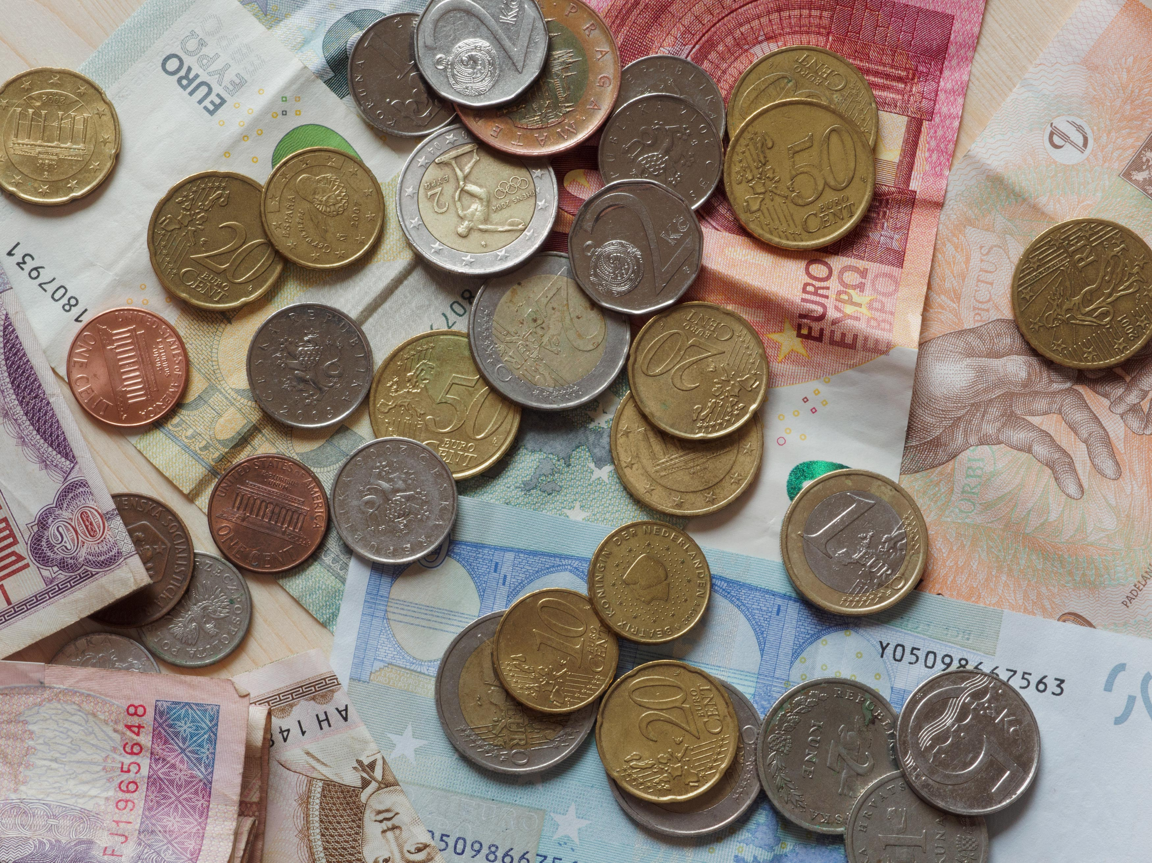
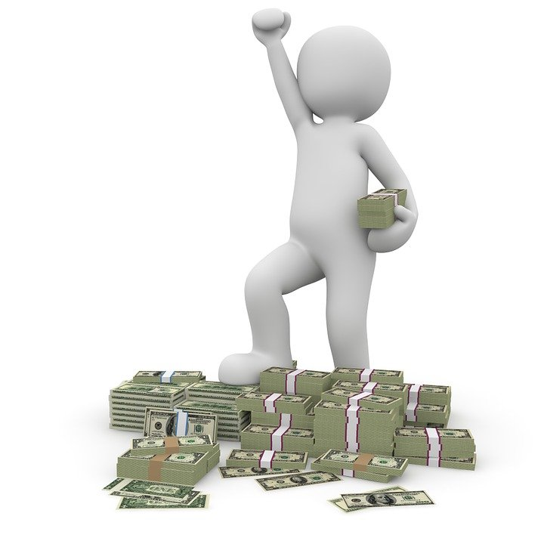
Profit Sharing
Do you think everybody in market get same share of profit? Why?

