Slide 1
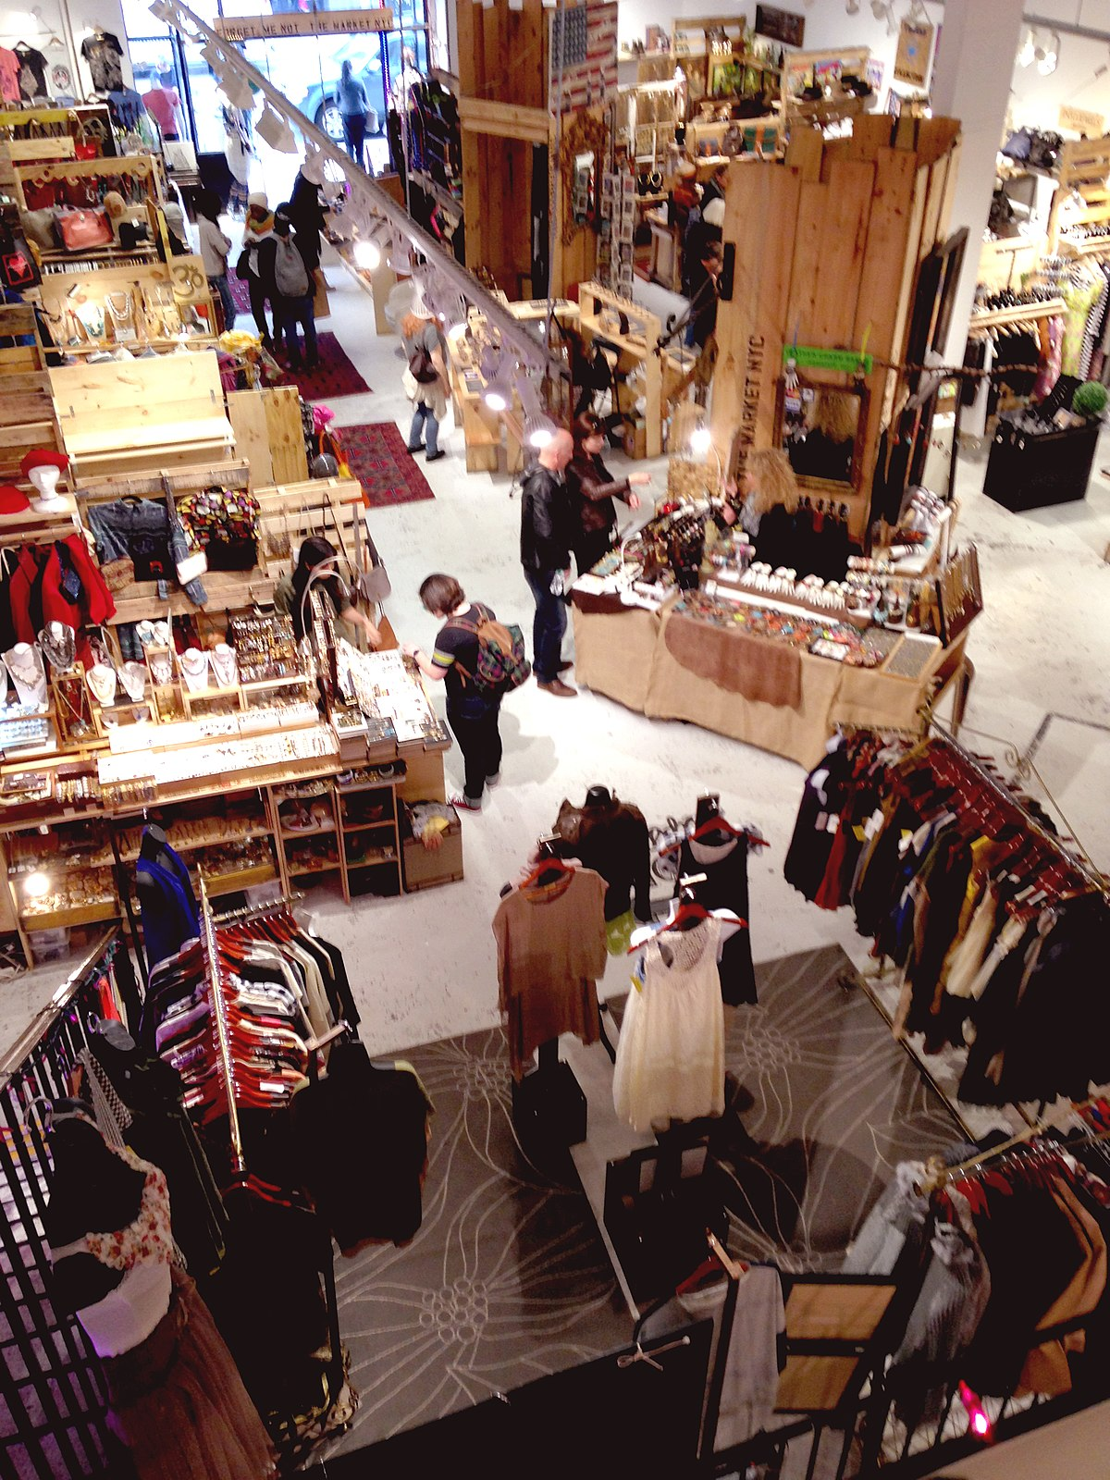
ELO's
1. What is market?
2. How product reach to market?
This presentation uses images under CC BY-SA license

