Slide 1
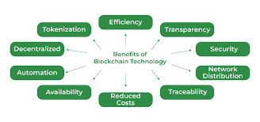
Advantages of Blockchain
• Greater Transparency
• Highly secure
• Easily traceable
• High efficiency and speed
• Low cost
• Zero percentage of fraud
• Extremely volatile

