Slide 1
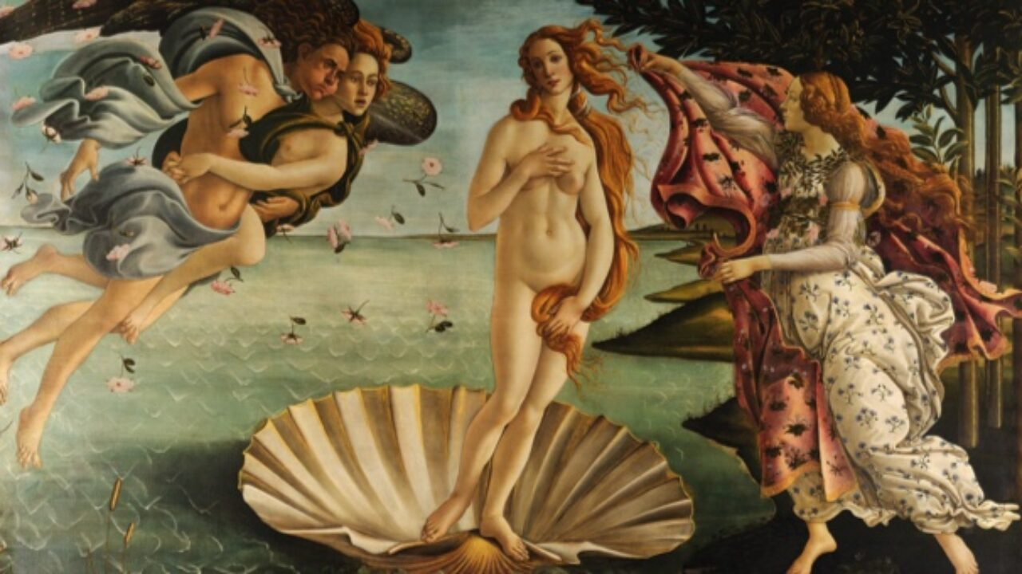
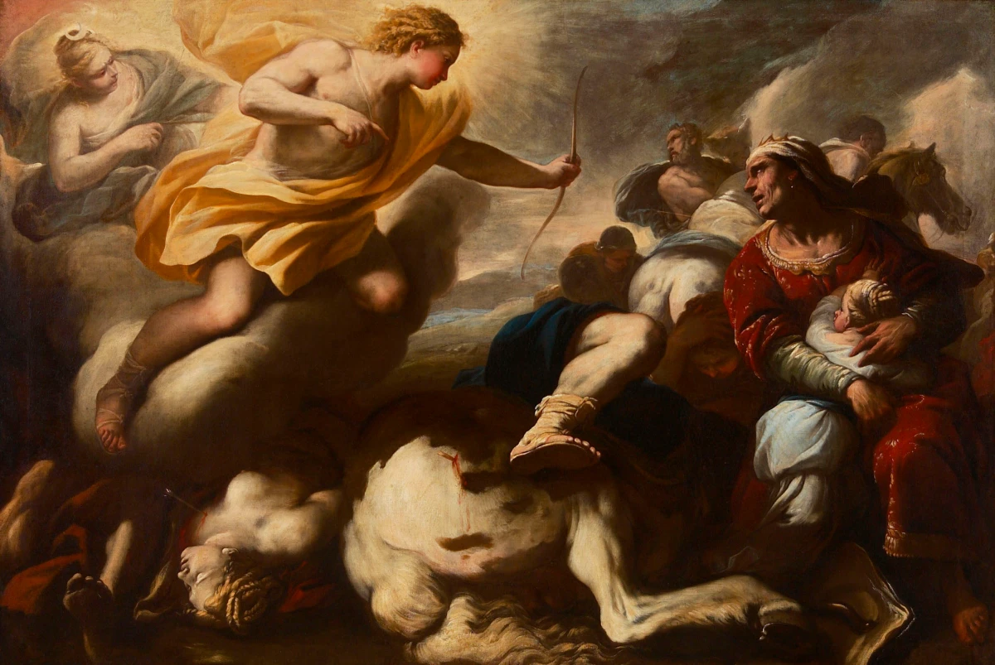
The Subject and Content of Art
D. Mythology and religion, dreams and fantasies.

