Slide 1

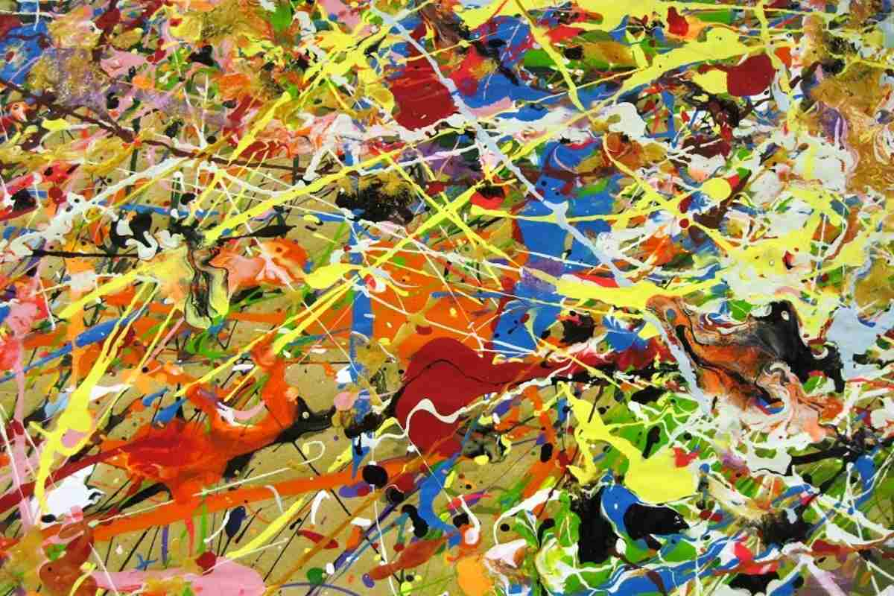
Non-representational or Non-objective Art
The Subject and Content of Art

