Slide 1

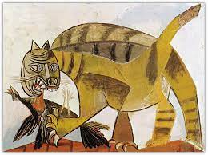
The Subject and Content of Art
Subject of Art
A cat catching a bird is the subject of both works above.

