Slide 1
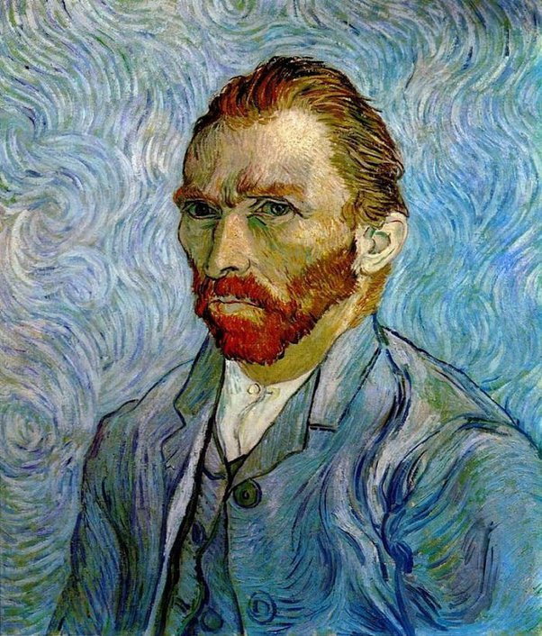
The Subject and Content of Art
Representational or Objective Art
Self-portrait of Van Gogh

