Slide 1
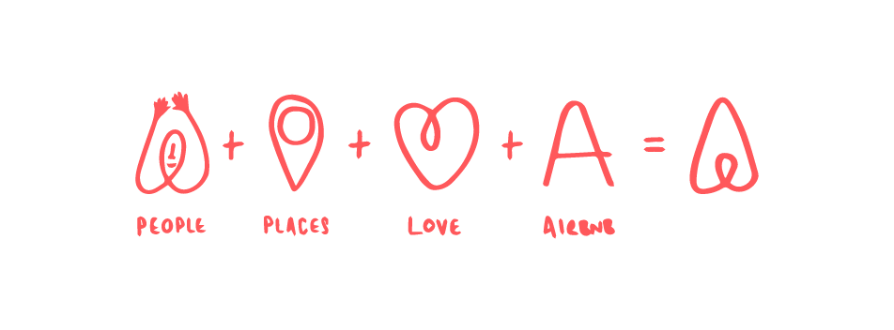
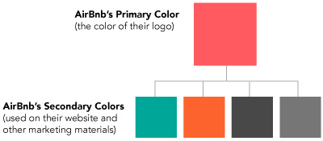
Branding
2013
A brand that could express the vision of its founders and guide and support its business through exponential growth and whatever the future may hold.
PEOPLE + PLACES + + LOVE + AIRBNB = Bélo
LOVE
The Bélo tells the story of the company in one symbol.
This higher purpose shifted Airbnb’s narrative to focus on belonging, with language and messaging elevating the conversation away from insurance and bookings to warmth and welcome.
Este propósito superior cambió la narrativa de Airbnb para centrarse en la pertenencia, con un lenguaje y mensajes que elevaban la conversación más allá del seguro y las reservas a calidez y bienvenida.

