Slide 1
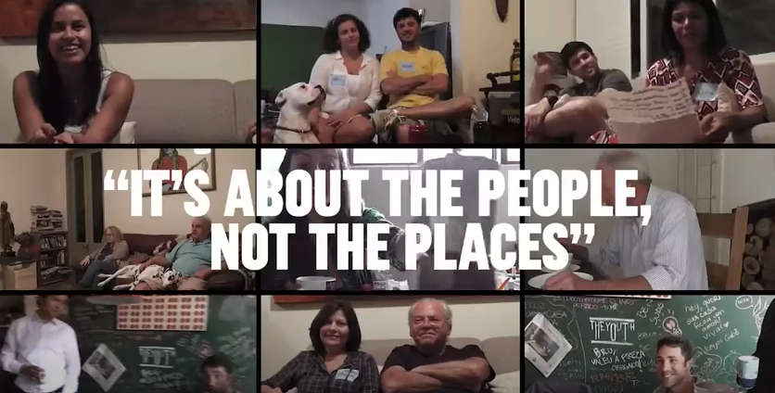
Airbnb is all about people and not about the places at all.
The passion of its founders and the love and generosity of people around the world was changing the culture of travel with places and personal experiences unlike any other. Belonging the world over was Airbnb’s truth and its differentiator.
IT'S ABOUT THE PEOPLE, NOT THE PLACES

