Slide 1
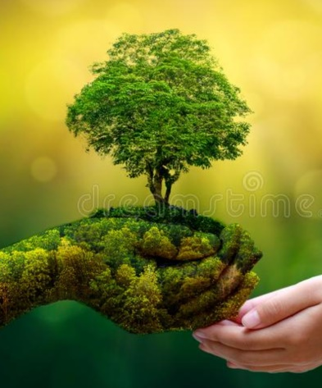
ENVIRONMENT
Everything around us is known as environment.
It includes every living and non living thing.
Everything which we see in our surroundings such as sunlight, atmosphere, land, water, minerals, humans, plants, animals, insects, air etc. comes in environment.
It is the sum of all surroundings which we see.

