Slide 1
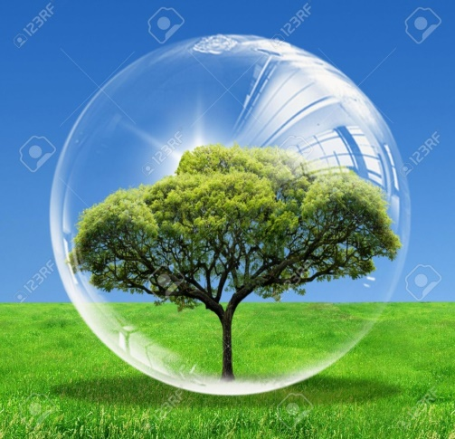
NATURAL ENVIRONMENT
The natural environment means the non human made surroundings conditions in which all biotic and abiotic things exist on earth.
Natural environment can further be divided into 4 parts.

