Slide 1
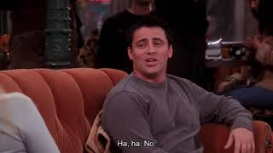
PART 4
List the events in Joey’s second date with Sarah in order from 2 - 6. The first one has been done as an example.
1. The waiter arrives with their desserts.
2. Joey doesn’t like the dessert he orders and tries to order a different one.
3. Sarah leaves the table for a phone call.
4. Joey is unable to control himself and eats all of Sarah’s dessert.
5. Joey refuses to apologize when Sarah returns.
6. Joey apologizes for getting angry that Sarah took his food on the first date.
VIEWING ACTIVITY

