Slide 1
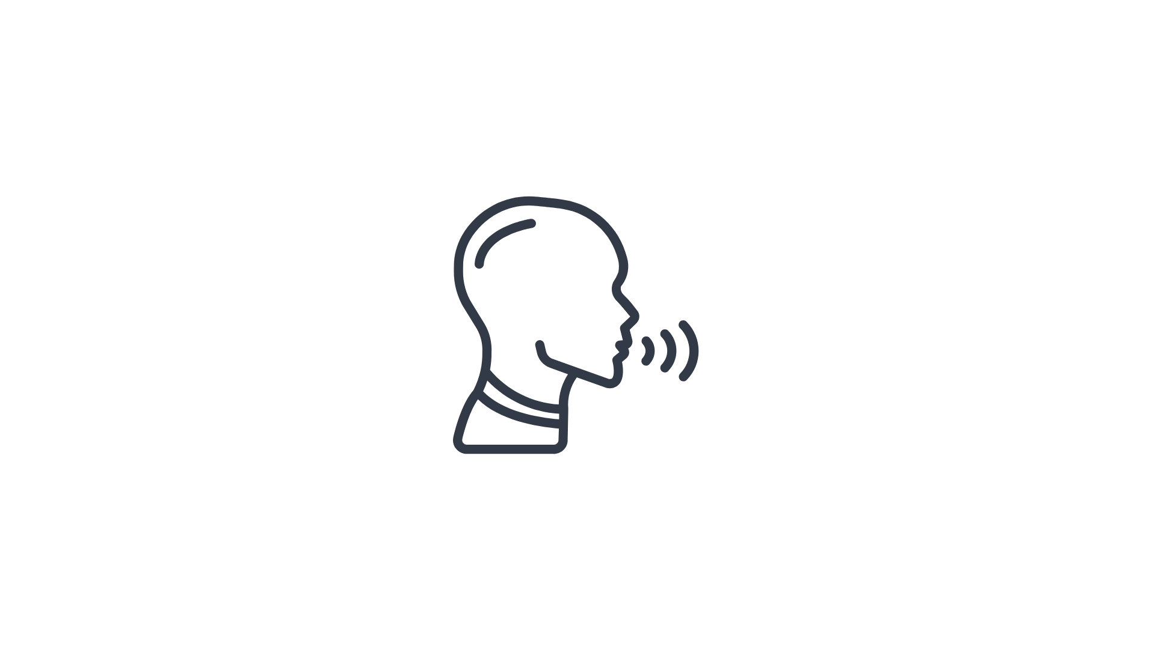
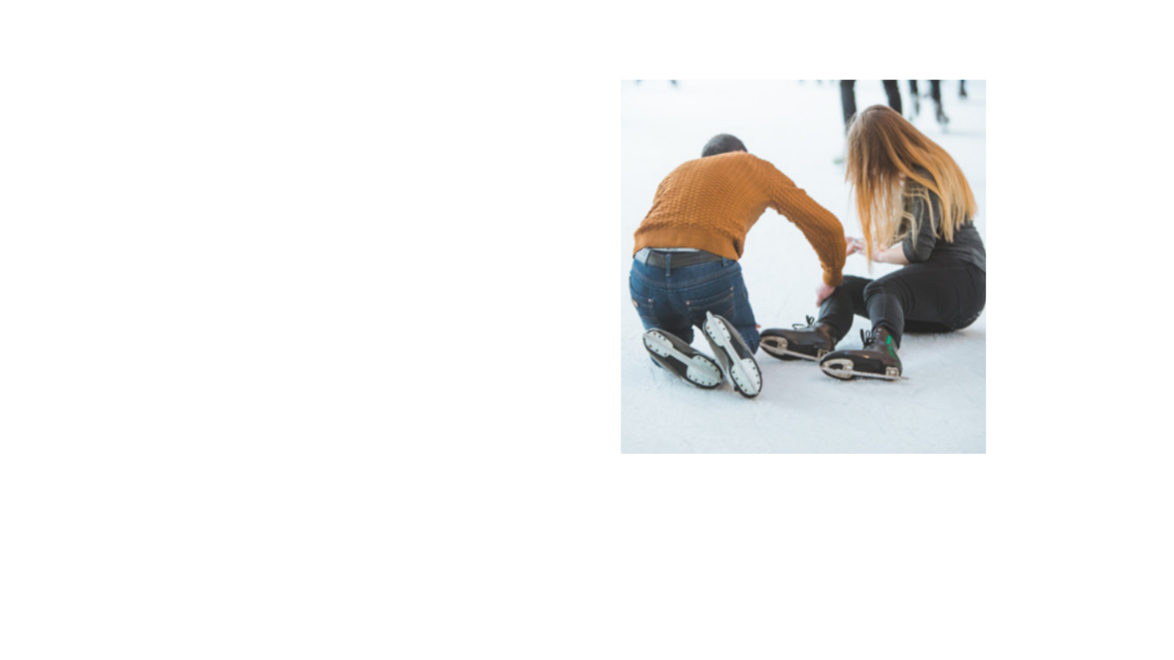

PART 4
Tell the story below out loud using the pronunciation rule you studied on the previous slide.
Last week, I went on a date. We were skating in the park,
we were laughing, and the guy was making some really funny jokes...
and then, out of nowhere, I fell down and I broke my leg!
Play and listen to the audio clip to check your answers. Repeat if necessary.

