Slide 1

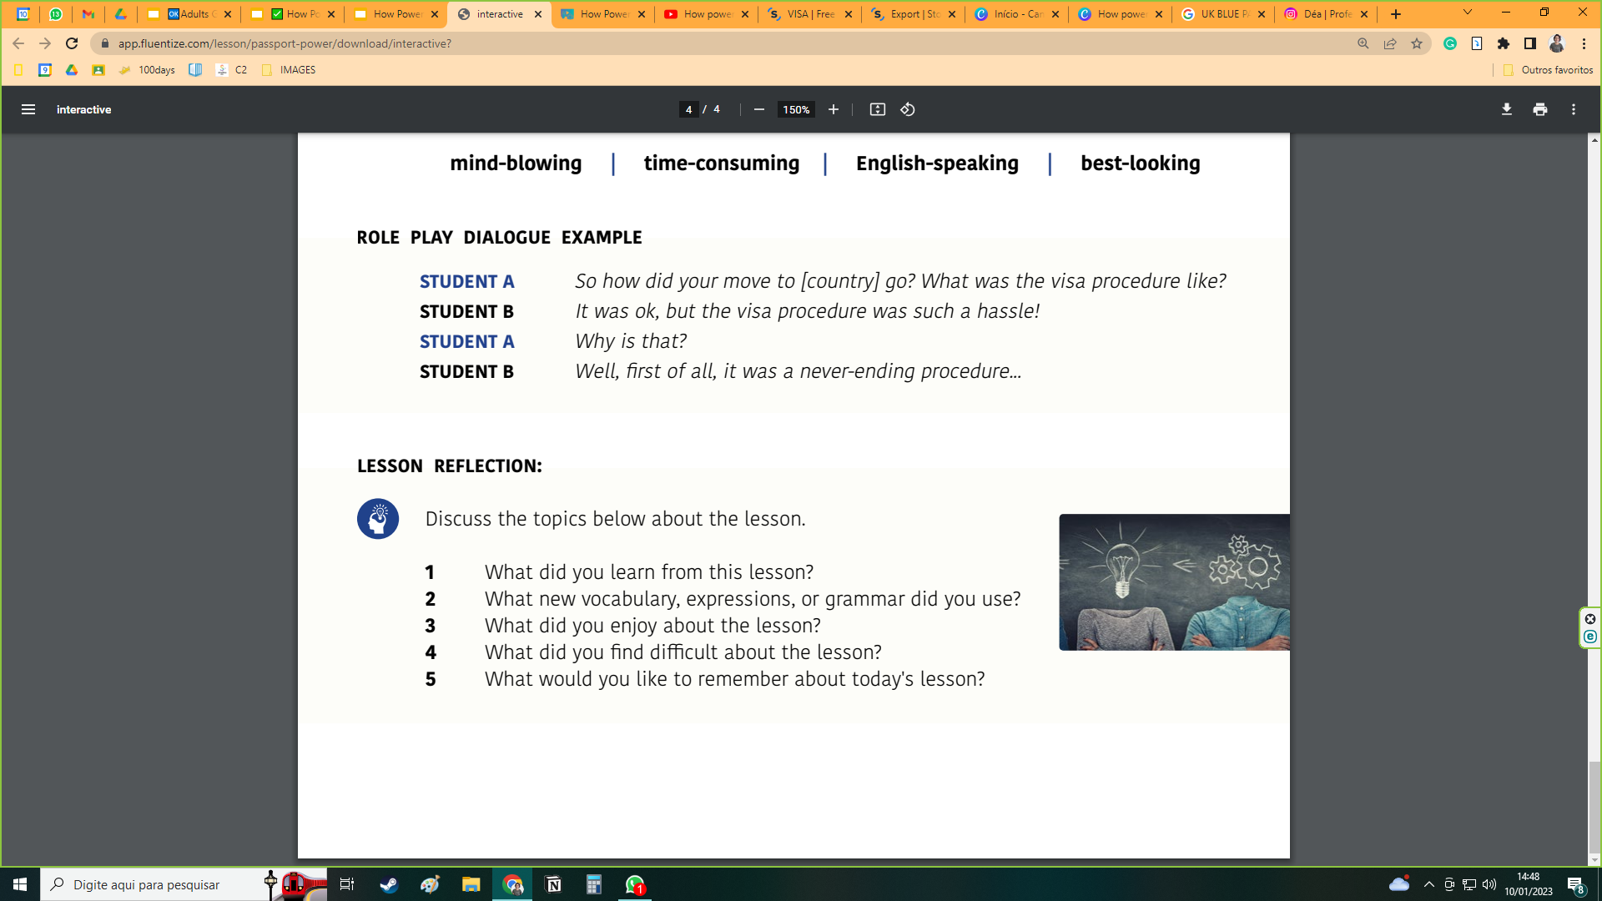
LESSON REFLECTION:
LESSON REFLECTION:
1. Did you learn or use any new vocabulary, grammar, phrases, etc. in this lesson? If so, what?
2. What did you enjoy about the lesson?
3. Is there anything you found difficult about the lesson?
QUIZ & REVIEW ACTIVITY

