Slide 1
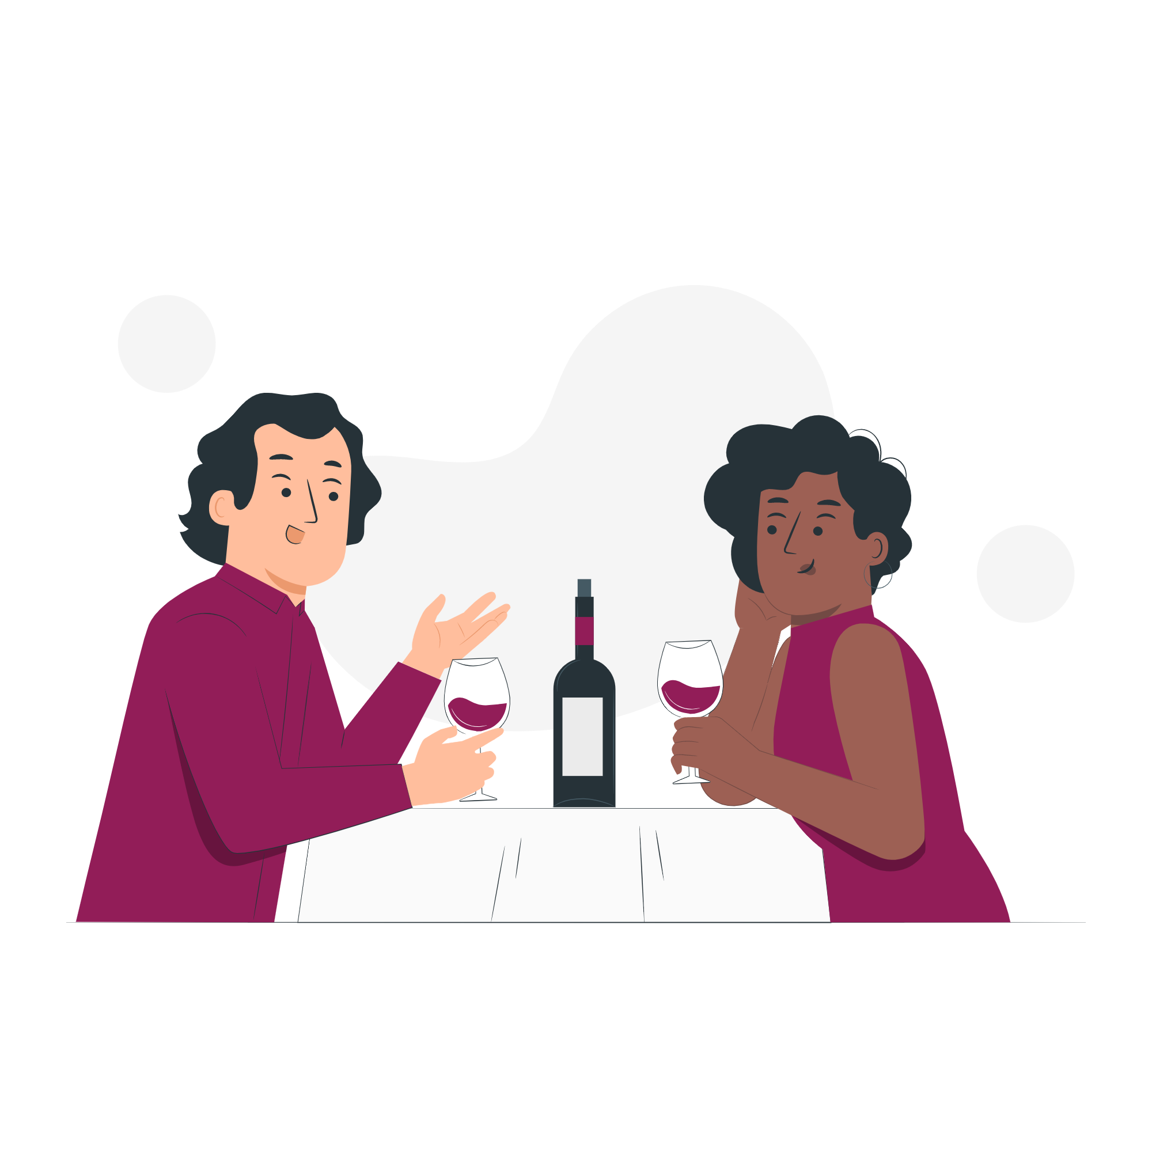
PREVIEW DISCUSSION
?
What do you think are some good ways to make a good first impression on a date?
▶
VIEWING ACTIVITY

