Slide 1
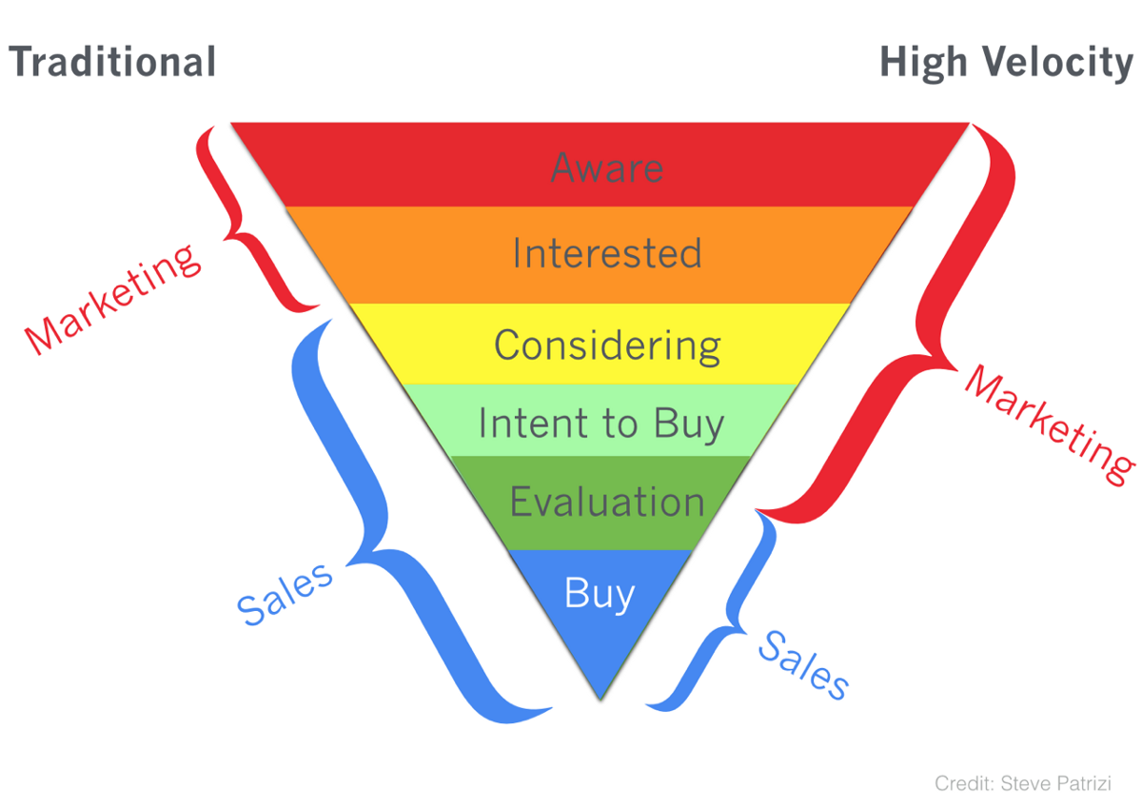

Marketing
Sales
Sales
Credit: Steve Parizi

