Slide 1
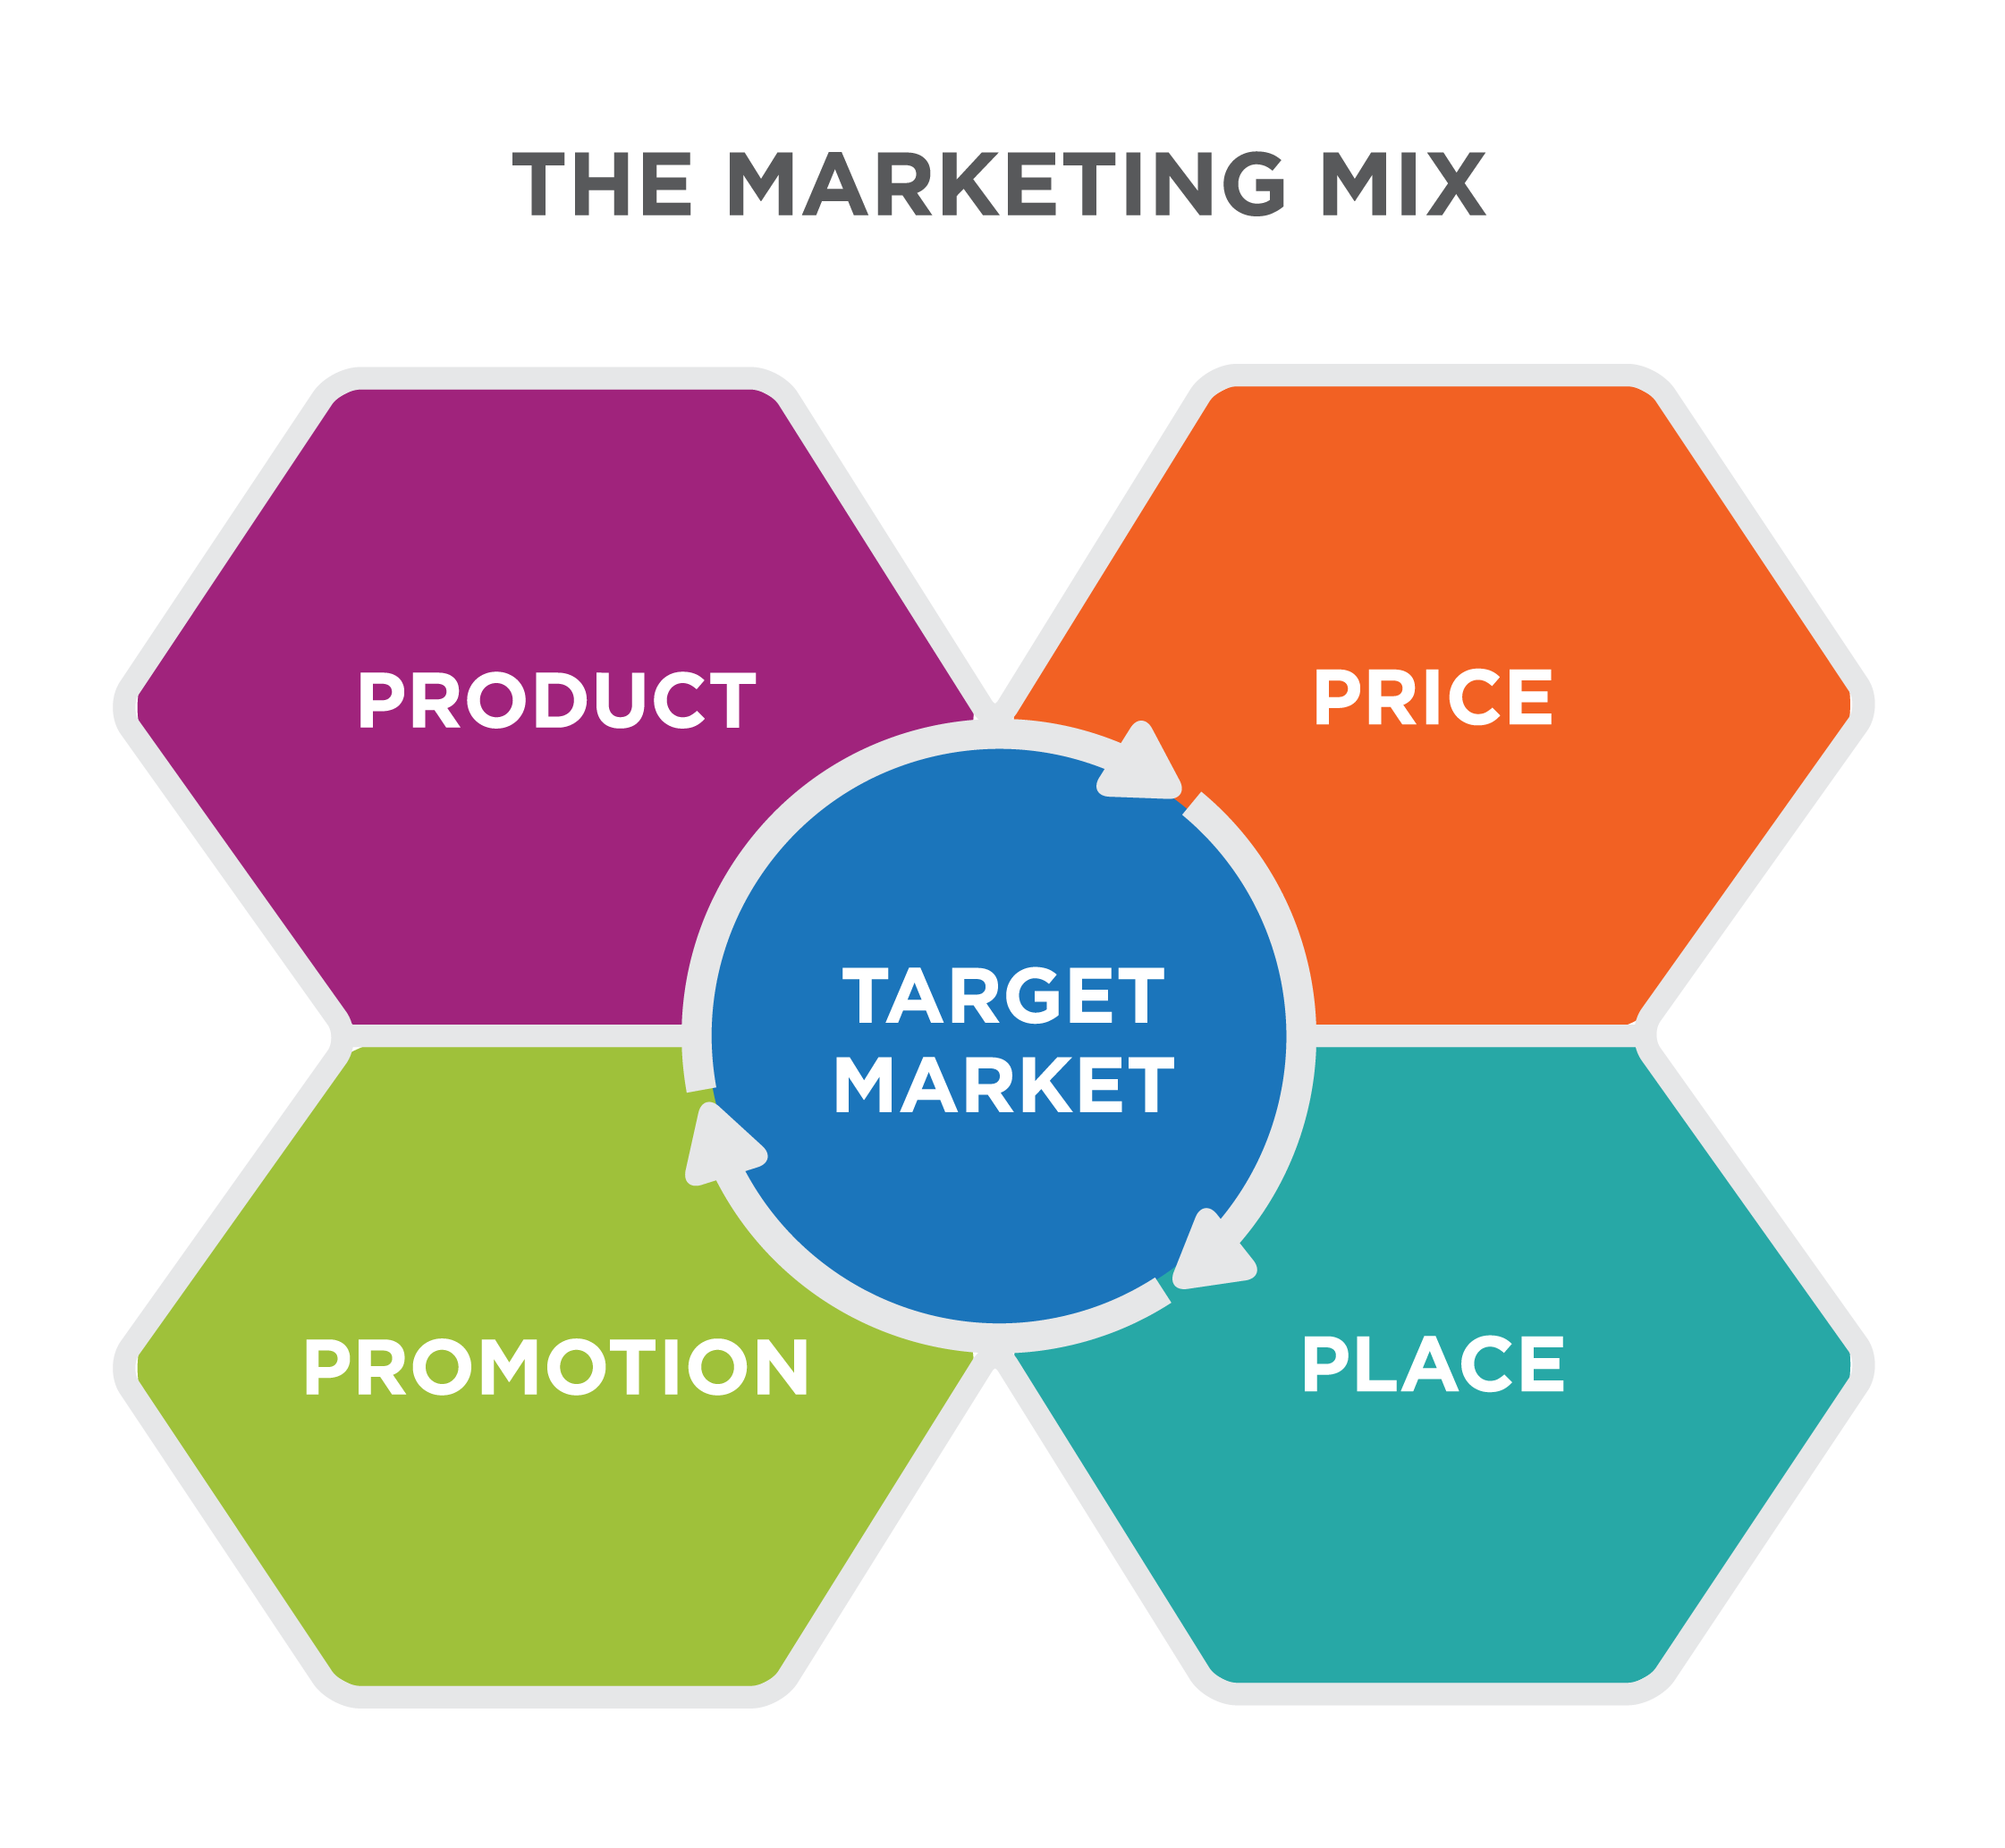
THE MARKETING MIX
Marketing

