Slide 1
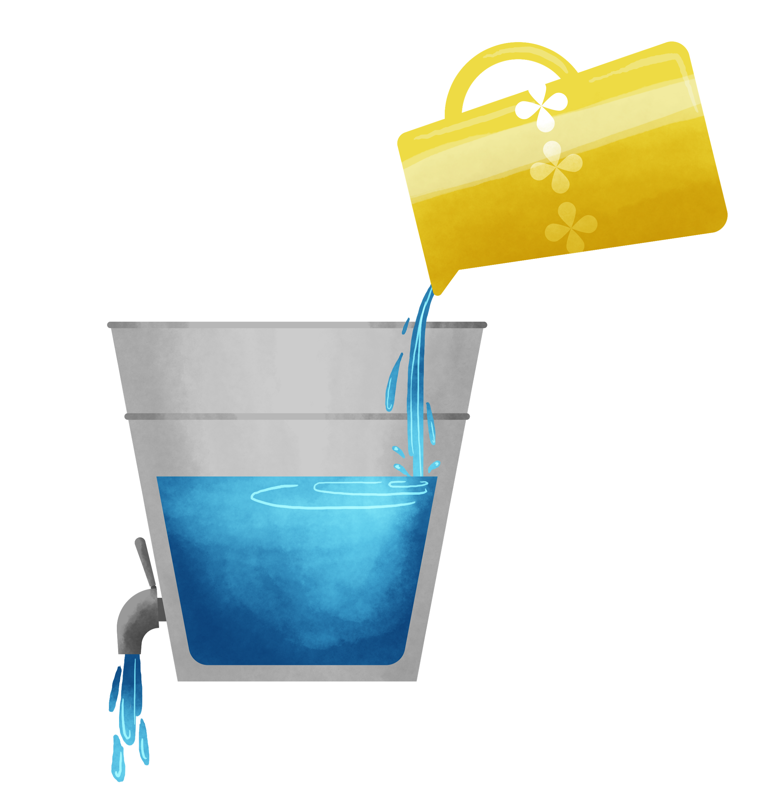
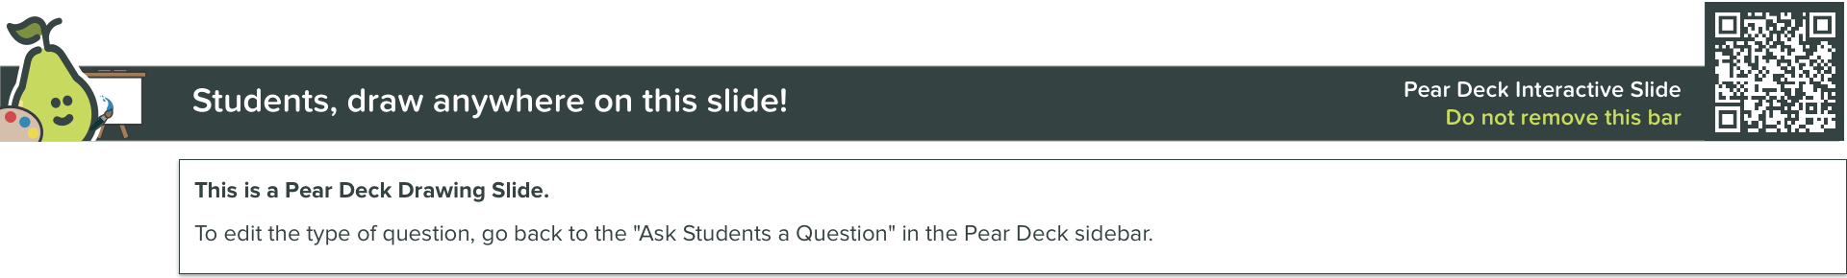
What is filling your bucket today and what’s draining it?
Filling
Draining

