Slide 1

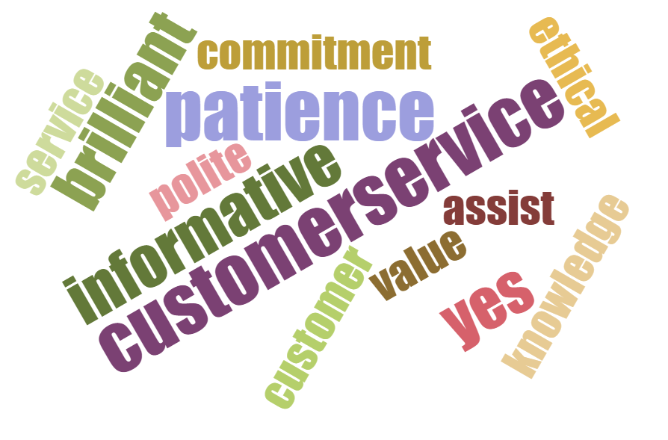
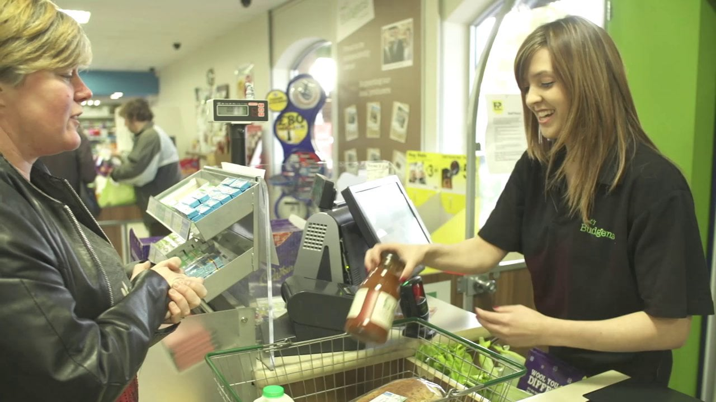
KNOW YOUR CUSTOMER
This Photo by Unknown author is licensed under CC BY-SA-NC
This Photo by Unknown author is licensed under CC BY-SA-NC
This Photo by Unknown author is licensed under CC BY

