Slide 1
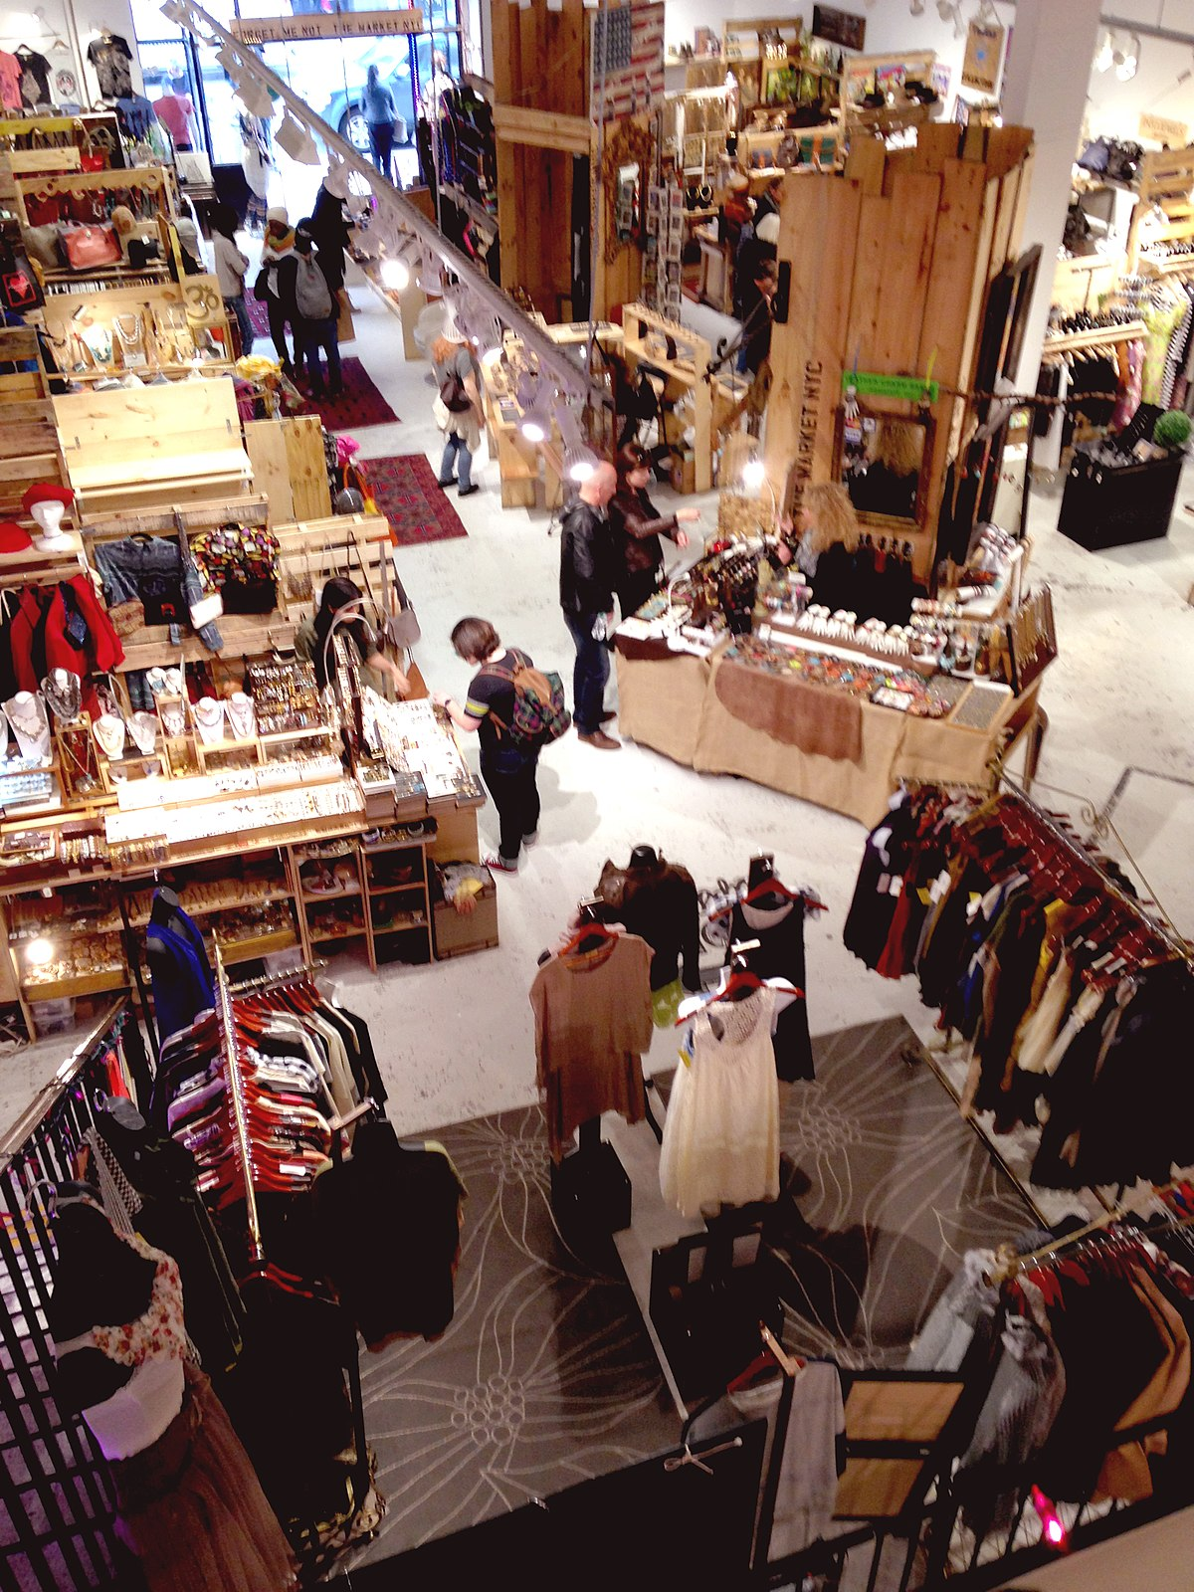
ELO's
1. Types of Market
This Photo by Unknown author is licensed under CC BY-SA

