Slide 1
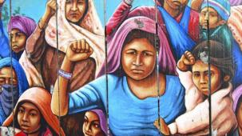
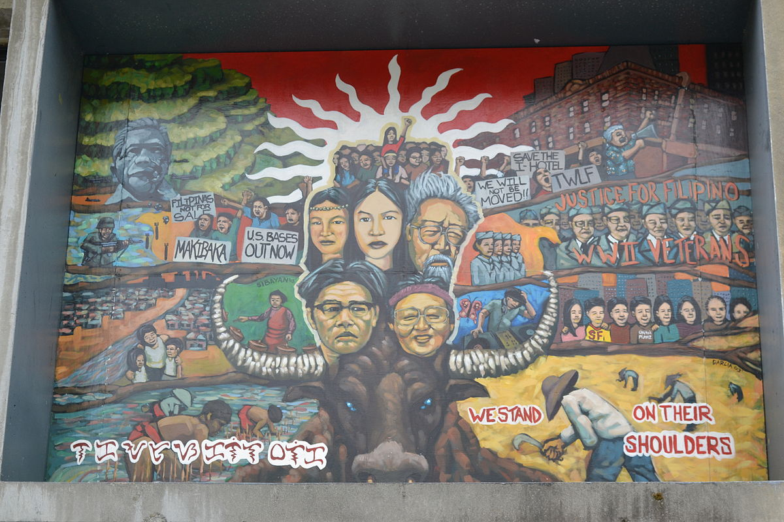
As an individual, how can we ensure equality in society?
This Photo by Unknown author is licensed under CC BY-NC.

