Slide 1
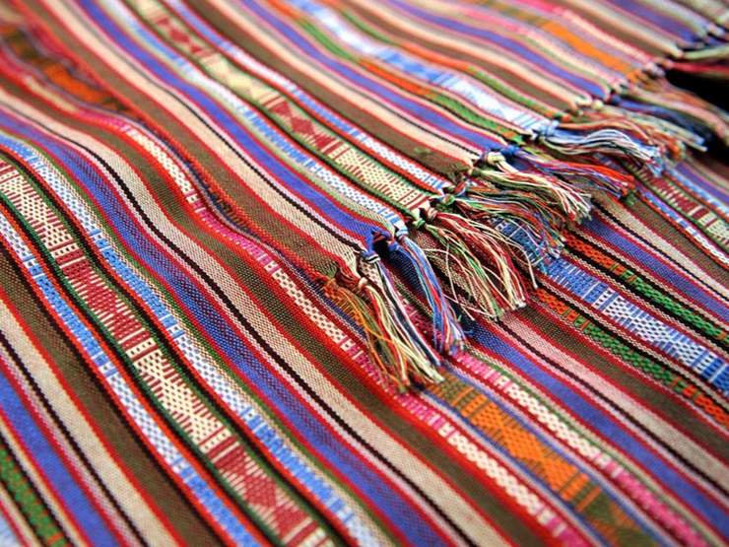
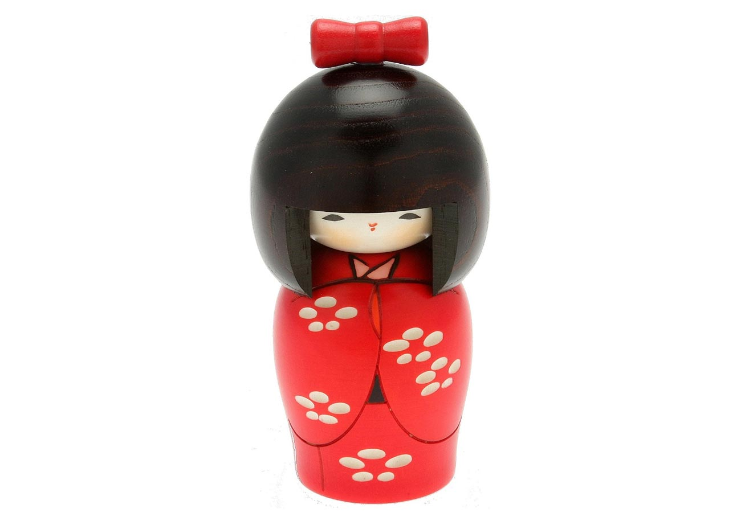
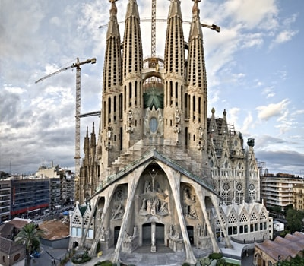
Global and Local Cultural Products
Cultural Products
✓ are goods and services such as arts, architectures, museums etc. that showcase the history and information of certain which belong to the country’s cultural heritage.

