Slide 1
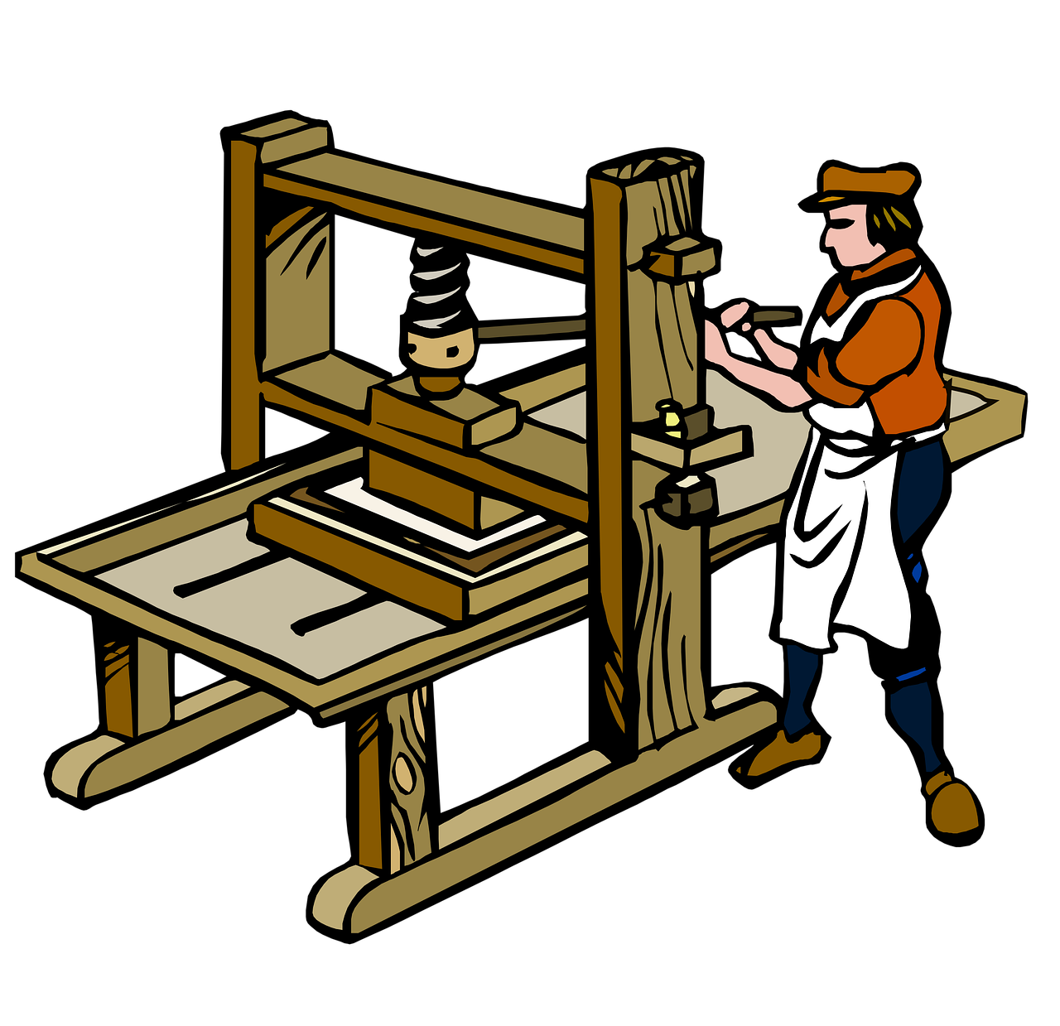
5 Stages of Development of Media
3. PRINTING PRESS
• It allowed the continuous production, reproduction, and circulation of print materials.
• Revolutionized the way information was disseminated.
• Enabled wider access to literature and education.

