Slide 1
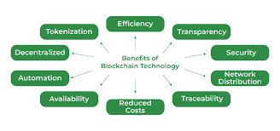
Advantages of Blockchain
☐ Greater Transparency
☐ Highly secure
☐ Easily traceable
☐ High efficiency and speed
☐ Low cost
☐ Zero percentage of fraud
☐ Extremely volatile

