Slide 1
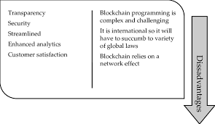
Disadvantages of Blockchain
Blockchain programming is complex and challenging
It is international so it will have to face a variety of global laws
Blockchain relies on a network effect
More power consumption
Immutability

