Slide 1
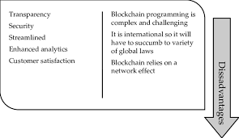
Disadvantages of Blockchain
[ ] Blockchain programming is complex and challenging
[ ] It is international so it will have to face a variety of global laws
[ ] Blockchain relies on a network effect
[ ] More power consumption
[ ] Immutability

