Slide 1
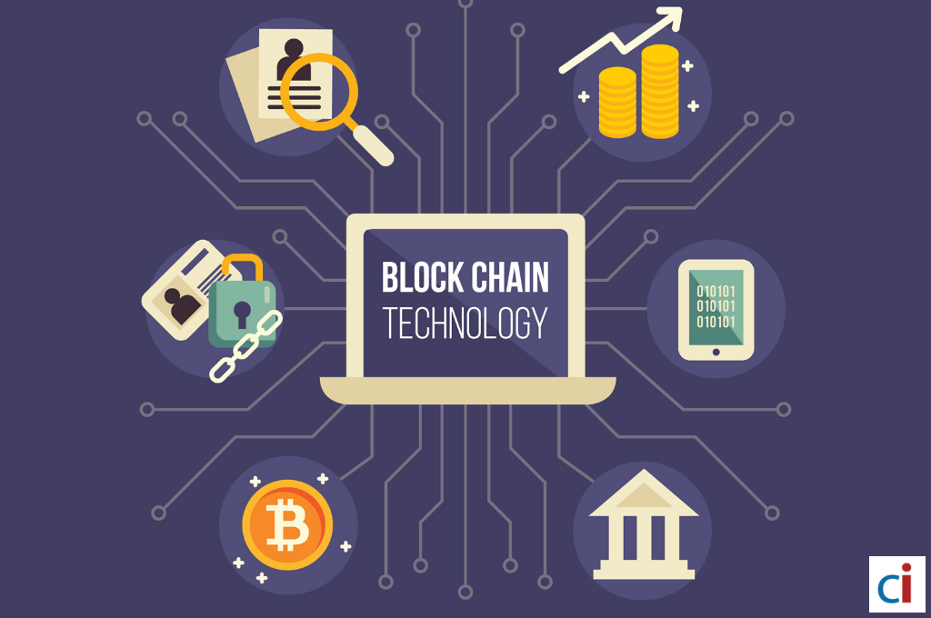
The Technology used in Blockchain
☑ Cryptographic Keys
☑ Network Protocol
☑ Distributed Ledger Technology
☑ Hashing

