Slide 1
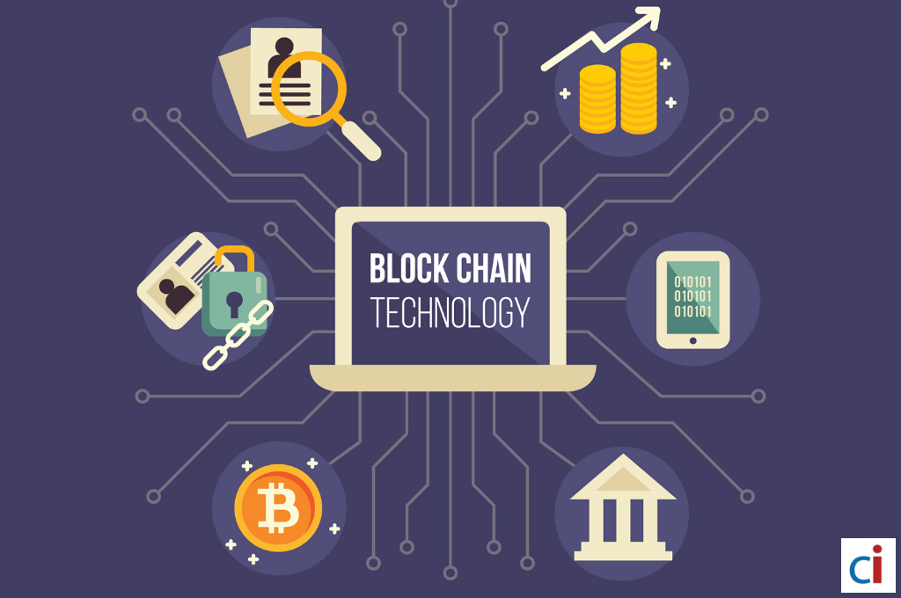
The Technology used in Blockchain
☐ Cryptographic Keys
☐ Network Protocol
☑ Distributed Ledger Technology
☑ Hashing

