Slide 1
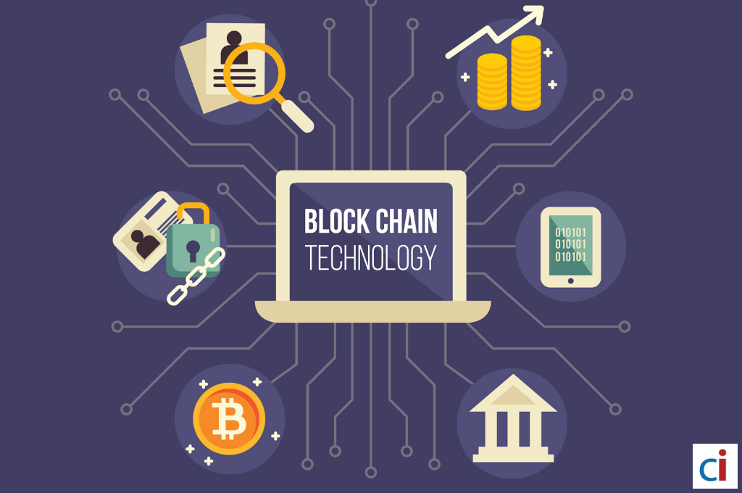
The Technology used in Blockchain
☐ Cryptographic Keys
☑ Network Protocol
☐ Distributed Ledger Technology
☑ Hashing

