Slide 1
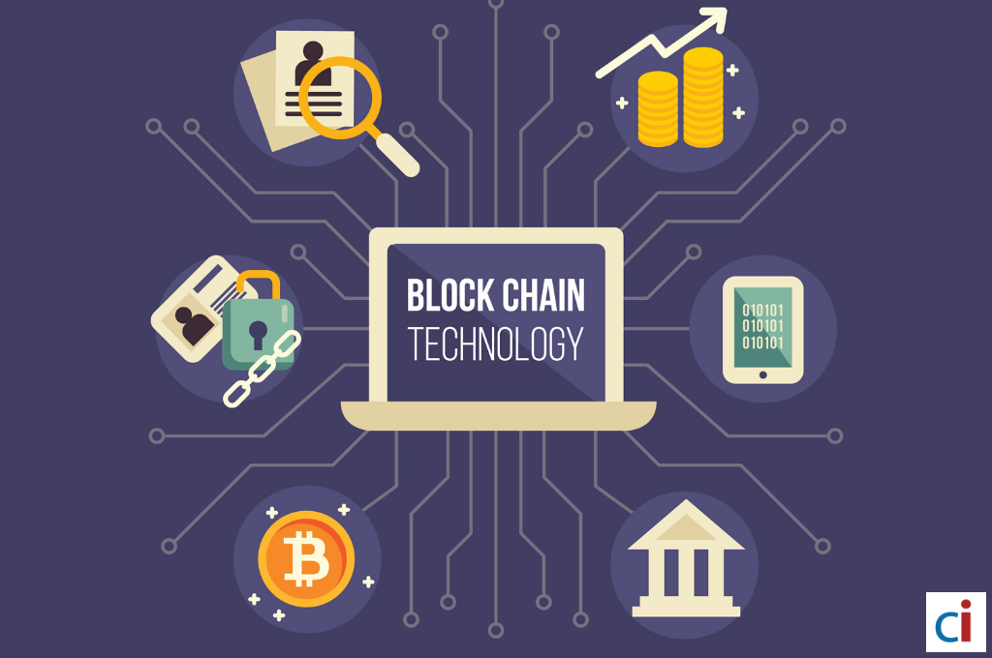
The Technology used in Blockchain
☐ Cryptographic Keys
☐ Network Protocol
☐ Distributed Ledger Technology
☐ Hashing

