Slide 1
Brain Tumor Segmentation Challenge 2017
Egor Krivov, Egor Kuznetsov

Slide 2
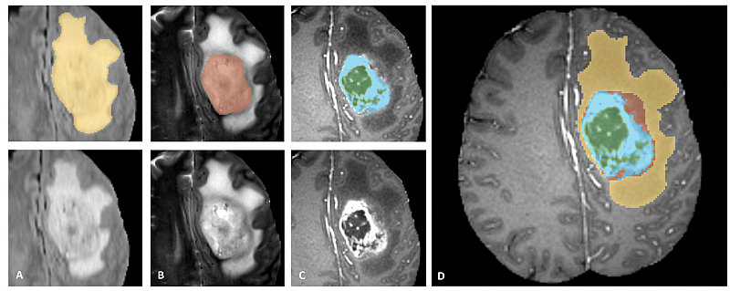
Data
285 multimodal 3D MRI scans
4 modalities (each ~140 × 172 × 145)
3 classes: whole tumor, tumor core, enhancing tumor

Slide 3
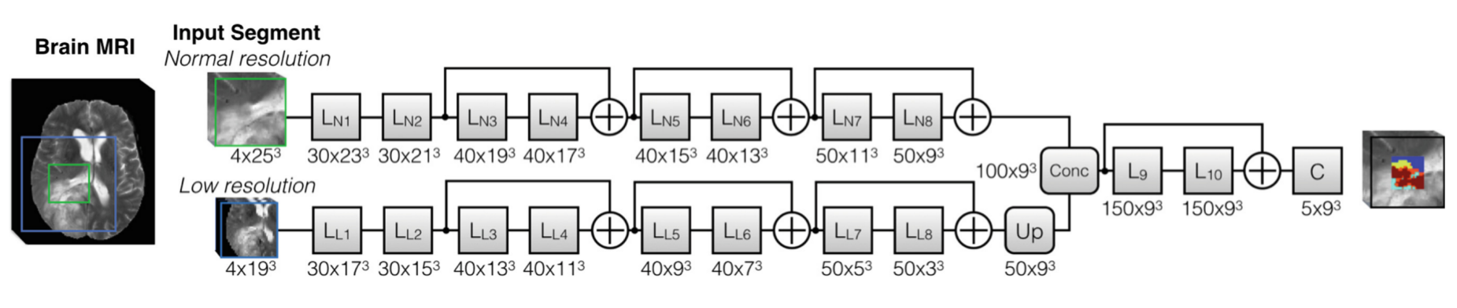
DeepMedic
Kamnitsas K. et al. DeepMedic on Brain Tumor Segmentation //Athens, Greece Proc. BRATS-MICCAI. – 2016.

Slide 4
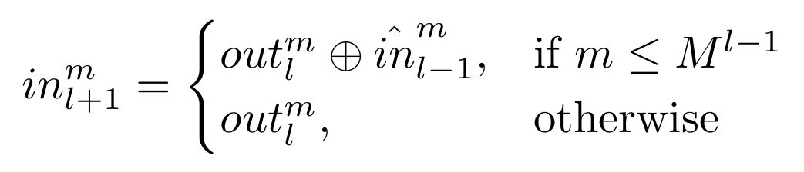
DeepMedic - Residual Connection
l-2
l-1
l
l+1
30 × 21³
40 × 19³
40 × 17³
50 × 15³

Slide 5
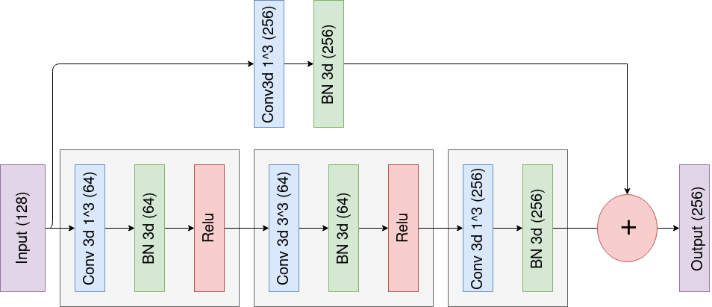
Bottleneck block (128, 64, 256)

Slide 6
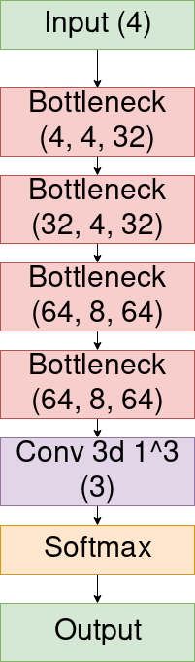
Our architecture

Slide 7
Dice score
Dice = 2*TP / (2*TP + FP+FN)
Dice loss = 2 * (∑_{i}p_{i} g_{i} ) / (∑_{i}p_{i} + g_{i})

Slide 8
Results
 | DSC Whole | DSC Core | DSC Enh.
DeepMedic (our) | 74.6 | 44.9 | 24.5
Our architecture | 79.6 | 67.3 | 62

