Slide 1


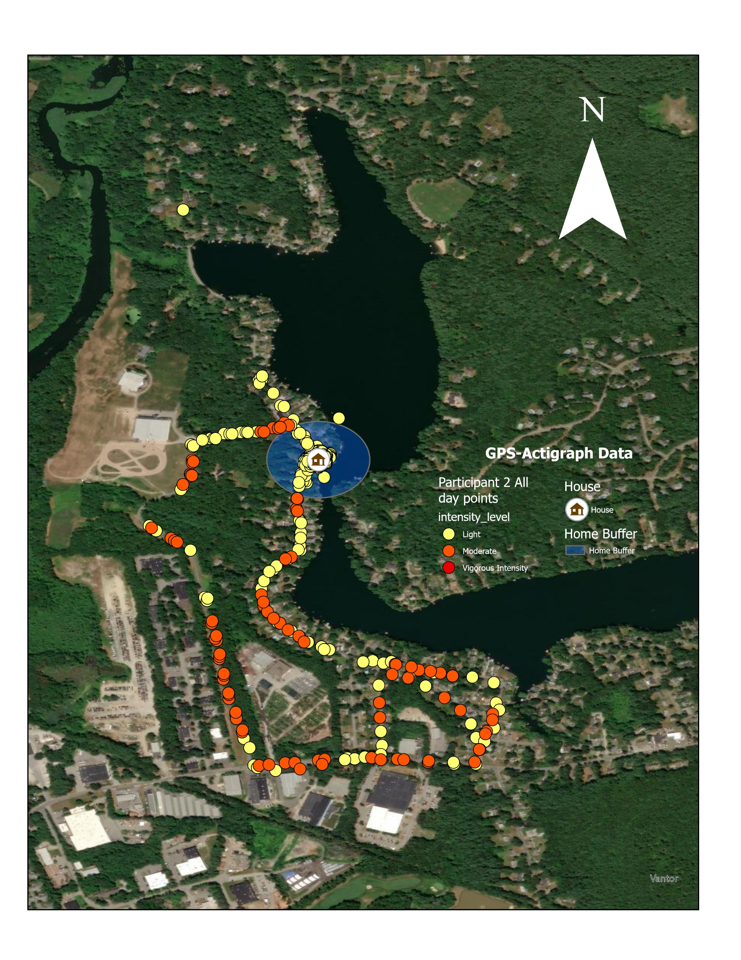
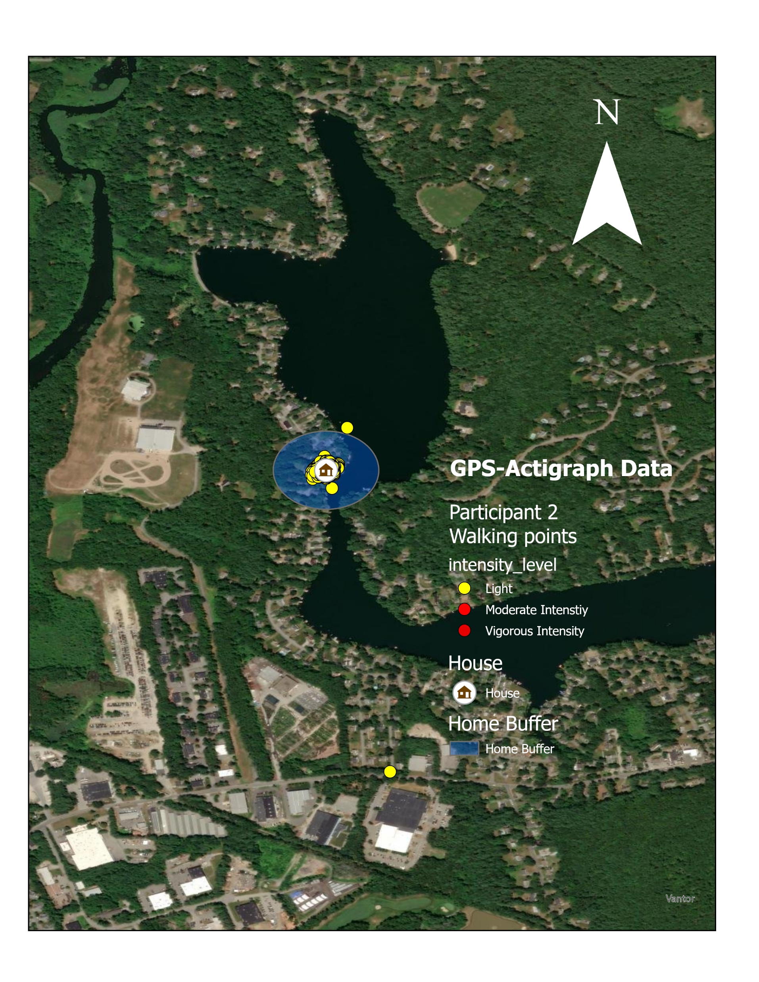
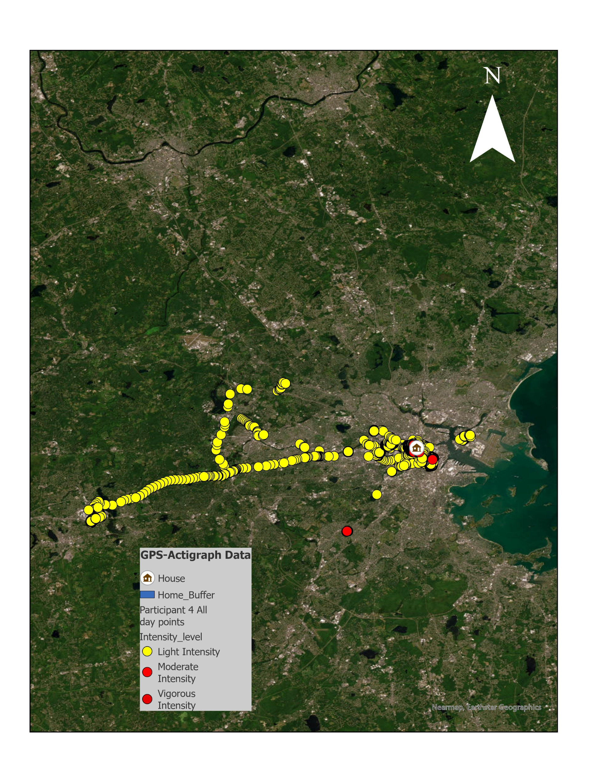
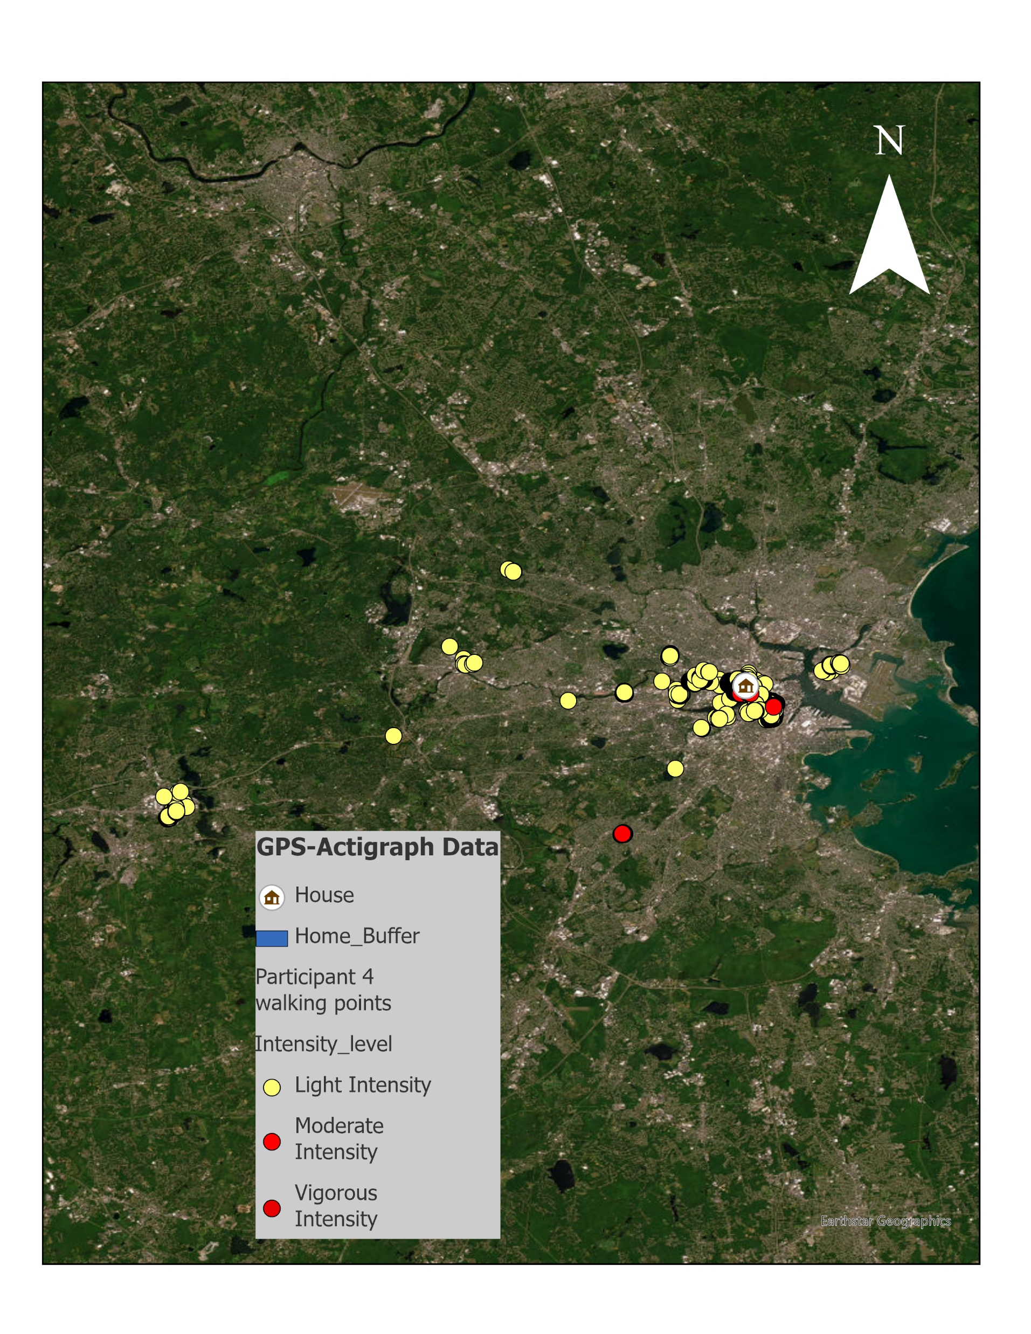
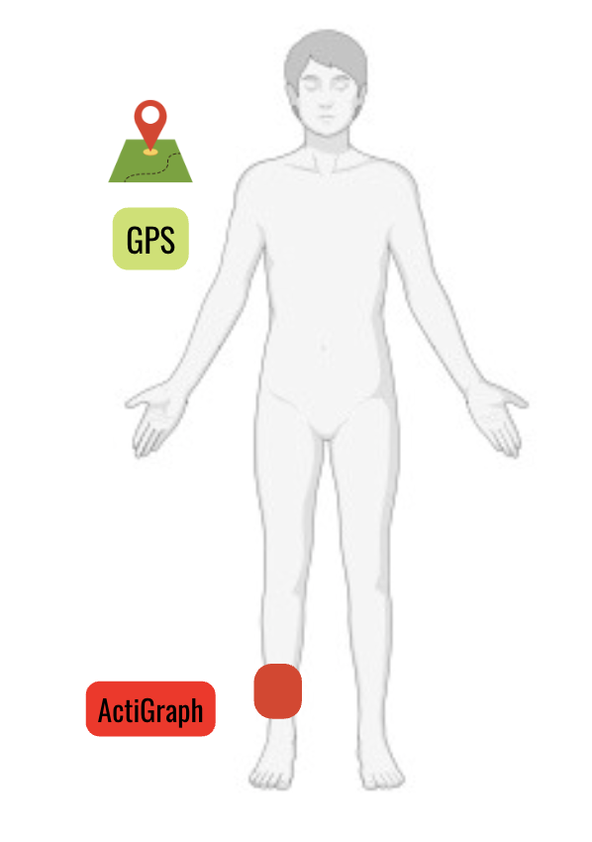
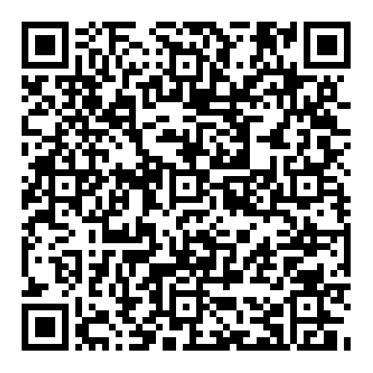


Geographical extent of physical activity and community mobility post-stroke: a GPS and accelerometry case series
Swapna Balakrishnan PT, DPT, NCS, Anya Bobkoskie, Bella Chiulli BS, Denise. Peters PT, DPT, PhD
Department of Rehabilitation and Movement Sciences, The University of Vermont, Burlington, VT
BACKGROUND
A1
A2
RESULTS & DISCUSSION
LIMITATIONS
Why this study matters:
Return to community is challenging for many stroke survivors.¹
Current clinical assessment of physical activity(PA) behaviors rely on self-report.²
Objective data of PA in real-word environments can provide valuable insights to help maximize PA participation.
Moderate activity was observed only in Participants 1 and 4; no vigorous activity was recorded (Table 2).
Time at home was lowest for Participant 1 and highest for Participant 3 (Table 3).
This study is a case series with a small sample size and therefore the findings are not generalizable.
The equations for classifying PA intensity was developed among healthy adults and may slightly underestimate PA intensity of stroke survivors.
STUDY PURPOSE
Non-paretic side
Created using Biorender.com
To explore the geographical extent of PA intensity in the community using global positioning systems(GPS) and Actigraph GT3X+ sensors among four community dwelling stroke survivors.
B1
B2
CONCLUSION
This study demonstrates initial feasibility of combining accelerometer and GPS data to estimate time spent at different PA intensities relative to locations among adults with stroke living in the community.
METHODS
Study Design: Multi-descriptive case series with remote observational design.
Study Procedures: Sample: Participants (n=4) with stroke (> 6 months)
Devices: ActiGraph GT3X+ accelerometer and Qstarz BT‑Q1000XT GPS, worn ≥8 hours/day; devices were mailed, procedures were remote, and participants completed daily logs.
Duration: 10–15 days of concurrent GPS and accelerometer monitoring with 10‑second epochs.
Analysis: Physical activity intensity (Freedson cut‑points) by location, with geospatial data classified as home (120‑m buffer around residence)³ or community; study enrollment and analyses are ongoing as part of a larger stroke cohort.⁴
CLINICAL RELEVANCE AND FUTURE DIRECTIONS
Figure 1: Panels A1 and B1 show the average daily travel paths for Participants 3 and 4, including both walking and vehicle travel. Panels A2 and B2 display GPS and ActiGraph GT3X+ points for Participants 1 and 4 during walking episodes (speed < 2 m/s).⁵ The home buffer is defined as a 120 m radius around the participant’s residence; locations beyond this boundary are classified as community.
Mapping real-world PA behaviors post-stroke can help tailor rehabilitation interventions and examine how environmental and community factors influence PA participation.
Figure: 2: Sensor Placement Sites
ID | Age (years) | Sex | Time Post-Stroke (months) | FAC | Assisted Device or Brace
1 | 41 | Male | 14 | 5 | None
2 | 56 | Male | 29 | 5 | Brace in the R ankle
3 | 73 | Male | 192 | 5 | Cane & walker
4 | 52 | Female | 47 | 5 | None
Mean (+ SD) | 56+13 | 3M/1F | 71+79 | 5 | -
Participant ID | Home (%) | Community(%)
1 | 0.3 | 99.6
2 | 46.62 | 53.37
3 | 96.26 | 3.72
4 | 63.84 | 36.15
Mean (+SD) | 52+40 | 48.21+40
Table 3 : Percentage of time spent at the home buffer and the community buffer
Table1: Participant Characteristics; FAC: Functional ambulation Category: score 5 (Fully independent ambulator), SD: Standard deviation R: right
References:
Participant ID | Light-intensity Home (min) | Light-intensity Community (min) | Moderate-intensity Home (min) | Moderate-intensity Community (min) | Vigorous-intensity Home (min) | Vigorous-intensity Community (min)
1 | 7.17 | 845.17 | 0 | 0.17 | 0 | 0
2 | 557.17 | 0 | 0 | 0 | 0 | 0
3 | 472.67 | 27.5 | 0 | 0 | 0 | 0
4 | 1322.17 | 943 | 1.83 | 3.17 | 0 | 0
Mean (+SD) | 589.8+ 544.9 | 453.9 + 510 | 0.46+0.92 | 0.83+1.56 | 0+0 | 0+0
RESULTS
Light-intensity activity was seen predominated within the home buffer for all participants except for Participant 1, who spent more time in the community (Table 2).
Monitoring days: P1 = 13, P2 = 11, P3 = 10, P4 = 15 (Table 1).
Scan QR code to download References
Acknowledgements:
Table 2: Time spent at various PA intensity in the home and community buffers

