Slide 1
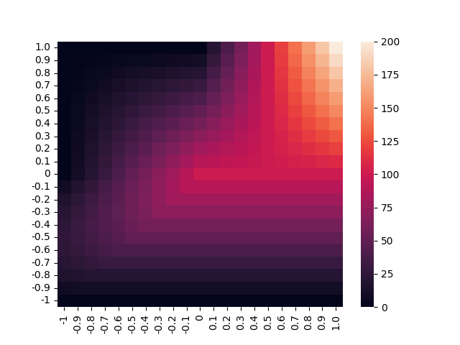
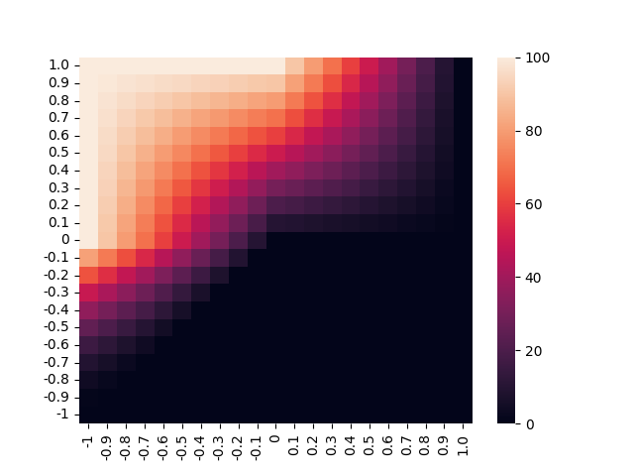
Resources Hosts Receive
Resources Symbionts Receive
Host Interaction Value
Host Interaction Value
Symbiont Interaction Value

