Slide 1
Predicting the thermal lens from first principles
THERMAL LENS MODEL · END-PUMPED A-CUT ND:YVO₄
A 3D finite-element model, from pump light to wavefront

Slide 2
From pump light to wavefront in seven steps
The system being modelled
OVERVIEW
1
2
3
4
5
6
7
Pump beam
Populations
Absorption
Heat
Laser
Temperature
Wavefront
radius w(z)
upper level N₂
pump I(r, z)
density Q
gain = loss, P_out
3D FE, k(T)
Δn, OPD, f_c, f_a
a-cut Nd:YVO₄, 1 at%, Ø 3 mm × 5 mm [placeholder]
808 nm fiber-coupled diode, end-pumped, waist 0.45 mm
Laser at 1064 nm, output coupler T_oc = 10%
Copper trapezoid mount, chiller on the top face at 20 °C
Axes: x = c-axis, y = a-axis (toward the chiller), z = beam
Boundaries: chiller face at T₀, other faces insulated, contact conductance h_c (W/m²·K)

Slide 3
Inputs, and where each value comes from
OVERVIEW
Material | Value | Source
Nd density (1 at%) | 1.26 × 10²⁶ m⁻³ | [D]
k_c, k_a at 25 °C | 12.1, 8.9 W/(m·K) | [T] Table 2
k(T) exponent n_k | 1 (dimensionless) | estimate
dnₑ/dT | 2.9 × 10⁻⁶ /K | [D]
Absorption α (π) | 2300 m⁻¹ | [D]
Lifetime τ_f | 90 µs | [D]
τ_rad, λ_f | 104.3 µs, 1032 nm | [H] Table 1
ETU W_up | 5.0 × 10⁻²² m³/s | [C]
σ_L (π, 1064 nm) | 15.6 × 10⁻²³ m² | [H] Table 1
Setup | Value | Source
Crystal R, L | 1.5 mm, 5 mm | placeholder
Pump power P | 2.5–10 W | placeholder
Pump waist w₀ | 0.45 mm at L/3 | placeholder
Pump M² | 171 (dimensionless) | estimate
Output coupler T_oc | 0.10 (10%) | chosen
Internal loss L_i | 0.02 (2%) per round trip | estimate
Laser mode w_L | 0.36 mm | estimate
Contact h_c | 2 × 10⁴ W/(m²·K) | placeholder
Chiller T₀ | 20 °C | placeholder
Fit radius a, passes | 0.45 mm, 1 pass | placeholder
Relay magnification | 2.14× (dimensionless) | placeholder

Slide 4
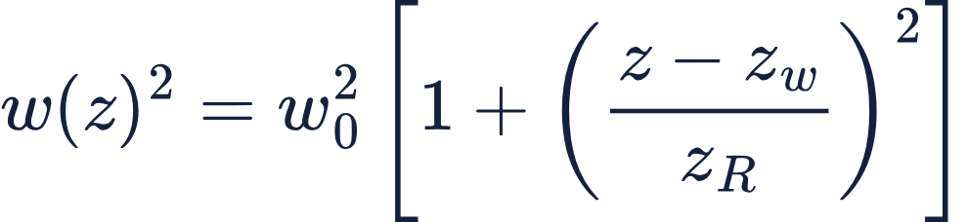
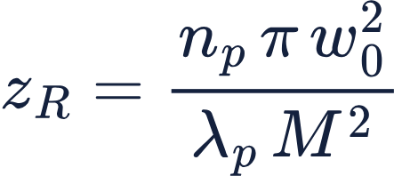
The pump spot barely spreads inside the crystal
STEP 1 · PUMP BEAM
What it means
Units w, w₀, z, z_w, z_R: m
The fiber-coupled diode beam has M² ≈ 171, so it behaves like a Gaussian beam 171 times worse than ideal. Inside the crystal (index n_p) its Rayleigh range is z_R ≈ 10 mm, twice the crystal length.
[S] Shayeganrad, Eq. 20
Units z_R, w₀, λ_p: m · n_p, M²: dimensionless
Printed by Copper2 | Value
w at pump face, w(0) | 0.456 mm
Waist w₀ at z = L/3 | 0.450 mm
w at exit face, w(L) | 0.474 mm
[S] Shayeganrad, Eq. 21
[S] Shayeganrad 2012, Eqs. 20–21 · M² from fiber core radius × NA, [S] p. 10
Notes:
M² = (w₀ θ) / (λ/π) = π w₀ θ / λ
Before we can say where the heat is made, we need to know how wide the pump beam is at every depth in the crystal. That width, w(z), is the one output of this slide, and every later step uses it.
The first equation is Shayeganrad’s Eq. 20. The beam has one narrowest point, the waist w₀, which is 0.45 mm and sits a third of the way into the crystal. Away from the waist the beam widens. How quickly it widens is set by the Rayleigh range, z_R. One Rayleigh range from the waist, the beam area has doubled.
The second equation, Eq. 21, gives that Rayleigh range. This is where M² comes in.
M² is a beam-quality number. It compares our beam with a perfect Gaussian beam of the same wavelength and waist. A perfect beam has M² = 1. A beam with M² = 171 spreads 171 times faster, so its Rayleigh range is 171 times shorter.
For a fiber-coupled diode, M² comes from the fiber itself. Light leaves a 200 µm core radius spread over a numerical aperture of 0.22. Multiply those and you get the beam’s size times its spread, 44 mm·mrad. A perfect Gaussian at 808 nm manages 0.26. The ratio is 171. Lenses can refocus the beam, but they can’t make that number smaller. That’s why it belongs in the equation.
Putting it in, with the crystal index n_p = 2.19, gives z_R ≈ 10 mm. A perfect beam would give about 1.7 m. So M² is the main thing setting how fast our pump spreads.
Even so, 10 mm is twice the crystal length. The table shows the spot goes from 0.456 mm at the front face to 0.474 mm at the exit, only about 5%. So the pump spot barely spreads inside the crystal, and absorption, not spreading, is what makes the pump fade with depth.
One caveat: 171 assumes the fiber is completely filled with light, so it’s an upper estimate. A better beam would only make z_R longer, so the conclusion holds either way.”
What the slide is for. Before we can say where heat is made, we need to know how wide the pump beam is at every depth z in the crystal. That width, w(z), is the only output of this slide, and every later step uses it.
Eq. 20: w(z)² = w₀²[1 + ((z − z_w)/z_R)²] ([S] Eq. 20)
• The beam has one narrowest point, the waist w₀ = 0.45 mm, sitting at depth z_w = L/3.
• Moving away from the waist in either direction, the beam slowly widens. (z − z_w) is "how far am I from the waist," and dividing by z_R turns that into "how far, measured in Rayleigh ranges."
• At one Rayleigh range from the waist, the beam area has doubled (w² = 2w₀²). Closer than that, it is still close to the waist size.
Eq. 21: z_R = n_p π w₀² / (λ_p M²) ([S] Eq. 21)
• z_R is the beam's "stays tight" distance. A wider waist (w₀²) or a shorter wavelength makes it longer.
• M² is the beam-quality penalty. Our fiber-coupled diode is about 171 times worse than a perfect Gaussian beam, so it spreads 171 times faster.
• n_p = 2.19 is the crystal's index at 808 nm. Light bends inward on entering the crystal, so inside it spreads n_p times more slowly than it would in air.
• Plugging in: z_R = 2.19 × π × (0.45 mm)² / (808 nm × 171) ≈ 10 mm.
What the numbers in the table mean.
• The crystal is 5 mm long and z_R is 10 mm, so the whole crystal sits well inside the "stays tight" zone.
• Front face (1.67 mm before the waist): w(0) = 0.456 mm. Exit face (3.33 mm after it): w(L) = 0.474 mm.
• So the spot changes by only about 5% front to back. That is the headline: "the pump spot barely spreads inside the crystal."
Why it matters later. On slide 8, the pump intensity scales as (w(0)/w(z))². With w changing by only 5%, that factor stays between about 1.00 and 0.93, so the narrowing or widening of the beam is a small correction next to absorption, which is what really makes the pump fade with depth.
Honest caveats. w₀, z_w = L/3 and M² are placeholders or estimates (M² ≈ 171 is an upper estimate from the fiber core and NA, per the speaker notes). Because z_R stays at least twice the crystal length even at M² = 120, the conclusion doesn't change.

Slide 5
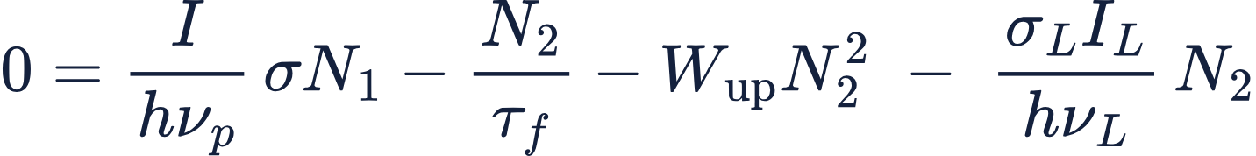

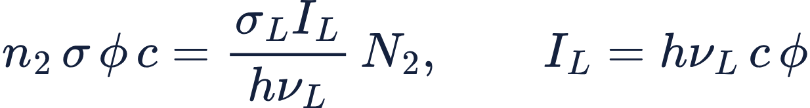
One rate equation for the upper laser level
STEP 2 · POPULATIONS
Term (m⁻³ s⁻¹) | Process
σN₁I/hν_p | Pump excites ground-state ions
N₂/τ_f | Spontaneous decay
W_up N₂² | Upconversion
σ_L I_L N₂/hν_L | Stimulated emission
Units each term: m⁻³ s⁻¹ · I, I_L: W/m² · σ, σ_L: m² · N₁, N₂: m⁻³ · hν_p, hν_L: J · τ_f: s · W_up: m³/s
[C] Cante, Eq. 5.2, steady state
[Ko] Koechner, Eq. 1.70
Units N, N₁, N₂: m⁻³
[C] Cante, Eq. 6.1
Assumption: lower laser level empty (Koechner’s ideal four-level case).
Units n₂, φ: m⁻³ · σ: m² · c: m/s · I_L: W/m² · hν_L: J
Koechner’s photon density φ written as intensity
[C] Cante et al. 2018, Section 2.2 · [Ko] Koechner, Section 1.5.2, p. 36
Notes:
At every point in the crystal we need to know what fraction of the neodymium ions are excited, sitting in the upper laser level. We call that density N₂. It decides three things: how much pump light gets absorbed, how much light the laser takes out, and how much heat is left over.
The top equation is the rate equation for N₂, from Cante Eq. 5.2 at steady state. A good way to picture it is a bucket. One term fills the bucket and three drain it. The zero on the left means the level has stopped changing, so filling equals draining. Every term has the same units: ions per cubic metre per second.
The first term is the filling. I over hν_p is the number of pump photons arriving per square metre per second. Each ground-state ion presents a target area σ, so this term counts how many ions get excited each second.
The first drain is spontaneous decay: excited ions relax on their own after about 90 microseconds.
The second drain is upconversion. Two excited ions next to each other trade energy, and one excitation is lost as heat. That’s why it goes as N₂ squared: it takes a pair.
The third drain is the laser itself, from Koechner Eq. 1.70. Laser photons stimulate excited ions down, and each one adds a copy of itself to the beam. Koechner writes this with photon density φ. The bottom line converts that to laser intensity, using I_L = hν_L c φ.
The middle line is just bookkeeping. Every ion is either in the ground state or excited, and the total is fixed by the 1% doping.
We make one assumption: the lower laser level stays empty. It drains far faster than it fills, which is Koechner’s ideal four-level case.
Why does lasing matter so much? Without the laser term, the hottest spot reaches about 11% excitation. With it, the laser drain is about 40 times faster than spontaneous decay, so N₂ is held at about half a percent. The next slide solves this equation for N₂.”
Slide 6 (Step 2, populations) in plain English
What the slide is for. At every point in the crystal, we want to know what fraction of the Nd ions are "charged up" in the upper laser level (N₂). That fraction decides how much pump light gets absorbed, how much light the laser extracts, and how much heat is left over.
The rate equation: 0 = σN₁I/hν_p − N₂/τ_f − W_up N₂² − σ_L I_L N₂/hν_L ([C] Eq. 5.2 at steady state, plus the [Ko] Eq. 1.70 laser term)
Think of N₂ as a bucket. One term fills it and three drain it. "0 =" means the bucket level has stopped changing, so filling equals draining.
• Filling, σN₁I/hν_p: pump photons arrive at I/hν_p per m² per second. Each ground-state ion (N₁) has a target area σ, so σI/hν_p is the chance per second that one ion gets excited.
• Drain 1, N₂/τ_f: excited ions relax on their own after about τ_f = 90 µs. Mostly they emit fluorescence; a bit of the relaxation is heat.
• Drain 2, W_up N₂²: two excited ions next to each other trade energy (upconversion), and one excitation is lost as heat. It goes as N₂² because it takes a pair.
• Drain 3, σ_L I_L N₂/hν_L: the laser beam's photons knock excited ions down and copy themselves. This is the useful output. Koechner writes it with photon density φ; the speaker notes show φc = I_L/hν_L, so it becomes intensity.
Bookkeeping, N = N₁ + N₂ ([C] Eq. 6.1): every ion is either in the ground state or excited, and the total N = 1.26×10²⁶ m⁻³ is fixed by the 1% doping.
Key assumption. The lower laser level is treated as empty. Ions that lase drop to a level that drains in about half a nanosecond, so nothing piles up there (Koechner's ideal four-level case).
Why lasing matters so much here. Without the laser term, the hot spot reaches about 11% excitation. With it, the laser drain is about 40 times faster than spontaneous decay, so N₂ is clamped at about 0.5%. Slide 7 solves this equation for N₂ in closed form.

Slide 6
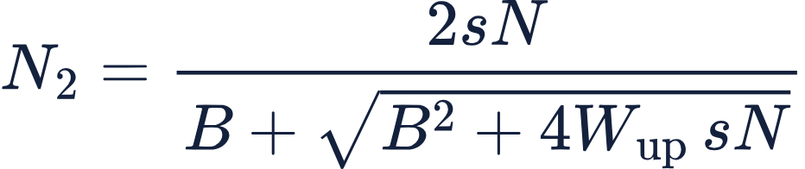
A closed-form root instead of a time simulation
STEP 2 · SOLVING FOR N₂
Checks
W_up = 0: N₂ = sN/(1/τ_f + s + g), the plain saturation result. No pump: N₂ = 0.
Put N₁ = N − N₂ into step 2, collect powers of N₂
Units both lines · each term of the top line: m⁻³ s⁻¹ · s, B, g, 1/τ_f: s⁻¹ · N, N₂: m⁻³ · W_up: m³/s · σ, σ_L: m² · I, I_L: W/m² · hν: J
At the hottest point, 10 W
Stimulated rate g ≈ 4 × 10⁵ s⁻¹ dominates 1/τ_f ≈ 1 × 10⁴ s⁻¹, so lasing clamps N₂/N at 0.54% (11% without lasing).
Positive root, multiplied through by its conjugate
0 = s(N − N₂) − N₂/τ_f − W_up N₂² − gN₂, with s = σI/hν_p and g = σ_L I_L/hν_L in s⁻¹
Collect: W_up N₂² + (1/τ_f + s + g) N₂ − sN = 0 (each term m⁻³ s⁻¹)
Root: N₂ = (−B + √(B² + 4W_up sN)) / 2W_up; the other root is negative
Multiply top and bottom by (B + √…): stays exact as W_up → 0
[C] Eq. 6.2 (written there for N₁, without the laser term)
Notes:
The last slide gave us a balance equation for N₂. This slide turns it into a formula that gives N₂ directly at every point in the mesh, so we don’t have to run a time simulation.
First, we write everything in terms of N₂. Any ion that isn’t excited is in the ground state, so N₁ = N − N₂. We also use two shorthands, both measured per second. s = σI/hνp is the pump rate per ground-state ion, and g = σL I_L/hν_L is the laser rate per excited ion.
Collecting powers of N₂ gives an ordinary quadratic. The N₂-squared term is upconversion. B is the total rate that pulls an ion out of whichever level it’s in: spontaneous decay, plus pumping, plus lasing.
The quadratic formula gives two roots. One is negative, and you can’t have a negative number of ions, so we keep the positive one.
Then we multiply the top and bottom by B plus the square root. That gives the same number in a safer form, the one shown on the slide. In the textbook form, if upconversion is very small, the top and bottom both go to zero, and a computer handles zero over zero badly. This form stays well behaved all the way down to W_up = 0.
Two quick checks. Turn off upconversion and we get the standard saturation result: the filling rate divided by the total rate. Turn off the pump and N₂ goes to zero. Both are what we’d expect.
At the hottest point, with 10 W of pump, the numbers per second are: pump rate about 2,300, spontaneous decay about 11,000, and laser rate about 400,000. The laser term dominates by a factor of about 40, so it holds the excitation at 0.54%. Without lasing it would be 11%.
The source is Cante Eq. 6.2, which is this same root written for N₁ and without the laser term. Adding the laser term and solving for N₂ is our own algebra, which is why the slide labels it as derived from Eq. 6.2.
What the slide is for. Slide 6 gave a balance equation. This slide turns it into a formula that gives N₂ directly at each point, with no time-stepping simulation.
Step 1: write everything in terms of N₂.
0 = s(N − N₂) − N₂/τ_f − W_up N₂² − gN₂
• Replace N₁ with N − N₂, since every ion not excited is in the ground state.
• Two shorthands: s = σI/hν_p is the pump rate per ground-state ion, and g = σ_L I_L/hν_L is the laser rate per excited ion. Both are "chances per second."
Step 2: collect it into a quadratic.
W_up N₂² + (1/τ_f + s + g) N₂ − sN = 0
• This is the familiar aN₂² + bN₂ + c = 0, with a = W_up, b = B = 1/τ_f + s + g, and c = −sN.
• B is the total drain-plus-pump rate, everything that pulls an ion out of whichever level it's in.
Step 3: take the root that makes sense.
N₂ = (−B + √(B² + 4W_up sN)) / 2W_up
• The quadratic formula gives two answers. The other one is negative, and a negative ion count is not physical, so we keep this one.
Step 4: rewrite it so it doesn't break.
N₂ = 2sN / (B + √(B² + 4W_up sN))
• Multiply top and bottom by (B + √…). It's the same number, just rearranged.
• Why bother? In the first form, if W_up is tiny the top and bottom both go to zero (0/0), which a computer handles badly. The new form stays clean all the way to W_up = 0.
Checks (sanity tests that it behaves).
• Turn off upconversion (W_up = 0): N₂ = sN/(1/τ_f + s + g). This is the standard saturation result, filling rate over total rate.
• Turn off the pump (s = 0): N₂ = 0. No pump, no excitation.
At the hottest point, 10 W pump.
• s ≈ 2.3×10³ s⁻¹, 1/τ_f ≈ 1.1×10⁴ s⁻¹, g ≈ 4×10⁵ s⁻¹.
• The laser term g is about 40 times bigger than the others, so it dominates the bottom of the fraction and holds N₂/N at 0.54% (11% without lasing).
Citation. [C] Eq. 6.2 is this same closed-form root, written there for N₁ and without the laser term. Ours adds g and solves for N₂, which is DERIVED algebra on top of it.
One small thing I noticed: the slide rounds 1/τ_f to "1 × 10⁴ s⁻¹". The actual value is 1/90 µs = 1.1×10⁴. That's not an error, but if you want it exact it's a quick fix.

Slide 7
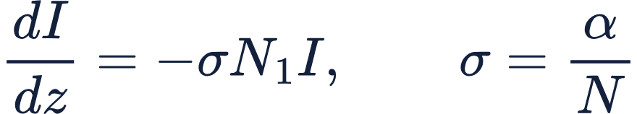
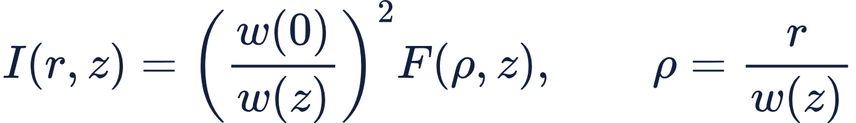
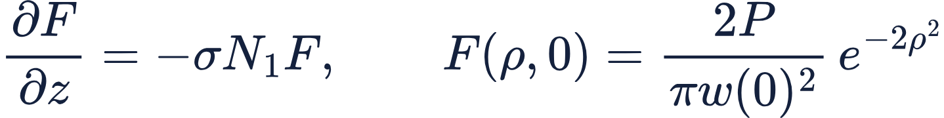
Only ground-state ions absorb the pump
STEP 3 · PUMP ABSORPTION
Why the ray form
Units I: W/m² · z: m · σ: m² · N, N₁: m⁻³ · α: m⁻¹
The beam widens with w(z). Along a line of fixed ρ = r/w(z) (dimensionless), the (w(0)/w(z))² factor carries the spreading, and F only loses power to absorption.
[C] Cante, Eq. 5.3 (they write α = σN)
Units I, F: W/m² · r, w: m · ρ: dimensionless
Saturation
N₁ depends on I through step 2, so F (W/m²) is integrated with RK4 along each ray. At 10 W: 9.999 W absorbed, 0.000 W transmitted.
Follow each ray of the spreading beam
Units F: W/m² · z, w: m · P: W · σ: m² · N₁: m⁻³
Eq. 5.3 along a ray; Gaussian at the pump face
[C] Cante et al. 2018, Eq. 5.3 · w(z) from step 1
Notes:
“Now that we know N₂ at any point, we can follow the pump light down the crystal. Two things weaken it as it travels. Absorption takes power out of the beam. Spreading spreads the same power over a larger area.
The top line is Cante Eq. 5.3. The rate the intensity falls with depth is σ times N₁ times I. Only ground-state ions, N₁, can absorb the pump, which is the title of the slide. Cante write the absorption coefficient α, which is just σN. On its own, though, this equation assumes the beam stays the same size, so it only covers absorption.
To include spreading, we follow rings instead of fixed radii. We label each point by ρ, its radius as a fraction of the local beam size w(z). A Gaussian beam keeps its shape as it widens, so the ring at half the beam radius stays at half the radius all the way through. Each ring is a path we can follow down the crystal.
The middle line splits the job in two. The ratio w(0) over w(z), squared, handles spreading. A ring’s area grows as w squared, so with no absorption its intensity falls in proportion. F handles absorption. F is the intensity the beam would have if it had kept its entrance size. At the pump face the ratio is one, so F starts as the incoming Gaussian, shown on the bottom right.
How big is each effect? Spreading changes the intensity by only a few percent: 3% up at the waist, 7% down at the exit face. Absorption cuts the intensity to about 10% within the first millimetre. So spreading is a small geometric correction, and F does almost all the work.
Last point: the absorption rate depends on N₁, and N₁ depends on the local intensity through the previous slide. So F’s decay rate depends on F itself. That’s why each ray is stepped through the crystal numerically with RK4. At 10 W, 9.999 W is absorbed and essentially nothing comes out the back.”
1. Two things lower the pump intensity as it travels.
• Absorption: ions take power out of the beam. This is Cante 5.3, dI/dz = −σN₁I.
• Spreading: after the waist the beam gets wider, so the same power covers more area.
Cante 5.3 alone only handles absorption, because it assumes the beam keeps the same size. We need to handle both.
2. Follow a ring, not a fixed radius. Label each point by ρ = r/w(z), its fraction of the local beam radius. A Gaussian keeps its shape as it widens, so the ring at ρ = 0.5 stays at half the radius all the way through. Each ring is a “ray” we can follow down the crystal.
3. Spreading alone: power conservation. A ring’s area grows as w(z)². With no absorption, the ring keeps its power. Power = intensity × area, so intensity × w(z)² stays constant, and I(z) = I_in × (w(0)/w(z))². That squared ratio is just the change in ring area: if the ring’s area grows 7%, its intensity drops 7%.
4. Add absorption by giving that job to F. Replace the fixed starting intensity with F:
I = (w(0)/w(z))² · F
• The ratio does the spreading.
• F does the absorption, ∂F/∂z = −σN₁F.
• F is the intensity the beam would have if it had stayed at its entrance size.
• At the pump face the ratio is 1, so F starts as the incoming Gaussian.
5. Check. Total power = w(0)²∫F·2πρ dρ. The w(z) cancels, so only absorption ever removes power, which is exactly what we want.
6. How big each effect is.
• Spreading changes the intensity by a few percent (×1.03 at the waist, ×0.93 at the exit).
• Absorption cuts it to 10% within 1 mm.
• So the ratio is a small geometric correction, and F does almost all the work.
7. Why it’s solved step by step. N₁ depends on the local intensity through slide 8. F’s decay rate therefore depends on F itself, so each ray is stepped through the crystal with RK4.

Slide 8
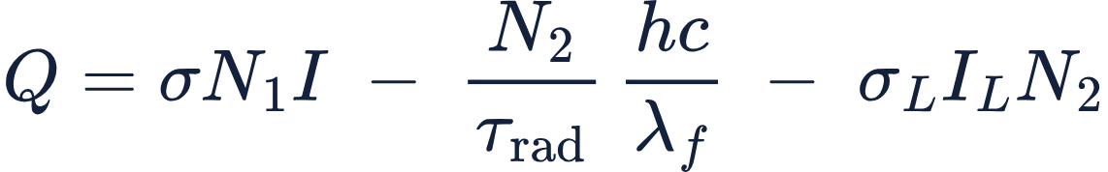
Heat is the absorbed energy that does not leave as light
STEP 4 · HEAT
Why this form
Units Q and each term: W/m³ · σ, σ_L: m² · N₁, N₂: m⁻³ · I, I_L: W/m² · hc/λ_f: J · τ_rad: s
Quantum defect, non-radiative decay and upconversion all end up in Q without listing them one by one, so nothing is counted twice.
Energy conservation in each volume element
Sanity check
Term | Derivation | At 10 W
σN₁I | absorbed pump = −dI/dz, [C] Eq. 5.3 | 10.00 W
(N₂/τ_rad) hc/λ_f | radiative decays × photon energy | 1.19 W
σ_L I_L N₂ | stimulated emissions × hν_L | 6.23 W
Q | what remains | 2.59 W
Heat fraction 2.59 W / 10.00 W = 0.258, just above the quantum-defect floor 1 − 808 nm/1064 nm = 0.241, as expected for a laser above threshold.
[C] Eq. 5.3 · τ_rad, λ_f values from [H] Table 1
Notes:
Now we can work out the heat. The idea is simple: heat is whatever absorbed energy doesn’t leave as light.
Take a small piece of crystal in steady state. Nothing builds up there, so every watt of pump it absorbs has to leave again, either as light or as heat.
The first term is what comes in: σN₁I, the absorbed pump power per cubic metre. It’s the power the beam loses on the last slide, now showing up as power the crystal gains.
Two kinds of light leave. The first is fluorescence. N₂ over τrad ions decay each second by giving off a photon, and each photon carries hc over λf. We use the radiative lifetime here, not the total lifetime, because only radiative decays give off light. The second is the laser: the stimulated rate from slide 5 times the laser photon energy, which gives σ_L I_L N₂.
Heat is what’s left over. Integrated over the crystal at 10 W, the table shows 10.00 W in, 1.19 W out as fluorescence, 6.23 W out into the laser, and 2.59 W left as heat.
Why not add up the heat sources one by one? You could. They split into laser quantum defect, fluorescence quantum defect, non-radiative decay and upconversion, and they add to the same 2.59 W. But writing heat as ‘what’s absorbed minus what leaves as light’ can’t count anything twice. Listing channels can, and one published version does.
Most of the heat comes from the quantum defect. An 808 nm pump photon carries 1.53 eV, and a 1064 nm laser photon carries 1.17 eV. So every photon that comes out as laser light leaves 24% of its pump energy behind as heat. That accounts for about three quarters of our heat.
The check: 2.59 out of 10 is a heat fraction of 0.258, just above the 0.241 floor. That’s what we expect for a laser well above threshold, where most excited ions leave through the laser
1. The idea: heat is whatever energy doesn’t leave as light. Take a small volume of crystal at steady state. Nothing builds up there: the populations and the temperature are constant. So every watt of pump it absorbs has to leave, either as light or as heat.
2. What comes in. Absorbed pump power per volume is σN₁I. That’s just −dI/dz from slide 9: the power the beam loses is the power the crystal gains.
3. What leaves as light (two kinds).
• Fluorescence: N₂/τrad ions per second decay by emitting a photon of energy hc/λf. It’s τrad, not τf, because only radiative decays make light; τf also counts decays that make only heat.
• Laser: the stimulated rate from slide 7, times the photon energy hνL, gives σ_L I_L N₂.
4. Heat is the leftover.
Q = σN₁I − (N₂/τrad)·hc/λf − σ_L I_L N₂
At 10 W: 10.00 − 1.19 − 6.23 = 2.59 W.
5. Why not list the heat sources one by one? You could. Substituting the slide 7 balance splits Q exactly into four causes:
• laser quantum defect, 1.98 W
• fluorescence quantum defect, 0.33 W
• non-radiative decay, 0.24 W
• upconversion, 0.04 W
Each pumped ion leaves by exactly one route, so they add to 2.59 W with nothing counted twice. Writing Q as “in minus light out” gets the same answer and can’t double-count. Shen’s Eq. 18 lists the channels and does double-count.
6. Where most of the heat comes from. A pump photon (808 nm) carries 1.53 eV, and a laser photon (1064 nm) carries 1.17 eV. So every laser photon leaves 24% of its pump photon behind as heat: the quantum-defect floor, 1 − 808/1064 = 0.241. That gap is 76% of our heat.
7. Check. Heat fraction = 2.59/10.00 = 0.258, just above the 0.241 floor. That’s what you expect for a laser well above threshold, where most ions leave through the laser.
Assumptions: fluorescence escapes without being reabsorbed; laser light leaves the crystal; τrad and λf come from Shen Table 1 (they only touch the 0.33 W); steady state.

Slide 9

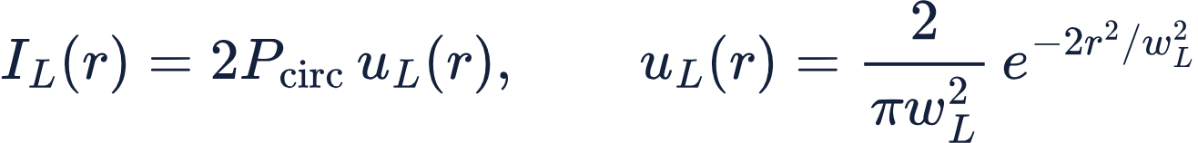
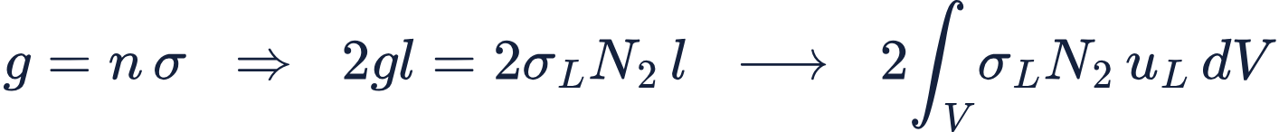
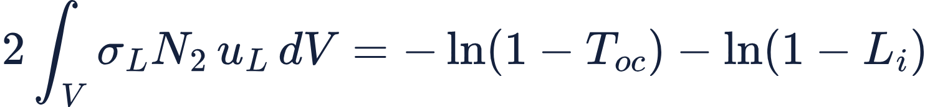
Laser power from the threshold condition gain = loss
STEP 5 · LASER
Units P_out, P_circ: W · T_oc: dimensionless
Units I_L: W/m² · P_circ: W · u_L: m⁻² · r, w_L: m
More circulating power empties N₂ and lowers the gain. The code finds the P_circ where gain just equals loss.
TEM₀₀ mode of unit area; 2 = forward + backward wave
Units g, α: m⁻¹ · l: m · R₁, R₂: dimensionless
[Ko] Eq. 3.4 with R₁ = 1 − T_oc, R₂ = 1 − L_i, α = 0
10 W pump: P_out = 4.96 W. Check printed by the code: power into the mode 6.229 W = P_circ × loss 6.229 W.
Units g: m⁻¹ · n, N₂: m⁻³ · σ, σ_L: m² · l: m · u_L: m⁻² · dV: m³
[Ko] Eq. 3.12, n = N₂, averaged over the mode
Units both sides dimensionless · T_oc, L_i: fractions
Result · solved for P_circ with fzero
[Ko] Koechner, Section 3.1, Eqs. 3.4 and 3.12, pp. 104–105 · σ_L from [H] Table 1
Notes:
So far we’ve treated the laser intensity as known. This slide works it out, using the condition every steady laser has to meet: over one round trip, gain equals loss.
Light bounces between the two mirrors. On each round trip the crystal amplifies it, and the mirrors let some of it escape. If gain is bigger than loss, the power grows. If loss is bigger, the light dies out. A laser running steadily sits exactly at break-even.
The first line describes the laser beam. Two waves are in the crystal at once, one going each way, and each carries the circulating power P_circ. Both stimulate emission, so their intensities add, which is where the factor 2 comes from. u_L is the shape of the TEM₀₀ mode, normalised to unit area.
The loss side is Koechner Eq. 3.4. The output coupler passes 10%, so R₁ = 0.90. We treat the 2% internal loss as a slightly leaky rear mirror, R₂ = 0.98, which is how Koechner handles it too. The round-trip loss is −ln(0.90 × 0.98), about 0.126. It’s written as a log because gain and loss multiply on every pass.
The gain side starts from Koechner Eq. 3.12: gain per metre is the number of excited ions times how strongly each one amplifies, σ_L N₂. N₂ isn’t uniform. It’s highest on axis near the pump face, so we weight it by where the laser beam actually is and add it up through the crystal. If N₂ were uniform, this reduces to Koechner’s 2gl.
Why is there one answer? Because the laser regulates itself. More circulating power means more stimulated emission. That empties N₂ and lowers the gain. At zero power the gain is about 14 times the loss. As the power rises the gain falls, until it meets the loss at P_circ = 49.6 W. MATLAB’s fzero finds that point.
The output coupler lets 10% through, so P_out = 4.96 W. As a check, the power the crystal gives the beam, 6.229 W, equals the power the cavity loses per round trip, also 6.229 W.
1. The idea: a laser settles where one round trip breaks even. Light bounces between the two mirrors. On each round trip the crystal amplifies it (gain), and the mirrors let some escape (loss). If gain beats loss, the power grows; if loss wins, it dies out. Steady operation is the point where they're exactly equal.
2. The loss side (EXACT, Koechner Eq. 3.4).
• The output coupler passes 10%, so R₁ = 0.90.
• We treat the 2% internal loss as a slightly leaky rear mirror, R₂ = 0.98. Koechner does the same on p. 104.
• Round-trip loss = −ln(0.90 × 0.98) = 0.1256. It's in log form because gain and loss multiply on each pass.
3. The gain side (DERIVED from Koechner Eq. 3.12, g = nσ).
• The local gain per metre is σ_L N₂: how many excited ions there are, times how strongly each one amplifies.
• N₂ isn't uniform; it's highest on axis, near the pump face. So we weight it by where the laser beam actually is (u_L, the mode profile with unit area) and add it up through the crystal.
• The light crosses the crystal twice per round trip, hence the factor 2: gain = 2∫σ_L N₂ u_L dV.
• If N₂ were uniform, this collapses to Koechner's 2gl.
4. Why there's a unique answer: the laser regulates itself.
• More circulating power means more stimulated emission, which empties N₂, which lowers the gain.
• At zero power the gain is 1.71, 13.6× the loss. As power rises, the gain falls until it meets the loss at P_circ = 49.6 W.
• That crossing in the graphic is what fzero finds.
5. Why 2P_circ in the laser intensity. Two waves are in the crystal at once, one going each way, each carrying P_circ. Both stimulate emission, so their intensities add: I_L = 2P_circ u_L.
6. Output power. The coupler lets 10% of the wave hitting it through: P_out = 0.10 × 49.6 = 4.96 W.
7. Check. At break-even, the power the crystal hands to the beam must equal what the cavity loses per round trip. The code prints both: 6.229 W = 6.229 W.
Assumptions:
• Mean field: the same P_circ everywhere in the cavity, worth about ±5% on P_out; the heat is unaffected.
• Fixed laser mode size: w_L = 0.36 mm, not changed by the thermal lens.
• The two waves' intensities simply add, with no standing-wave pattern.
• σ_L at room temperature, so P_out is a bit optimistic.

Slide 10

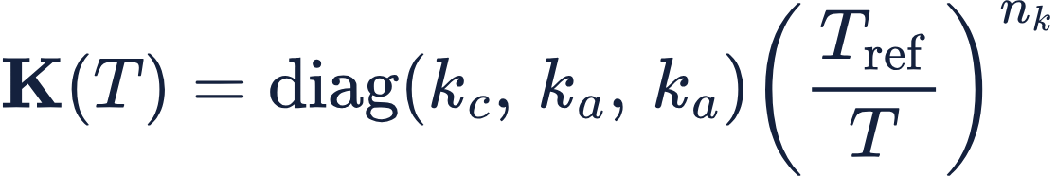
Anisotropic heat flow, solved in 3D
STEP 6 · TEMPERATURE
Units K: W/(m·K) · T: K · ∇: m⁻¹ · Q and each term: W/m³
How it is solved
MATLAB PDE Toolbox, femodel thermalSteady
Crystal, contact layer and copper in one mesh, 170,914 nodes
Q from step 4 enters the crystal only
Nonlinear, because k falls as T rises
[H] Shen, Eq. 19 at steady state
Units k_c, k_a: W/(m·K) · T, T_ref: K · n_k: dimensionless
[K] Cini & Mackenzie, Eq. 1 (their m = −n_k)
k_c = 12.1, k_a = 8.9 W/m·K at 25 °C, [T] Table 2
a-cut
The c-axis lies along x in the cross-section, so Shen’s K = diag(K_x, K_y, K_z) becomes diag(k_c, k_a, k_a).
[H] Shen et al. 2017, Eq. 19 · [K] Cini & Mackenzie 2017, Eq. 1 · [T] Sato & Taira 2006, Table 2
Notes:
“We now know where heat is made: mostly on axis, near the pump face. This slide finds the temperature that results. The heat has to travel from where it’s made to the chiller: through the crystal, across the contact, through the copper. The temperature settles where heat flows out exactly as fast as it’s made.
The top equation is Shen’s Eq. 19 at steady state. Q is the heat made per cubic metre. The divergence term is the net heat flowing out of that volume. Heat flows downhill in temperature, and faster where the conductivity is higher. In steady state the two balance. We drop the time term because the crystal settles in well under a second and we run continuous-wave.
K is a matrix because YVO₄ doesn’t conduct heat equally in every direction. It conducts about 36% better along its c-axis, 12.1 watts per metre-kelvin, than along a, 8.9. In an a-cut crystal the c-axis lies across the beam, along x, so K is diag(k_c, k_a, k_a).
That’s the origin of the astigmatism. Heat escapes more easily along c, so the hot spot spreads out further that way. A flatter temperature profile bends light less, so the lens is weaker along c. That’s why f_c is longer than f_a, by a factor of about 1.16.
Conductivity also falls as the crystal gets hotter. We use the power-law form from Cini and Mackenzie, Eq. 1, anchored at the measured 25 °C values. At the hot spot, about 125 °C, k drops by roughly a quarter. That makes the centre run hotter than a constant-k model would, and it makes the problem nonlinear. The exponent of 1 is our estimate.
For the surroundings, the chiller face is held at 20 °C, the other outside faces are insulated, and the contact layer has a placeholder conductance in the indium-foil range.
It’s solved in MATLAB’s PDE Toolbox on a single mesh of about 171,000 nodes, covering crystal, contact and copper, and checked for mesh convergence. Heat leaving through the chiller matches the 2.59 W we put in to within 0.2%. The peak rise is 104.5 K, on axis at the pump face.
1. The idea: heat has to get from where it's made to the chiller. Slide 10 tells us where the heat is made, mostly on axis near the pump face. That heat flows out through the crystal, across the contact, through the copper, and into the chiller. The temperature settles where heat flows out as fast as it's made.
2. The equation (EXACT, Shen Eq. 19 with the time term dropped): ∇·(K∇T) + Q = 0.
• Q is the heat made per volume.
• ∇·(K∇T) is the net heat flowing out of that volume.
• Heat flows downhill in temperature, faster where the conductivity K is higher.
• At steady state the two balance. We drop the time term because the crystal reaches equilibrium in about half a second, and we run CW.
3. Why K is a matrix: the crystal conducts better in one direction.
• YVO₄ conducts heat 36% better along its c-axis (12.1 W/m·K) than along a (8.9).
• In an a-cut crystal the c-axis lies across the beam, along x, so K = diag(k_c, k_a, k_a). Shen states exactly this mapping under Eq. 19.
4. Why this makes the lens astigmatic. Heat escapes more easily along c, so the hot spot spreads out farther that way. A flatter temperature profile along c bends light less, so the lens is weaker along c: f_c > f_a, a ratio of 1.16.
5. Why k depends on temperature. Hot crystals conduct worse. We use the power law k ∝ (T_ref/T)^n_k (Cini Eq. 1, form only), anchored at the measured 25 °C values. With n_k = 1, k drops about 27% at the 124.5 °C hot spot. That makes the centre run hotter than a constant-k model would, and makes the solve nonlinear. The exponent is our estimate.
6. The surroundings (modelling choices).
• The chiller face is held at 20 °C.
• Every other outer face is insulated.
• The crystal-copper contact is a thin layer with conductance h_c = 2×10⁴ W/m²K, a placeholder in the indium-foil range.
7. How it's solved. MATLAB PDE Toolbox on one mesh covering the crystal, contact and copper (170,914 nodes, mesh-converged). Q from slide 10 goes into the crystal only. Newton iteration handles k(T).
8. Check. The heat leaving through the chiller face matches the 2.59 W put in, to 0.20%. Peak rise: 104.5 K, on axis at the pump face.
Assumptions: steady state; ideal chiller; uniform contact all around the crystal; the same k(T) exponent on both axes; no feedback of temperature onto absorption or heat.

Slide 11
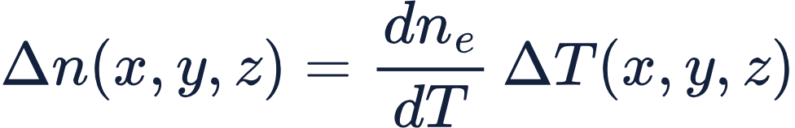
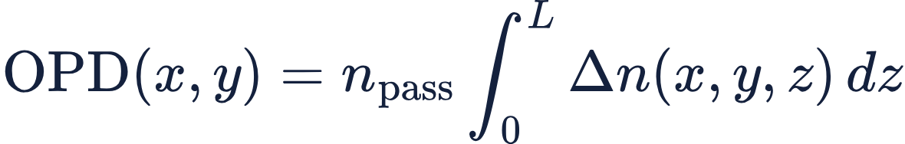
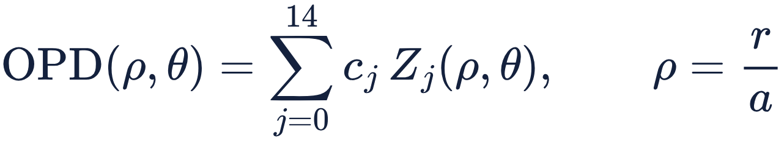
From temperature to optical path difference
STEP 7 · INDEX AND WAVEFRONT
Set to zero, by decision
Units Δn: dimensionless · dnₑ/dT: K⁻¹ · ΔT: K
End-face bulging (length change)
Stress-induced index change
EXACT · [Ch] Chénais, Eq. (3.9), p. 117, strain term set to zero; π probe (E ∥ c) sees nₑ
The fit
Units OPD, z, L: m · n_pass, Δn: dimensionless
Thibos defines the Zernikes on a unit circle (ρ from 0 to 1), so ρ = r/a maps our fit circle, r ≤ a = 0.45 mm, onto it. Least squares over 437 grid points, θ from the c-axis. Z₄ defocus, Z₅ astigmatism along c/a, Z₁₂ spherical: forms in Thibos Table 2.
[Ch] Chénais, Eq. (3.12), p. 118, stress and bulging terms set to zero
Units OPD, c_j: waves at 1064 nm (× 1.064 µm for m) · Z_j, ρ: dimensionless · θ: rad · r, a: m
Checks on the fit
[Th] Thibos, W = ΣΣ Cₙᵐ Zₙᵐ (p. 242), written with the single index j (their Eq. 4)
Residual 0.0003 waves rms: 15 terms capture the map.
Z₃ and Z₈ print 0.0000, as the left–right symmetry of crystal and mount requires.
Straight rays hold: peak OPD 0.26 waves (0.28 µm), f ≈ 1 m ≫ L = 5 mm.
[Ch] Chénais et al. 2006, Section 3.6.1, Eqs. (3.9), (3.12) · [Th] Thibos et al. 2000, p. 242, Eq. 4, Table 2
Notes:
"We now have the temperature everywhere in the crystal. This slide turns it into what a wavefront sensor actually sees: the optical path difference, or OPD.
The first equation is Chénais Eq. 3.9. When the crystal warms up, its refractive index rises, by dnₑ/dT for every kelvin. Our probe is polarised along the c-axis, so it sees the extraordinary index, nₑ. With dnₑ/dT = 2.9 × 10⁻⁶ per kelvin and a 104.5 K peak rise, the index goes up by about 3 × 10⁻⁴ at the hottest point. Chénais also include a strain term, which we set to zero.
The second equation, Chénais Eq. 3.12, adds this up along the beam. For each point (x, y) across the aperture, we integrate Δn through the crystal length. That gives the extra optical path a ray picks up at that position. The centre is hottest, so light there is delayed most. A wavefront delayed most in the middle is what a converging lens does. n_pass is the number of passes, set to 1 for now.
Chénais also include end-face bulging and stress-induced index changes. By decision, we set both to zero and keep only the thermo-optic part. Both would make the real lens stronger, so if anything our lens is a lower bound.
The third equation describes the OPD map with Zernike polynomials, following Thibos. Zernikes are defined on a unit circle, so we divide the radius by our fit radius, a = 0.45 mm, which is the pump radius. We fit 15 terms by least squares over 437 grid points, with θ measured from the c-axis. The coefficients come out in waves at 1064 nm. The three that matter are Z₄ defocus, Z₅ astigmatism along c and a, and Z₁₂ spherical.
Three checks. The fit residual is 0.0003 waves rms, so 15 terms capture the map. Z₃ and Z₈ are zero, as the left–right symmetry of crystal and mount requires. And the peak OPD is only 0.26 waves, with a focal length near a metre against a 5 mm crystal, so treating the rays as straight lines through the crystal is safe."
Likely question: "Why the pump radius as the fit radius?" That's where the heat and the lens are. The focal length depends strongly on the fit radius, so the WFS31 has to use the same circle, 0.96 mm at the sensor, for the comparison to mean anything.
If you'd like, I can turn this into speaker notes for slide 11 and add them. That only adds notes to the empty slide; it doesn't touch the others.

Slide 12
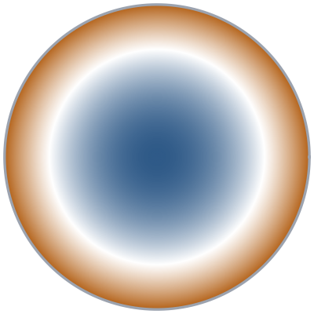

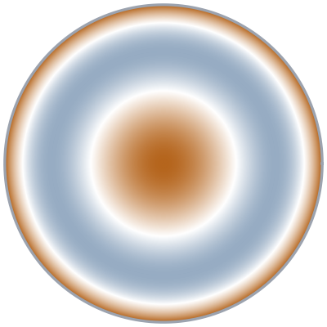
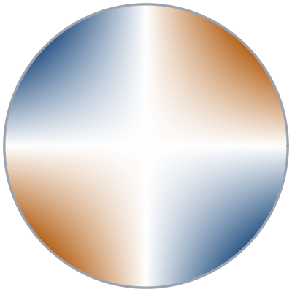
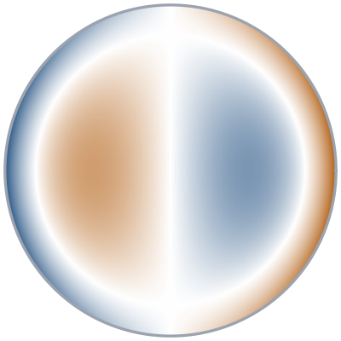
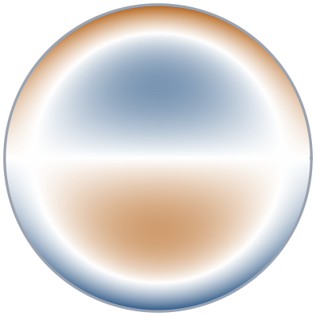
Each Zernike term has a physical cause in this crystal
STEP 7 · ZERNIKE TERMS IN THIS MODEL
Which terms can appear
Carry the result at 10 W maps: c-axis horizontal, a-axis vertical
Z₄ defocus
−0.0221 waves
Z₅ astigmatism 0°/90°
+0.0023 waves
Z₁₂ spherical
+0.0026 waves
Nonzero: heat and anisotropy
Z₄, Z₅, Z₁₂, Z₁₃, Z₁₄
Nonzero only through the one-sided chiller
Z₁ (tilt along a), Z₆, Z₇
Zero by left–right symmetry
Z₂, Z₃, Z₈, Z₉, Z₁₀, Z₁₁
At 10 W, Z₃, Z₇ and Z₈ print 0.0000: the mount's top–bottom imbalance barely reaches the 0.45 mm circle.
The lens: centre delayed most
Weaker lens along c (k_c > k_a)
Gaussian heat: edge flatter than a parabola
Zero or negligible at 10 W
Z₃ astigmatism 45°
0.0000 waves
Z₈ coma along c
0.0000 waves
Z₇ coma along a
0.0000 waves
Zero: lens axes lie along c and a
Zero: left–right mirror symmetry
Allowed by the one-sided chiller, but negligible
DERIVED · flipping x → −x sends θ → 180° − θ. Terms in cos θ, sin 2θ, cos 3θ, sin 4θ change sign, so they must vanish.
[Th] Thibos et al. 2000, Table 2 (forms of Z₃–Z₁₂)
Notes:
This slide makes one point: every term in the Zernike fit is there for a physical reason, and symmetry tells us which terms are allowed at all.
The top row holds the three terms that carry the result. Z₄, defocus, is the lens itself. The centre of the beam passes through the hottest glass, so it’s delayed most. At 10 W it’s −0.022 waves, and it gives us the focal lengths.
Z₅, astigmatism, is about ten times smaller. It says the lens is a little weaker along c. The crystal conducts heat better along c, so the hot spot spreads out more that way and bends light less.
Z₁₂, spherical, is about the same size as Z₅. It comes from the Gaussian pump: the wavefront is close to a perfect bowl in the middle but flattens toward the pump edge. That’s why it has the opposite sign to defocus. It’s also the part a curved cavity mirror can’t correct.
The bottom row holds terms that should be zero, which makes them a useful check. Crystal, mount and pump are mirror images left to right. Any shape that flips sign under that mirror has to vanish. Z₃ and Z₈ are two of them, and the list on the right gives the full set. Both print 0.0000, which tells us the mesh and the fit are behaving.
The chiller is only on top, so top to bottom isn’t symmetric. That allows Z₇, coma along a. It’s allowed, but it still prints zero: inside our 0.45 mm circle the mount’s imbalance is too small to see.
So the wavefront is a lens, slightly stronger along a, with a little spherical aberration, and nothing else. That’s exactly what the physics allows.
This slide is about one idea: every bar on the Zernike chart is there for a physical reason, and symmetry tells us which bars are allowed at all.
Top row, the three terms that carry the result. Z₄, defocus, is the lens itself. The center of the beam goes through the hottest glass, so it's delayed most. At 10 W it's −0.0221 waves, and it's what gives us the focal lengths.
Z₅, astigmatism, is about ten times smaller. It says the lens is a little weaker along the c-axis. That's because the crystal conducts heat better along c, 12.1 against 8.9 W/m·K, so the hot spot spreads out more that way and bends light less.
Z₁₂, spherical, is about the same size as Z₅. It comes from the Gaussian pump: the wavefront is close to a perfect bowl in the middle but flattens near the pump edge. That's why it has the opposite sign to defocus. It's also the part a curved cavity mirror can't correct.
Bottom row, the terms that should be zero, and that's a useful check. The crystal, the copper mount and the pump are mirror images left to right. Any shape that changes sign when you mirror it left to right has to vanish. Z₃ and Z₈ are two of them, and the list on the right gives the full set. Both print 0.0000, which tells us the mesh and the fit behave.
The chiller is only on top, so top to bottom isn't symmetric. That allows Z₇, coma along a. It's allowed, but it still prints zero: inside our 0.45 mm circle the mount's imbalance is too small to see.
Takeaway: the wavefront is a lens, slightly stronger along a, with a little spherical aberration, and nothing else. That's exactly what the physics allows.
If someone asks whether the real sensor will also show Z₃ = 0: only if the crystal's c-axis lines up with the sensor's x-axis. If it's rotated, astigmatism leaks from Z₅ into Z₃, so compare the total astigmatism √(c₃² + c₅²) and its angle instead.

Slide 13

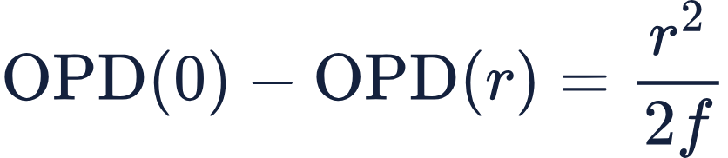

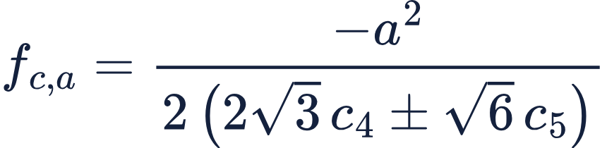
Two focal lengths, one along each crystal axis
STEP 7 · FOCAL LENGTHS
Units f_WFS, f: m · M: dimensionless
Units OPD, r, f: m
DERIVED · paraxial imaging: a relay of transverse magnification M has longitudinal magnification M²
[Ch] Chénais, Eqs. (3.13) and (3.17), pp. 118–119, along c and a
Units Z₄, Z₅, ρ: dimensionless · θ: rad
So the WFS31 should see a lens 2.14² = 4.6 times weaker than the crystal’s.
[Th] Thibos, Table 2
Test: a synthetic lens of known f was fitted, and f was recovered exactly.
Units OPD, c₄, c₅, r, a: m
What f means here
ρ² parts of Z₄, Z₅; cos 2θ = +1 along c, −1 along a
f is the best-fit lens over the 0.45 mm circle. On axis, Z₁₂ makes it stronger: about 0.90 m (c), 0.81 m (a).
The WFS31 must use the same circle (0.96 mm at the sensor) and take f from Z₄, Z₅ only.
Units f_c, f_a, a: m · c₄, c₅: m (waves × 1.064 µm)
match the r² coefficients of the two lines above
DERIVED · on-axis f adds Z₁₂'s ρ² part; Z₁₃ omitted
[Ch] Chénais et al. 2006, Eqs. (3.13), (3.17) · [Th] Thibos et al. 2000, Table 2
Notes:
“This slide turns the fitted wavefront into two focal lengths, one along each crystal axis.
The first line is what a lens does. A thin lens delays the centre of the beam more than the edge, by r² over 2f. A stronger lens, with a shorter f, means the delay falls off faster as you move out. That’s Chénais’ thin-lens relation, and we use it twice, once along c and once along a.
The second line picks out the two Zernike shapes that hold the lens. Z₄, defocus, is a round bowl, the same in every direction. Z₅, astigmatism, is a saddle: it adds to the bowl along one axis and takes away along the other. Together they’re the sphere and cylinder of an eyeglass prescription.
The third line keeps only the r² part of those two shapes. Along c, cos 2θ is +1, so the astigmatism adds. Along a it’s −1, so it subtracts. The bracket is how far the wavefront drops from the centre to the edge of our 0.45 mm circle: 75.5 nm along c and 87.4 nm along a.
Matching that to the first line gives the bottom formula: f is the circle radius squared over twice that drop. That gives 1.34 m along c and 1.16 m along a. The lens is stronger along a because heat flows less easily that way, so the temperature peak is steeper.
On the right: the relay images the crystal onto the sensor at 2.14 times magnification. The same delays are spread over a wider circle, so the lens looks 2.14 squared, about 4.6, times weaker there: 6.15 m and 5.31 m. To check the code, we fed the fit a perfect lens of known focal length, and it gave that focal length back exactly.
One caution about what f means. It’s the best-fit lens over the whole circle, so it’s an average. The very centre is stronger, because the wavefront flattens toward the pump edge. On axis it’s 0.93 m along c and 0.80 m along a. The next two slides come back to this.
This slide turns the fitted wavefront into two focal lengths, one along each crystal axis.
Line 1 is what a lens is. A thin lens delays the center of the beam more than the edge, and that extra delay grows as r² over 2f. So a stronger lens, a shorter f, means the delay drops off faster as you move out. This is Chénais' thin-lens definition, and we use it twice: once along c and once along a.
Line 2 picks out the two Zernike shapes that hold the lens. Z4, defocus, is a round bowl, the same in every direction. Z5, astigmatism, is a saddle: it adds to the bowl along one axis and takes away along the other. Together they're the "sphere and cylinder" of an eyeglass prescription.
Line 3 keeps only the r² part of those two shapes. Along c, cos 2θ is +1, so astigmatism adds; along a it's −1, so it subtracts. The bracket is simply how far the wavefront drops from the center to the edge of our 0.45 mm circle: 75.5 nm along c and 87.4 nm along a.
Line 4 matches line 3 to line 1. It boils down to f equals the circle radius squared, divided by twice that drop. That gives 1.34 m along c and 1.16 m along a. The lens is stronger along a because heat flows less easily that way, so the hot spot is steeper.
On the right, f_WFS = M²f. The relay magnifies the crystal 2.14 times onto the sensor. The same delays are spread over a wider circle, so the lens looks 2.14², or 4.6, times weaker there: 6.15 and 5.31 m. And the test: we fed the fit a perfect lens of known f, and it gave that f back exactly.
What f means here. This f is the best-fit lens over the whole 0.45 mm circle, so it's an average. The very center is stronger, because the wavefront flattens near the pump edge: on axis it's 0.93 m along c and 0.80 m along a. Slide 15 shows the two side by side. To compare with the sensor, the WFS31 analysis has to use the same circle, 0.96 mm at the sensor, and take f from Z4 and Z5 only, as we do.
Takeaway: two focal lengths, 1.34 and 1.16 m, a ratio of 1.16, from a simple formula we've checked.
If someone asks:
• Why not put Z12 into f? By the standard convention spherical aberration is reported separately, and a sensor reports f from Z4 and Z5. Adding Z12 gives the on-axis lens instead.
• Why M² and not M? The relay stretches the same delays over M times the radius, so the curvature drops by M².
• Why does f depend on the circle size? Because the wavefront isn't a perfect parabola: a small circle sees only the strongly curved center, and a large one averages in the flatter edge.

Slide 14
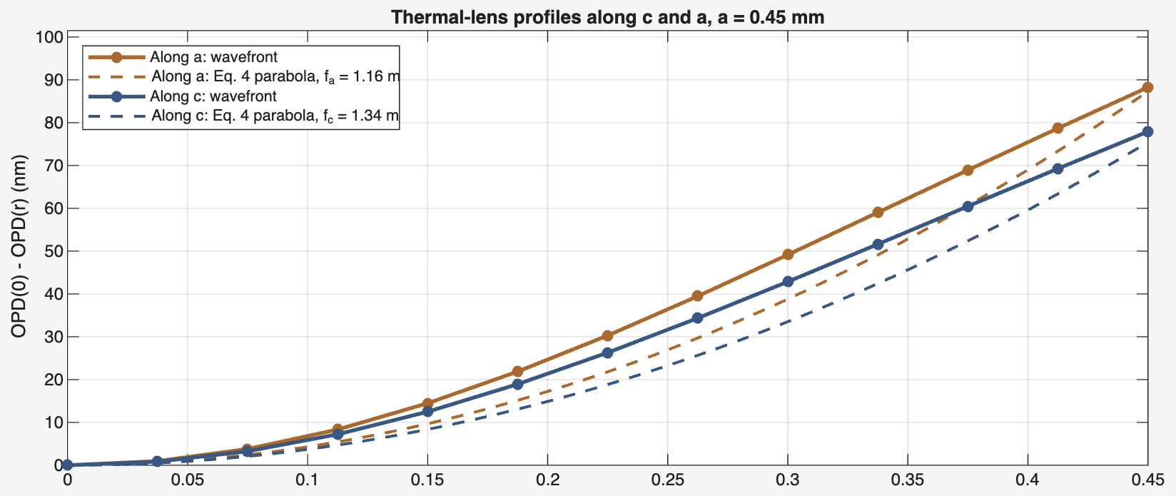
What f means, and how to test it on the WFS31
STEP 7 · READING THE FIT
Two lenses from one wavefront
 | Eq. 4 (average) | On axis
Along a | 1.16 m | 0.80 m
Along c | 1.34 m | 0.93 m
Average: the best fit over the whole 0.45 mm circle, and what a sensor reports. On axis: the centre only, about 1.45 times stronger, because the wavefront flattens toward the pump edge (Z₁₂).
Compare in this order
1 f_c/f_a = 1.16 shape: k_c/k_a and the mount
r at the crystal (mm)
Solid: the wavefront along each axis, from the OPD grid. Dashed: its Eq. 4 parabola. At every radius the a curve drops faster, so the lens is stronger along a. Each wavefront sits above its parabola in the middle and meets it at the edge: the centre is a stronger lens than the average.
Match first: same 0.96 mm circle at the sensor, f from Z₄ and Z₅, pump-off reference subtracted, sign checked with a known lens.
[Ch] Chénais et al. 2006, Eq. (3.17) · f from Eq. 4, slide 13 · profiles from the OPD grid (plot_lens_overlay.m) · on-axis f derived
Notes:
This slide answers one question: what does our focal length actually measure? A thermal lens isn’t a perfect lens, so there are two honest answers.
The plot shows the wavefront along both axes, read straight off the simulated grid at 10 W: orange along a, blue along c. Each solid line is how far the wavefront drops from the centre out to the edge of our 0.45 mm circle. For a perfect lens, that would be a parabola.
First, compare the two colours. At every radius the orange curve drops faster, so the lens is stronger along a: 1.16 m against 1.34 m. That’s the anisotropic conductivity at work, and the ratio, 1.16, is the first number to test on the sensor.
Second, compare each solid line with its dashed line. The dashed line is the best-fit parabola over the whole circle, which is our quoted focal length. The wavefront sits above it in the middle and meets it at the edge. So the centre bends light more than the average does. The table puts a number on it: on axis the lens is about 1.45 times stronger, 0.80 m along a and 0.93 m along c.
Which one we quote depends on the question. A wavefront sensor reports the average, so that’s what we compare with the WFS31.
For that comparison, order matters. First, the ratio f_c over f_a. It doesn’t depend on dn/dT, which is our biggest uncertainty. Second, spherical over defocus, minus 0.12, which tests the pump profile. Third, the absolute focal length, which is what we calibrate.
And before comparing anything: use the same circle, 0.96 mm at the sensor; take f from Z₄ and Z₅ only; subtract a pump-off wavefront; and check the sign with a known lens.

Slide 15
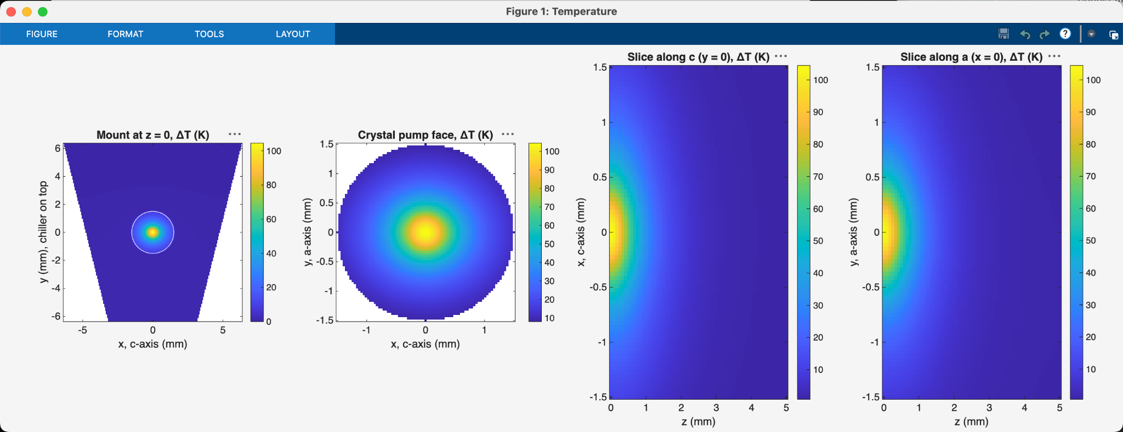
Temperature: hottest at the pump face, on axis
RESULTS · 10 W PUMP
Peak ΔT 104.5 K at the pump-face center
Heat 2.585 W, out through the chiller 2.580 W
1/α = 0.43 mm: heat sits near the face
Notes:
Here's a spoken transcript for slide 15, about 90 seconds long.
"This is the temperature rise at 10 W of pump with the laser running. Everything is measured relative to the 20 °C chiller.
The left panel shows the whole cross-section at the pump face: the copper trapezoid, with the chiller on top, and the crystal in the middle. Almost all of the temperature rise sits inside the crystal. The copper stays within a few kelvin of the chiller, so the mount isn't what limits us. The heat has to get out of the crystal first.
The second panel zooms in on the crystal's pump face. The hot spot is on axis, peaking at 104.5 K above the chiller. It isn't perfectly round. Heat escapes more easily along c, horizontally, than along a, vertically, and the chiller sits on one side. That's hard to see by eye at this scale, but it's the origin of the astigmatism we saw in the Zernike fit.
The two right panels are slices through the length of the crystal, one along c and one along a, with the pump coming in from the left. The heat sits near the entrance face. The absorption length, 1 over α, is only 0.43 mm, so most of the heat is deposited in the first millimetre, and the back half of the crystal is barely warm.
Two checks along the bottom. The heat put in is 2.585 W, and 2.580 W leaves through the chiller, which balances to 0.2%. And lasing matters a lot: the earlier non-lasing model put 4.67 W of heat into the crystal and peaked at about 250 K. The laser carries energy out as light that would otherwise end up as heat."
Tips
Crop the MATLAB window bar. The traffic-light buttons and the FIGURE/FORMAT/TOOLS menu are visible in the screenshot. Cropping them off and enlarging the figure into the empty space below would make the panels readable from the back of the room.
Make the ellipse visible or don't promise it. By eye the hot spot looks round. Either say "slightly" as above, or add a line such as "contour stretched along c". I can make a contour-line version of panel 2 in your MATLAB code if you want the shape to show.
Likely question: "Why is the peak at the face rather than at the waist?" Absorption puts most of the heat in the first millimetre, which is ahead of the waist at L/3 (1.67 mm). The beam size barely changes, so absorption sets where the peak is.

Slide 16
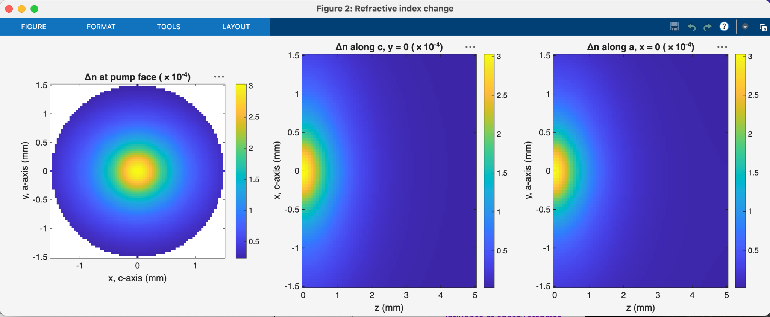
Refractive index: the same map, scaled by dnₑ/dT
RESULTS · 10 W PUMP
Peak Δn = 3.03 × 10⁻⁴ at the pump-face center
dnₑ/dT = 2.9 × 10⁻⁶ /K (datasheet)
Δn is positive: a converging lens
Notes:
Here's a spoken transcript for slide 16, about a minute long. This slide is a quick one.
"This is the change in refractive index, and it's the same map as the temperature, just rescaled. The index rises by dnₑ/dT for every kelvin. Our probe is polarised along c, so it sees the extraordinary index, and we use the datasheet value of 2.9 × 10⁻⁶ per kelvin.
So the peak, 104.5 K, becomes a peak index change of 3.03 × 10⁻⁴, at the centre of the pump face. That's a small number, three parts in ten thousand. But it's spread over the depth of the crystal, and across a beam less than a millimetre wide, and that's enough to make a lens with a focal length of about a metre.
The sign is what matters most. dnₑ/dT is positive, so the index is highest on axis, where it's hottest. Light in the middle travels slower than light at the edge, which is exactly what a converging lens does.
One caution: this map, and every focal length after it, scales directly with dnₑ/dT. Published values at 1064 nm range from about 0.6 to 9.5 × 10⁻⁶ per kelvin. That's why we test the shape first, the ratio f_c/f_a, which doesn't depend on this number, and then use the measured lens to calibrate it."
Tips
Your notes point to a slide that isn't in this deck. They end with "see the limits slide", and this deck has no limits slide. Their "3 to 4 times lower than published 633 nm values" is also the older comparison. The audit from this morning found a 0.6–9.5 × 10⁻⁶ /K spread at 1064 nm, which is what the transcript uses. I'd say that rather than read the old line.
Same as slide 15: cropping the MATLAB window bar and enlarging the figure would help.
Likely question: "Why use the datasheet value and not a paper?" The literature disagrees by more than a factor of ten. We keep 2.9 × 10⁻⁶ as the nominal value and plan to pin it down from the WFS31 measurement.

Slide 17
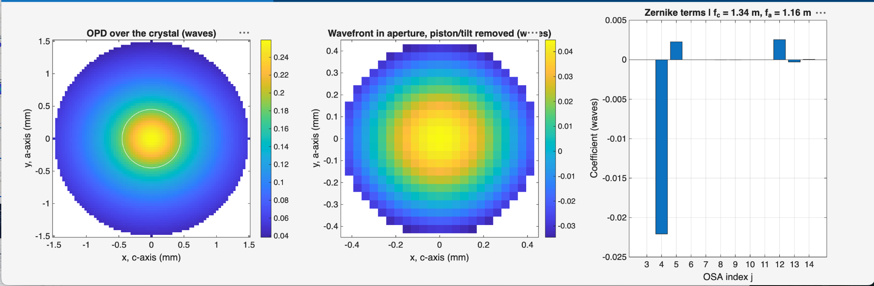
Wavefront: mostly defocus, with c/a astigmatism
RESULTS · 10 W PUMP
Zernike2 output | Value
Peak OPD | 0.259 waves
Z₄ defocus | −0.0221 waves
Z₅ astigmatism | +0.0023 waves
Z₁₂ spherical | +0.0026 waves
Fit residual (rms) | 0.0003 waves
f_c (crystal) | 1.342 m
f_a (crystal) | 1.159 m
f_c, f_a at WFS31 | 6.15, 5.31 m
Zernike values in waves at 1064 nm, over a = 0.45 mm.
Notes:
Here's a spoken transcript for slide 17, about 75 seconds long.
"This is the end of the chain: the wavefront that the thermal lens puts on a beam passing through the crystal at 10 W.
The left panel is the optical path difference over the whole crystal face. It peaks at about a quarter of a wave on axis. The white circle marks our 0.45 mm fit circle, the size of the pump.
The middle panel zooms into that circle, with piston and tilt removed. That's the shape the Zernike fit sees.
On the right is the fit itself. One bar dominates: Z₄, defocus, at minus 0.022 waves. So the wavefront is mostly a simple lens. Z₅, astigmatism, is about a tenth of that. Its positive sign means the lens is stronger along a than along c. Z₁₂, spherical, is about the same size as Z₅, from the Gaussian shape of the heat. Everything symmetry rules out is zero, and the fit residual is 0.0003 waves, so 15 terms capture the whole map.
The table turns that into focal lengths: 1.34 m along c and 1.16 m along a in the crystal, a ratio of 1.16. Through the 2.14× relay, the WFS31 should see 6.15 m and 5.31 m. Those are the numbers we take to the bench."
Tips (all layout)
The caption overlaps the bottom of the table ("Zernike values in waves…" sits on top of the WFS31 row). Moving it down about 0.4 in fixes it.
The figure runs off the left edge of the slide. It starts at about 0.03 in. Nudge it right to match the 0.89 in margin the other slides use, and crop off the window bar as on slides 15 and 16.
A MATLAB "…" menu covers the middle panel's title ("(w…es)"). Re-export the figure, or crop more tightly.
Small bar at j = 13. The chart shows a small negative bar there. If someone asks, it's secondary astigmatism, the same c/a anisotropy acting on the flatter edge of the wavefront.
This slide repeats much of slides 12 to 14. If you're short on time, present it as the summary ("here's everything on one page") and move through it quickly.

Slide 18
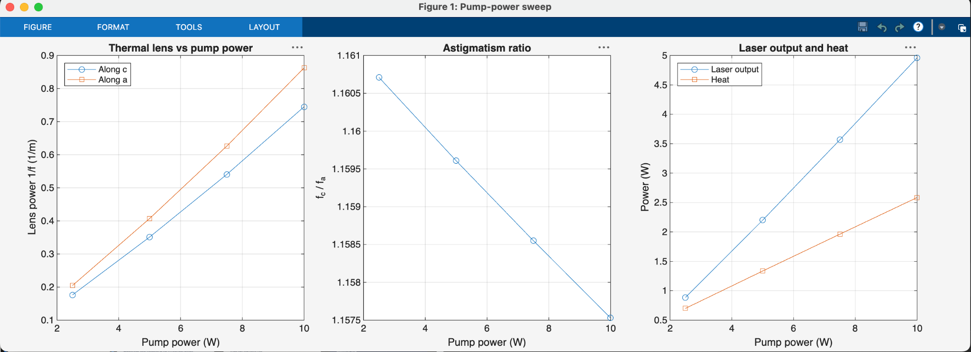
Four pump powers, same model
RESULTS · PUMP-POWER SWEEP
P (W) | P_out (W) | Heat (W) | Peak ΔT (K) | f_c (m) | f_a (m) | f_c/f_a | Z₄ (waves)
2.5 | 0.886 | 0.700 | 25.2 | 5.67 | 4.89 | 1.161 | −0.0052
5.0 | 2.200 | 1.335 | 50.0 | 2.85 | 2.45 | 1.160 | −0.0104
7.5 | 3.567 | 1.962 | 76.3 | 1.85 | 1.60 | 1.159 | −0.0160
10.0 | 4.961 | 2.585 | 104.5 | 1.34 | 1.16 | 1.158 | −0.0221
Notes:
"To see how the model scales, we ran the same model at four pump powers, 2.5, 5, 7.5 and 10 W, with nothing else changed: same mesh, same inputs. Energy balance held to 0.2% at every power.
The left plot shows lens power, 1 over f, against pump power. It's nearly a straight line along both axes, close to proportional to the pump. Along a, the orange line, it's always the stronger lens.
The right plot shows the laser output and the heat. Output rises with a slope of about 54%, and the laser reaches threshold below 1 W. The heat rises more slowly than the pump. The heat fraction falls from 28% at 2.5 W to about 26% at 10 W, because at higher power more of the excited ions leave through the laser, which carries energy out as light.
The middle plot is the astigmatism ratio, f_c over f_a. Look at the axis: it runs from 1.1575 to 1.161. The ratio barely moves, 1.161 to 1.158 across a fourfold change in power, which is a change of 0.3%. That's the key result. The shape of the lens is set by the crystal and the mount, not by how hard we pump.
That gives us a clean first test on the bench: measure f_c over f_a at any power, and the model says it should be about 1.16."
Tips
The middle plot exaggerates the change. With the y-axis zoomed to the fourth decimal place, the ratio looks like it's falling steeply. Either set the axis to something like 1.0–1.4 so it shows as flat, or say "look at the axis" out loud, as the transcript does. I can change the ylim in pump_sweep2.m if you want.
Crop the MATLAB window bar, as on slides 15 to 17.
Likely question: "Why does the lens grow slightly faster than the heat?" k falls as the crystal heats, so each extra watt of heat gives a slightly steeper temperature profile. 1/f goes as about P to the power 1.04.
That's the last results slide. Slide 19 is the references, so you've reached the end of the deck.

Slide 19
Sources
REFERENCES
[C] S. Cante, S. J. Beecher, J. I. Mackenzie, “Characterising energy transfer upconversion in Nd-doped vanadates at elevated temperatures,” Opt. Express 26(6), 6478 (2018). doi:10.1364/OE.26.006478
[Ko] W. Koechner, Solid-State Laser Engineering (Springer), Sect. 1.5.2, Eq. 1.70, p. 36; Sect. 3.1, Eqs. 3.4, 3.12, pp. 104–105. [edition to confirm]
[S] G. Shayeganrad, “Optimum design of end-pumped solid-state lasers,” in Solid State Laser, ed. A. H. Al-Khursan (InTech, 2012), pp. 3–26. doi:10.5772/38902
[H] Y. Shen et al., “Four-dimensional thermal analysis of 888 nm pumped Nd:YVO₄ dual-rod acousto-optic Q-switched laser,” Appl. Sci. 7(5), 470 (2017). doi:10.3390/app7050470
[K] L. Cini, J. I. Mackenzie, “Analytical thermal model for end-pumped solid-state lasers,” Appl. Phys. B 123(12), 273 (2017). doi:10.1007/s00340-017-6848-y
[T] Y. Sato, T. Taira, “The studies of thermal conductivity in GdVO₄, YVO₄, and Y₃Al₅O₁₂ measured by quasi-one-dimensional flash method,” Opt. Express 14(22), 10528 (2006). doi:10.1364/OE.14.010528
[Ch] S. Chénais, F. Druon, S. Forget, F. Balembois, P. Georges, “On thermal effects in solid-state lasers: the case of ytterbium-doped materials,” Prog. Quantum Electron. 30(4), 89 (2006). doi:10.1016/j.pquantelec.2006.12.001
[Th] L. N. Thibos, R. A. Applegate, J. T. Schwiegerling, R. Webb, “Standards for reporting the optical aberrations of eyes,” J. Refract. Surg. 18(5), S652 (2002). doi:10.3928/1081-597X-20020901-30
[D] Newlight Photonics, Nd:YVO₄ crystal datasheet (α, N, τ_f, dnₑ/dT, λ_L). newlightphotonics.com
Notes:
How each was read: Cante Section 2.2 in full (Southampton eprint, published text). Koechner Sections 1.5.2 and 3.1 from page photos; edition still to confirm. Shayeganrad Eqs. 18-21 in full. Shen in full; only Eq. 19 is used as an equation, plus Table 1 values (τ_rad, λ_f, and σ_L, which Shen quotes from Sato and Taira 2012). Cini and Mackenzie in full. Sato and Taira Table 2. Chénais Section 3.6 in the journal version (pp. 117–119); equation numbers (3.x) are from that version. Thibos Table 2. n_e at 808 nm (2.186) is from the LaserComponents Nd:YVO4 datasheet.

