Slide 1
Coffee Supply Analysis
Anya Nash

Slide 2
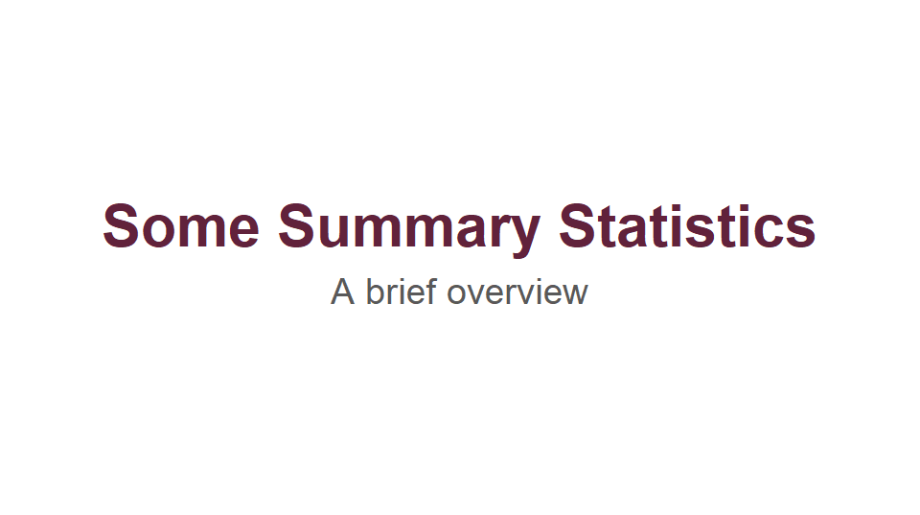

Slide 3
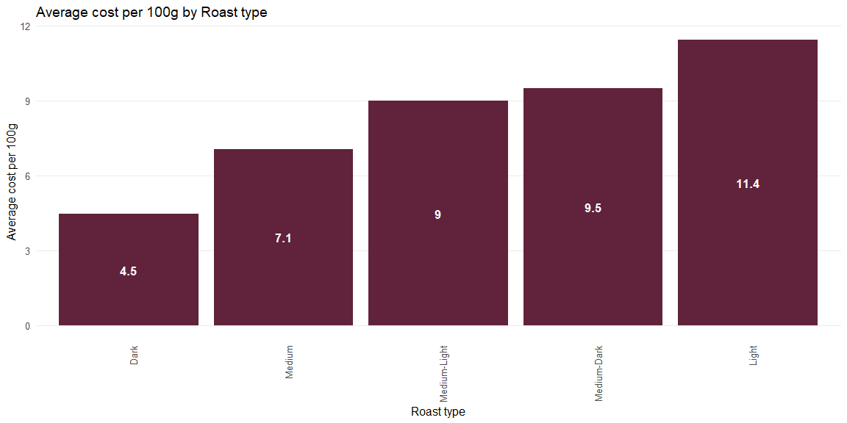
Average Cost Per 100g by Roast Type

Slide 4
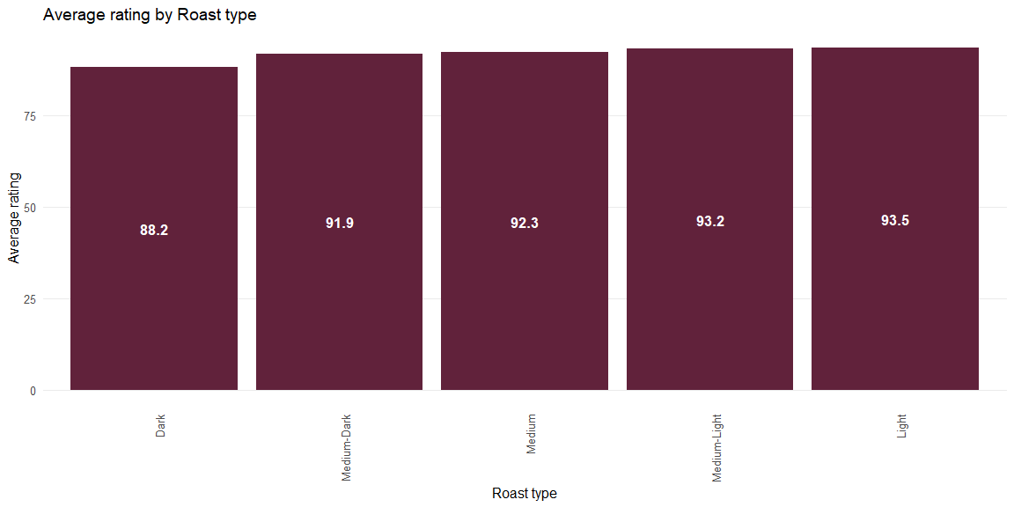
Average Rating by Roast Type

Slide 5
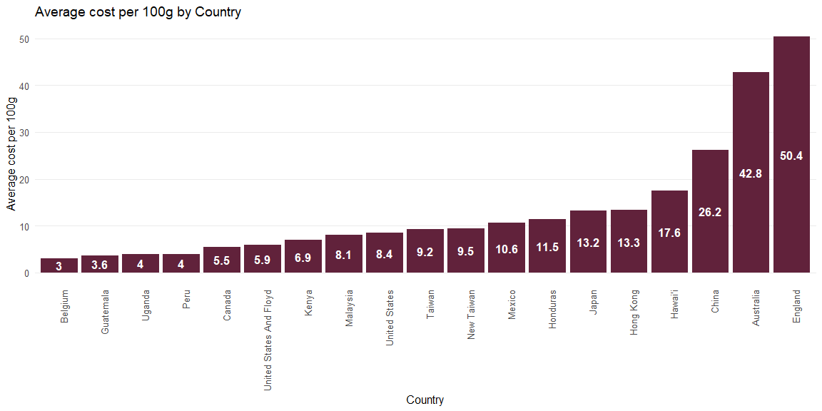
Average Cost Per 100g by Country

Slide 6
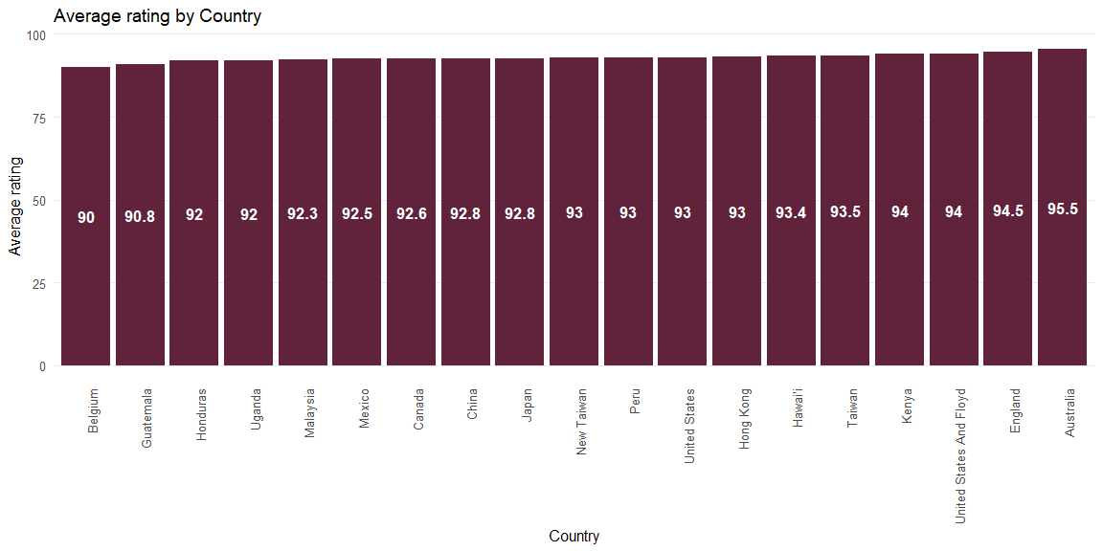
Average Rating by Country

Slide 7
Number of Roasters by Roast Type
Roast | No_of_Roasters
Medium-Light | 327
Medium | 136
Light | 119
Medium-Dark | 27
Dark | 3

Slide 8
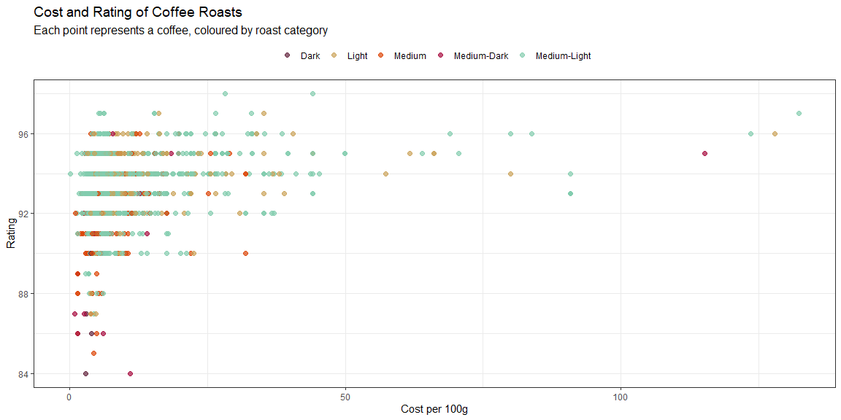
Cost and Rating of Coffee Roasts

Slide 9
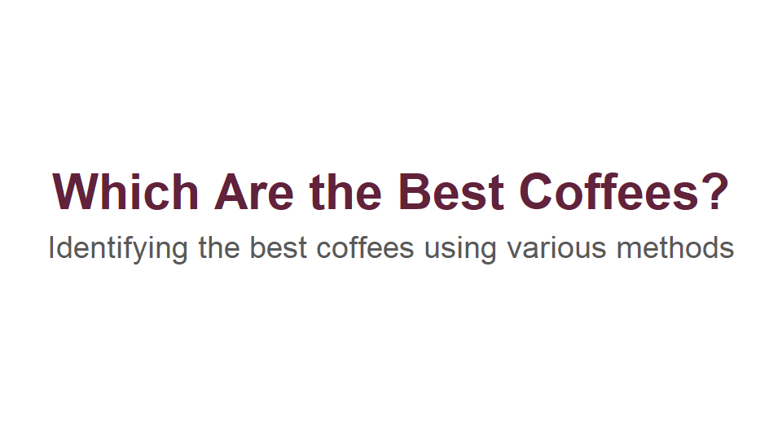

Slide 10
Cheapest Roast by Roast Type
Roast | Cost | Rating | Value | Name | Roaster
Dark | 2.93 | 84 | 28.67 | Pike’s Place Blend | Starbucks Coffee
Light | 3.39 | 95 | 28.02 | Panama La Mula Geisha Washed | GK Coffee
Medium | 1.13 | 92 | 81.42 | Espresso Blend | Ba Yang Coffee
Medium-Dark | 0.99 | 87 | 87.88 | 100% Guatemalan | Hill's Bros. Coffee
Medium-Light | 0.17 | 94 | 552.94 | Karen J Kona Red Bourbon | Hula Daddy Kona Coffee

Slide 11
Highest Rated Roast by Roast Type
Roast | Cost | Rating | Value | Name | Roaster
Dark | 8.50 | 94 | 11.06 | Indonesia Sumatra Gayo Espresso | Simon Hsieh's Aroma Roast Coffees
Light | 16.15 | 97 | 6.01 | Testi Ayla Double Ethiopia | Barrington Coffee Roasting
Medium | 19.82 | 96 | 4.84 | Kona Mocca® | Hula Daddy Kona Coffee
Medium-Dark | 7.79 | 96 | 12.32 | Bull Demon King | Simon Hsieh Aroma Roast Coffees
Medium-Light | 28.27 | 98 | 3.47 | GW01 Finca Sophia Olympus Geisha | GK Coffee

Slide 12
Best Valued Roast by Roast Type
Roast | Cost | Rating | Value | Name | Roaster
Dark | 2.93 | 84 | 28.67 | Pike’s Place Blend | Starbucks Coffee
Light | 3.39 | 95 | 28.02 | Panama La Mula Geisha Washed | GK Coffee
Medium | 1.13 | 92 | 81.42 | Espresso Blend | Ba Yang Coffee
Medium-Dark | 0.99 | 87 | 87.88 | 100% Guatemalan | Hill's Bros. Coffee
Medium-Light | 0.17 | 94 | 552.94 | Karen J Kona Red Bourbon | Hula Daddy Kona Coffee

Slide 13
Best Valued Combination for Each Three-Roast Combination
Roast_Combo | Avg_Value | Coffee_1 | Coffee_2 | Coffee_3
M + MD + ML | 240.75 | Espresso Blend | 100% Guatemalan | Karen J Kona Red Bourbon
D + MD + ML | 223.16 | Pike’s Place Blend | 100% Guatemalan | Karen J Kona Red Bourbon
L + MD + ML | 222.95 | Panama La Mula Geisha Washed | 100% Guatemalan | Karen J Kona Red Bourbon
D + M + ML | 221.01 | Pike’s Place Blend | Espresso Blend | Karen J Kona Red Bourbon
L + M + ML | 220.79 | Panama La Mula Geisha Washed | Espresso Blend | Karen J Kona Red Bourbon
D + L + ML | 203.21 | Pike’s Place Blend | Panama La Mula Geisha Washed | Karen J Kona Red Bourbon
D + M + MD | 65.99 | Pike’s Place Blend | Espresso Blend | 100% Guatemalan
L + M + MD | 65.77 | Panama La Mula Geisha Washed | Espresso Blend | 100% Guatemalan
D + L + MD | 48.19 | Pike’s Place Blend | Panama La Mula Geisha Washed | 100% Guatemalan
D + L + M | 46.04 | Pike’s Place Blend | Panama La Mula Geisha Washed | Espresso Blend

Slide 14
Best Valued Combination for Each Same-Country Three-Roast Combination
Roast_Combo | Country | Avg_Value | Coffee_1 | Coffee_2 | Coffee_3
L + M + ML | Hawai'i | 197.04 | Ethiopia Yirgacheffe G1 | Medium-Dark Roast | Karen J Kona Red Bourbon
L + MD + ML | Hawai'i | 195.66 | Ethiopia Yirgacheffe G1 | CBD Coffee Dark Roast | Karen J Kona Red Bourbon
M + MD + ML | Hawai'i | 190.78 | Medium-Dark Roast | CBD Coffee Dark Roast | Karen J Kona Red Bourbon
D + M + MD | United States | 58.54 | Pike’s Place Blend | Colombia | 100% Guatemalan
L + M + MD | United States | 56.92 | Look for the Helpers | Colombia | 100% Guatemalan
D + M + ML | Taiwan | 54.11 | Indonesia Sumatra Gayo Espresso | Espresso Blend | Taiwan Natural Alishan Zhuo-Wu Geisha
D + MD + ML | United States | 48.39 | Pike’s Place Blend | 100% Guatemalan | Elida Natural ASD (Panama)
D + L + MD | United States | 46.79 | Pike’s Place Blend | Look for the Helpers | 100% Guatemalan
D + L + M | Taiwan | 40.17 | Indonesia Sumatra Gayo Espresso | Panama La Mula Geisha Washed | Espresso Blend
D + L + ML | Taiwan | 36.31 | Indonesia Sumatra Gayo Espresso | Panama La Mula Geisha Washed | Taiwan Natural Alishan Zhuo-Wu Geisha

Slide 15
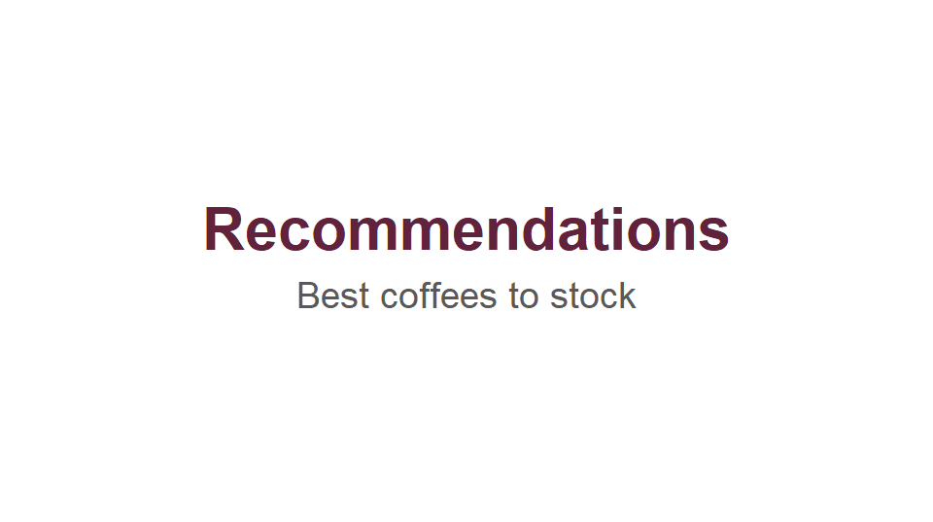

Slide 16
Recommendation 1
If just one type of coffee is to be stocked, I would recommend this coffee:
Medium-Light roast: Karen J Kona Red Bourbon, roasted by Hula Daddy Kona Coffee
It has the best value for money
It is both inexpensive and highly rated

Slide 17
Recommendation 2
If the goal is to supply a range of coffee roasts, I would recommend the following combination:
A medium roast: Espresso Blend
A medium-dark roast: 100% Guatemalan
And a medium-light roast: Karen J Kona Red Bourbon

Slide 18
Recommendation 3
If the goal is to supply a range of coffee roasts and there is an advantage from importing them all from the same country, I would recommend the following roasts from Hawai’i:
Light roast: Ethiopia Yirgacheffe G1
Medium roast: Medium-Dark Roast
And medium-light roast: Karen J Kona Red Bourbon

