Slide 1


miledevs.com
Партнерство з агенціями
  MILEDEVS

Slide 2
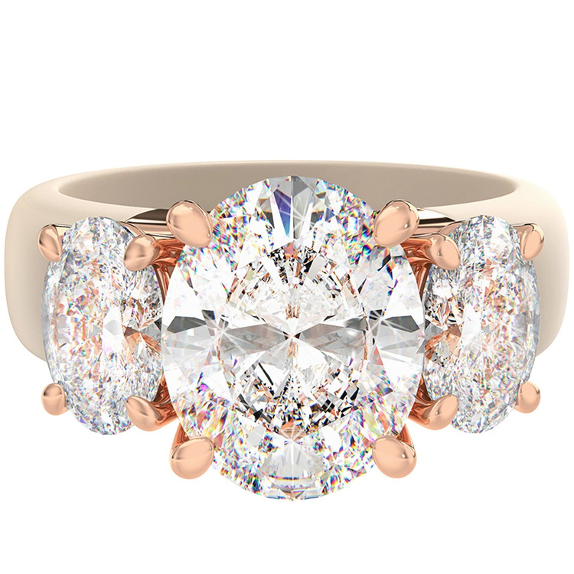

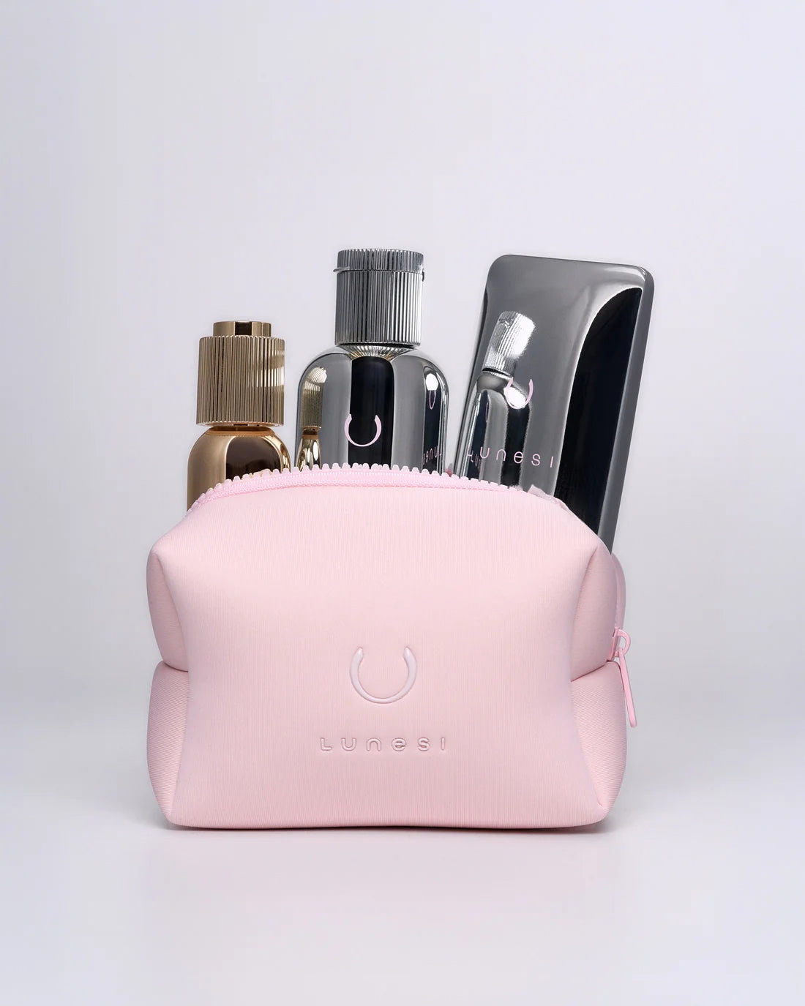
MileDevs in short
We build and grow Shopify stores for brands. Here is what working with us looks like:
1
2
3
We build stores that sell
One team for the whole store
The first step is free
New stores, redesigns, migration to Shopify, fixes, speed and conversion
Design, development, integrations and testing, led by a project manager
We audit your store and show what to fix, with a mockup for every issue
Next: who we are, what we do, results, case studies, how we work and answers to common questions

Slide 3

  МИ MILEDEVS
A Shopify agency for growing brands. We build and improve stores that sell.
7+
300+
years on Shopify
stores for brands in the US, Canada and Europe
Shopify
Top Rated
Selected Partner
on Upwork

Slide 4
What brands come to us with
Whichever one is yours, we look at the whole store, not just one page.
1
2
3
4
New brand
Moving to Shopify
Traffic, few sales
Ready to grow
You need a store that is ready to sell from day one
From WordPress or another platform, without losing products or orders
Visitors come from ads and social, but only a few buy
Custom features, integrations or new markets

Slide 5
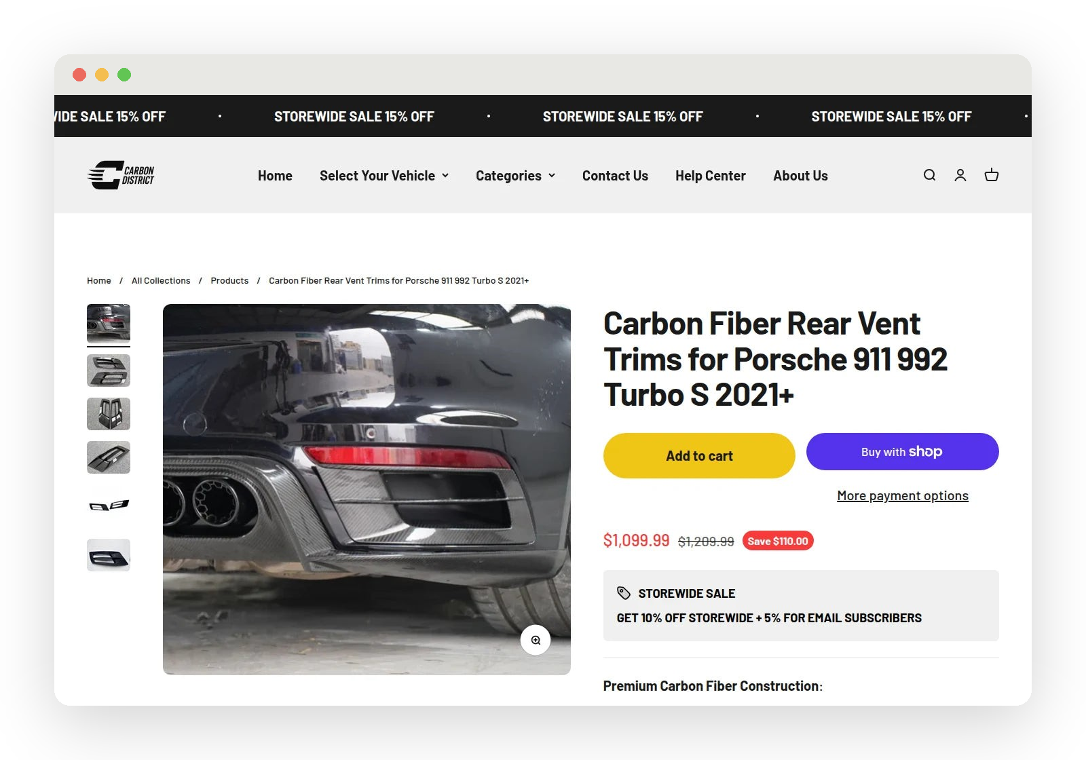
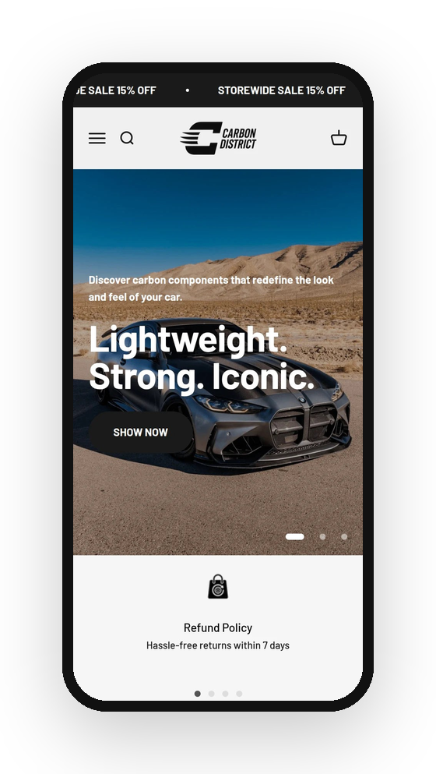

A store built around the way you sell
Custom design and development for your brand
Migration to Shopify without losing products, customers or orders
Custom features: apps and integrations that fit your processes
Multiple languages and currencies for new markets
Ongoing support after launch
How long it takes
New store
4–8 weeks
Redesign
2–4 weeks
Small fixes
24–72 h

Slide 6
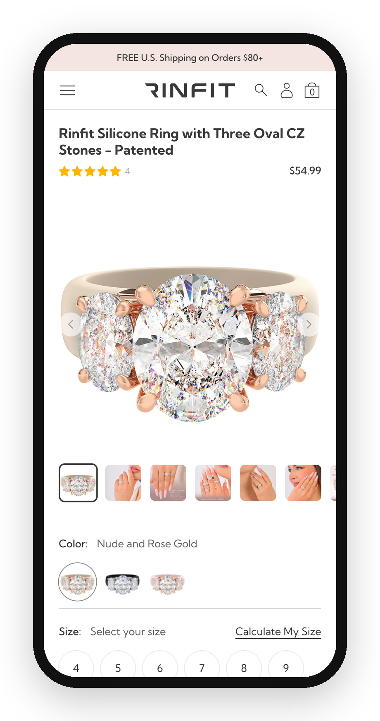

Fewer obstacles on the way to checkout
Search
Product
Cart
Checkout
Payment
CRO and UX/UI audit
We find where your store loses shoppers, from search to payment
Mobile experience
Product pages, navigation and checkout
Loading speed
It has a direct effect on sales
Features for your niche
Based on niche and competitor research, such as 3D and 360° product views

Slide 7
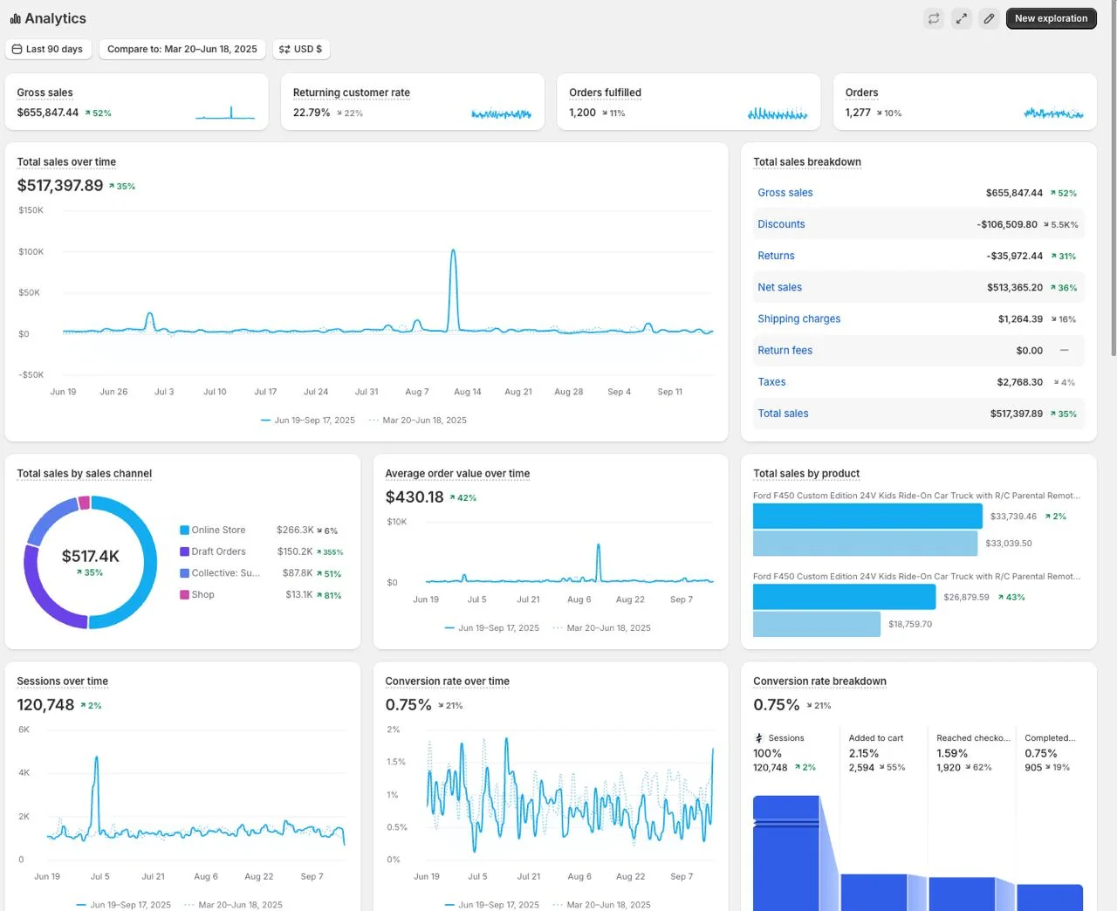
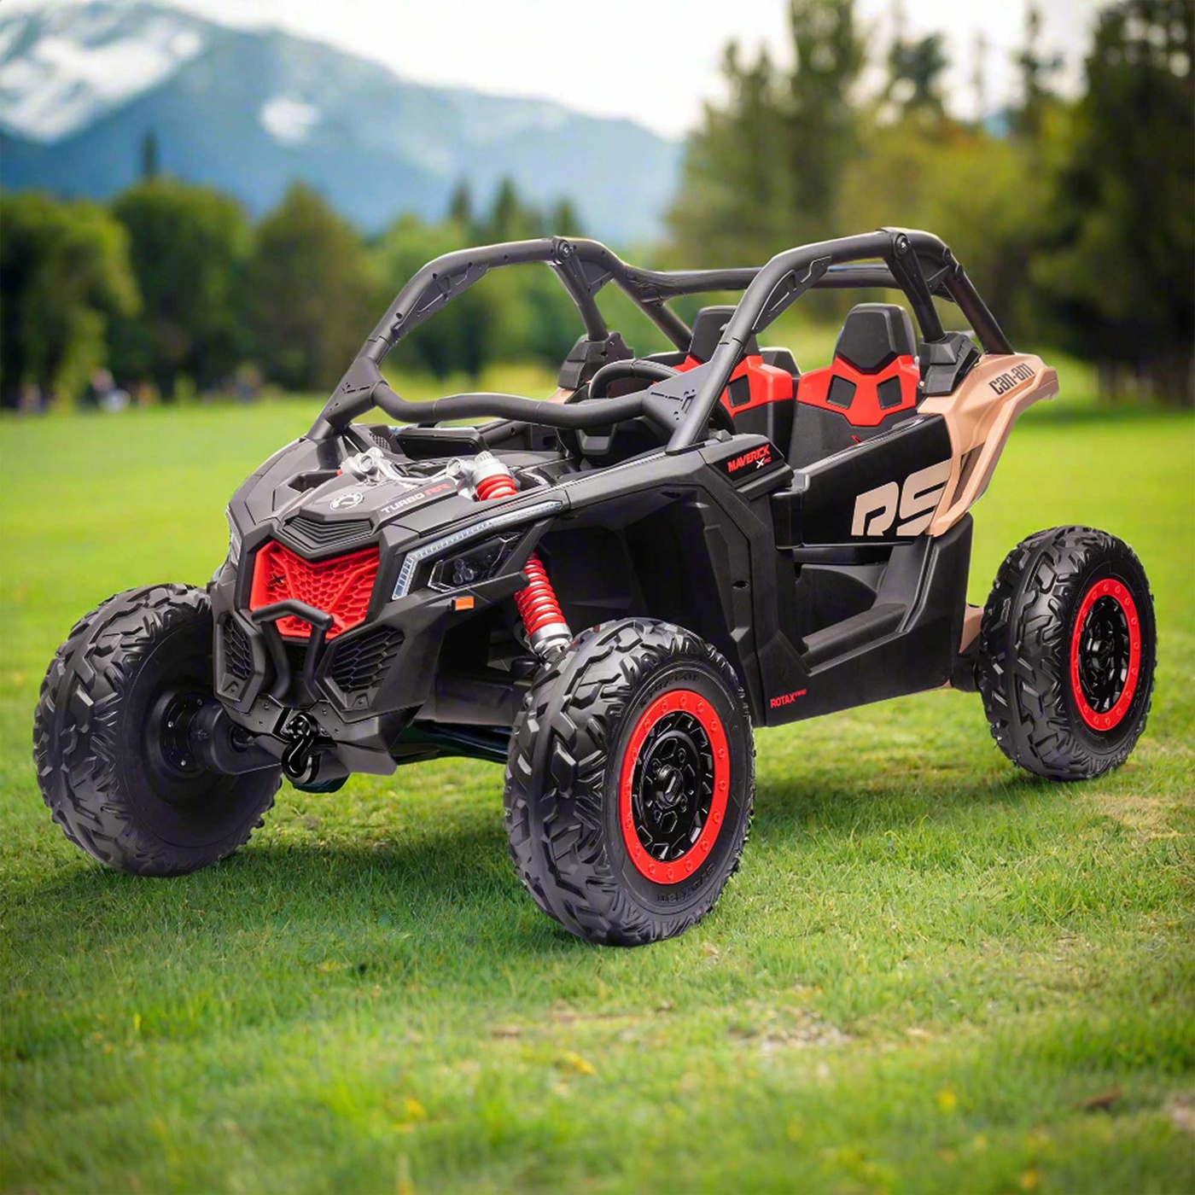
Results in numbers
Store build · design
Kids' electric ride-on store on Shopify
+35%
Sales
$383K → $517K in 90 days
+42%
Average order value
$303 → $430
+52%
Gross sales
vs the previous 90 days
Another client
+19% in sales after CRO changes to product pages and checkout, May vs April 2026
Shopify Analytics · Jun 19 – Sep 17, 2025 vs Mar 20 – Jun 18, 2025

Slide 8


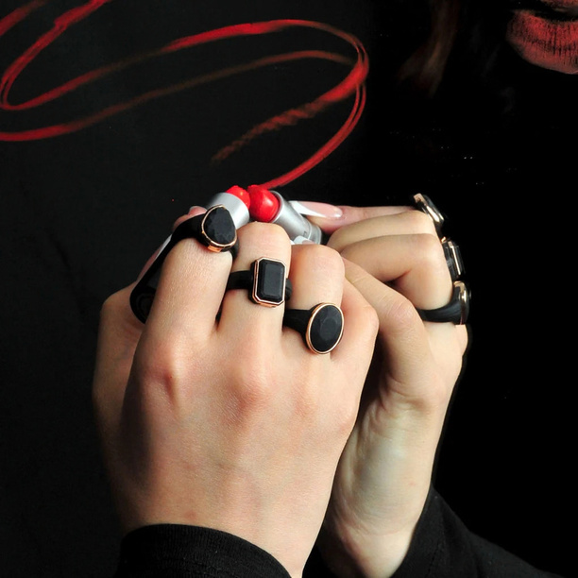
Less manual work after every order
What we connect
Shopify Flow
Klaviyo
CRM and chatbots
Step 1
Step 2
Step 3
Step 4
Step 5
Order or lead
CRM
Bot 24/7
Your team
Repeat purchase
A customer orders or leaves a request
It goes straight into your CRM, no manual entry
Answers common customer questions
Gets notified and takes it from there
A flow brings the customer back to buy again

Slide 9

MILEDEVS products
Ready-made solutions that keep working after launch
Product 1
Product 2
Product 3
AI Blog Automation
Custom Shopify Theme
AI Sales Chatbot
Writes and publishes SEO articles in your brand voice
Our fast theme: SEO-ready, 90+ PageSpeed
Knows your catalog, recommends products and collects leads 24/7
What you get
What you get
What you get
Search traffic without a copywriter
A fast start without costly custom development
Leads even at night and on weekends

Slide 10
A team behind your store
Designers, developers, integration specialists and QA. Each one owns their area and delivers quality work.
1
2
3
4
Design
Development
Integrations
Testing
Structure and interface for your brand and catalog
Custom Shopify themes and sections, speed and clean code
Apps, CRM, automation and Shopify Plus solutions
Every build is checked on different devices before launch
Project management
A project manager keeps timelines, communication and reports, so you always know where the project stands
At every stage

Slide 11
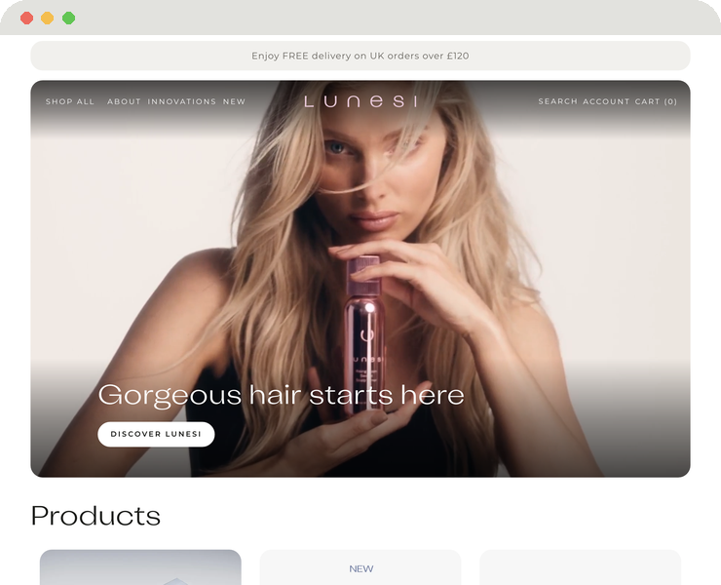
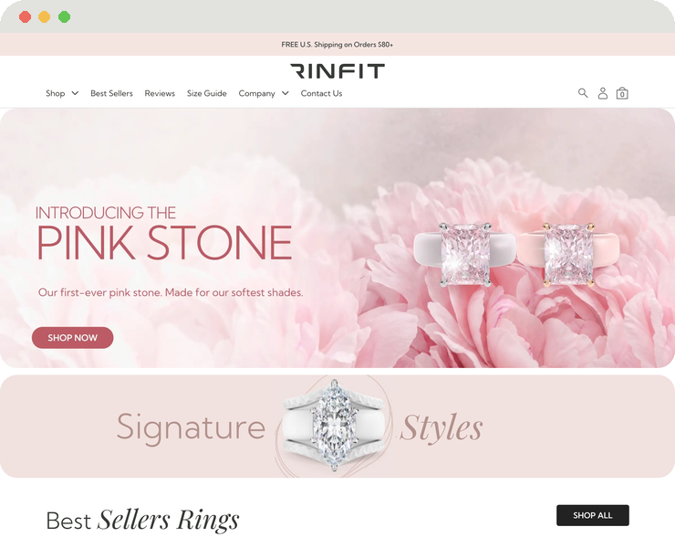
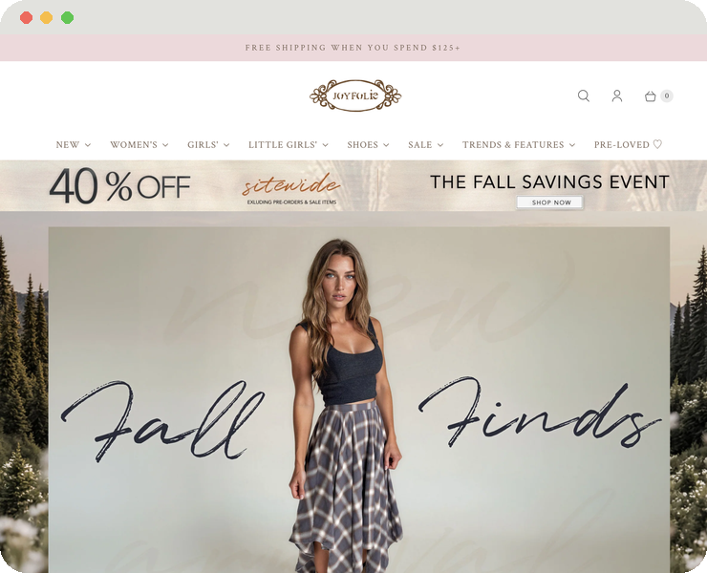
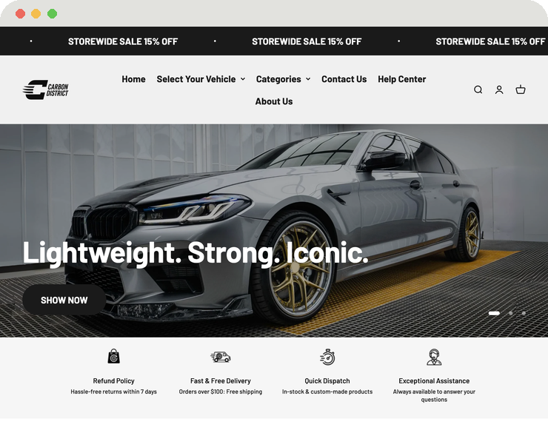
Work you can see
All case studies are at miledevs.com/pages/portfolio. We are happy to walk you through any project on a call.
Lunesi
Rinfit
Joyfolie
Carbon
Hair care
Silicone rings
Fashion and footwear
Car accessories
Custom theme, multi-currency, shipping and marketing integrations
Design implementation, mobile improvements, size and color filters
Full-cycle store development
Full-cycle store development

Slide 12

How we work
1
2
3
4
Call and brief
Plan and estimate
Build
Launch and support
You tell us about your brand, store and goals
Scope, timeline and price are agreed before we start
Design and development with regular status updates
We stay after launch: updates, optimization and growth support

Slide 13
Common questions
How much does it cost?
How long does it take?
We estimate after a short call. Scope, timeline and price are fixed before we start.
Small fixes take 24–72 hours, a redesign 2–4 weeks, a new store 4–8 weeks.
Will we lose data when moving to Shopify?
Do you work with existing stores?
We move products, customers and orders, and test every key flow before switching traffic to the new store.
Yes: redesign, fixes, speed, CRO audit and ongoing support.
Who will we talk to?
Where do we start?
A project manager who keeps you updated at every stage.
With a free audit of your store. No Shopify access needed.

Slide 14

How to start
1
Message Anna on WhatsApp
+380 98 068 5004
2
Send your store link
Or your idea, plus 2–3 sentences about your goal
3
Get a free audit
We show where your store loses shoppers and how each page should look
Anna Serputko · MileDevs
WhatsApp: +380 98 068 5004 · Telegram: t.me/anna_miledevs
Website: miledevs.com · Free audit: miledevs-free-audit.netlify.app/en

