Slide 1
Data Science Capstone project
Anyatha K
17th,August 2021

Slide 2

Outline
Executive Summary
Introduction
Methodology
Results
Conclusion
Appendix

Slide 3

Executive Summary
This project aims to predict if the Falcon 9 Space Rocket first stage will land successfully and to provide EDA concerning Space X rocket launches and firs stage landings.
In this project data on Space X rocket launches was gathered from internet (web-scraping, API requests).
It was further processed with tools available in Python programming language.
EDA was provided with help of various visualization tools (including interactive) and with help of SQL quires.
Several classification models (Logistic Regression, SVM, Decision Tree and KNN) were trained and optimized to predict the success of first stage landing.
Best performing model was chosen with help of accuracy score.
Prediction quality was analyzed with help of confusion matrix.
EDA shows that a list of different factors affect the success of first stage landing.
High accuracy score (over 80%) could be achieved for predictions based on gathered datasets.
SVM method provides best accuracy score result.
False positives rate is the point for further improvement of the predicting model based on confusion matrix analysis.

Slide 4

Introduction
Space X company offers Falcon 9 rocket launches on its website with a cost of 62 million USD whereas other providers offer launches at cost of 165 million USD.
Major part of the savings is because Space X can reuse the first stage.
If other company can determine if the first stage will successfully land, it can predict the cost of a launch.
This information can be used to bid against space X for a rocket launch.
Predict if the Falcon 9 Space Rocket first stage will land successfully.
Provide exploratory data analysis concerning Space X rocket launches and firs stage landings.
Gather insights on conditions of successful and unsuccessful landings.

Slide 5

Methodology
Data collection:
Requested from the SpaceX REST API endpoints (https://api.spacexdata.com/v4).
Scraped from Wikipedia Web-page (https://en.wikipedia.org/wiki/List_of_Falcon_9_and_Falcon_Heavy_launches)
Data wrangling:
Removing not relevant data-records.
Replacement of missing values with average values.
Exploration of data-types in the given data-sets.
Setting of Y-variable (Label) for further model training.
Exploratory data analysis (EDA) using visualization and SQL:
The dependencies between features of datasets were visualized and explored with charts and plots.
Additional insights in the provided datasets were made with help of SQL queries.
Features for prediction (independent variables) were prepared based on the results of visual analysis.
Interactive visual analytics using Folium and Plotly Dash:
Additional analysis of geographical patterns of launch sites was made with help of Folium package.
Interactive data visualization with help of Python Plotly Dash package was prepared to get better insight in provided data.
Predictive analysis using classification models: For this project, the relevant data was:
Features (independent variables) were standardized with .StandardScaler() function.
Dependent and independent variables set were split into test set and training set for model training. Logistic Regression, SVM, Decision tree and KNN methods were used for predictive models.
Best Hyperparameters for models were chosen with GridSearchCV.
The predictive quality of models was compared using confusion matrix and .score() function.

Slide 6
Methodology

Slide 7
Data collection
Data collection:
The dataset was collected using requests to the SpaceX API (https://api.spacexdata.com/v4).
Scraped from Wikipedia Web-page (https://en.wikipedia.org/wiki/List_of_Falcon_9_and_Falcon_Heavy_launches).

Slide 8
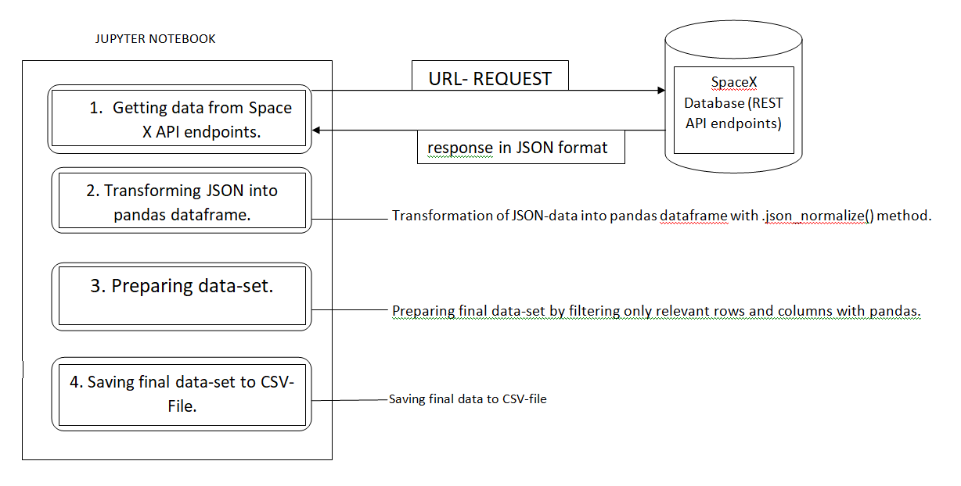
Data collection – SpaceX API
Each column calls the API and appends the response to a list.
This response was then converted to a JSON file using .json().
The JSON file was then converted into a dataframe to perform proper data analysis using the pandas method pd.json_normalize().
https://github.com/anyatha92/Capstone-/blob/master/notebook_2._Data_Collection_CtB_sote_.ipynb

Slide 9
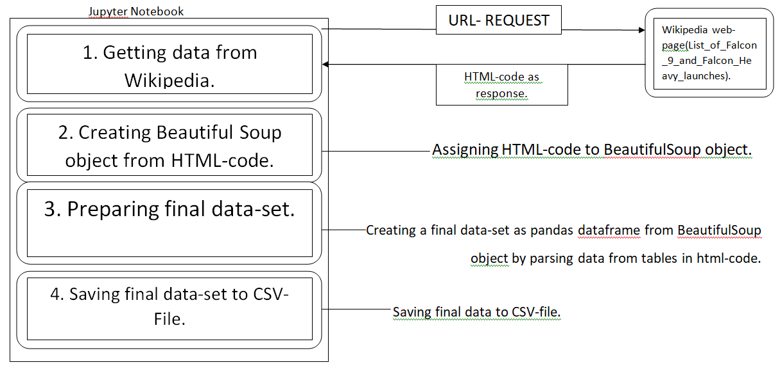
Data collection – Web scraping
Extract a Falcon 9 launch records HTML table from Wikipedia.
Parse the table and convert it into a Pandas data frame.
https://github.com/anyatha92/Capstone-/blob/master/notebook_3._Data_collection(web_Scraping)_TWORZyhZK.ipynb

Slide 10
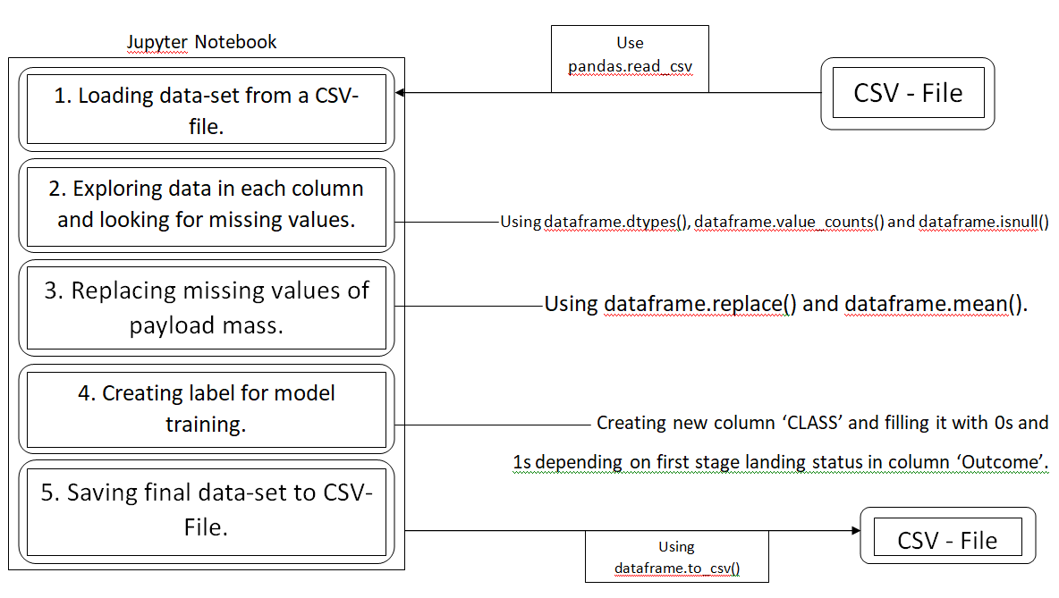
Data wrangling
Perform:
Exploratory Data Analysis.
Determine Training Labels.
https://github.com/anyatha92/Capstone-/blob/master/notebook_1._Data_Wrangling_RBhJXYPyX.ipynb

Slide 11
EDA with data visualization
CHART TYPE | PURPOSE
a. SCATTER PLOT | To check if landing success rate increase with for later flights and to see if success rate is higher for higher payload mass. To check the distribution of launches between the launch sites in time. To check the change of success rate from earlier launches to later launches for each launch site. To check the distribution of launches with different payload mass between the launch sites. To check the payload mass range that has high and low success rates. To check the change of success rate from earlier launches to later launches for each orbit type. To check the influence of payload mass on success rate for each orbit type.
b. BAR PLOT | To see if different orbits have different success rates.
c. LINE PLOT | To check the change of success rate from 2013 till 2020.
https://github.com/anyatha92/Capstone-/blob/master/notebook_5._EDA_Data-visualization_YiV0QgXWL.ipynb

Slide 12
EDA with SQL
Performed SQL queries:
Display the names of the unique launch sites in the space mission.
Display 5 records where launch sites begin with the string 'CCA’.
Display the total payload mass carried by boosters launched by NASA (CRS).
Display average payload mass carried by booster version F9 v1.1.
List the date when the first successful landing outcome in ground pad was achieved.
List the names of the boosters which have success in drone ship and have payload mass greater than 4000 but less than 6000.
List the total number of successful and failure mission outcomes.
List the names of the booster_versions which have carried the maximum payload mass with help of subquery.
List the records which will display the month names, failure landing_outcomes in drone ship ,booster versions, launch_site for the months in year 2015.
Rank the count of successful landing_outcomes between the date 2010-06-04 and 2017-03-20 in descending order.
https://github.com/anyatha92/Capstone-/blob/master/notebook_4._EDA_SQL_dkbBkLEJy.ipynb

Slide 13
Build an interactive map with Folium
OBJECTS | MAP OBJECT TYPE | PURPOSE
Mark all launch sites on a map. | Circle Popup Label Text Label | To show the location of every launch site on the map.
Mark the success/failed launches for each site on the map. | Color-Labeled Marker | To identify success rate for every launch site.
Calculate the distances between a launch site to its proximities. | Polyline Text Label | To measure the distance to the nearest railway, highway, city, coast.
https://github.com/anyatha92/Capstone-/blob/master/notebook_6._Data_Visualization_Folium__dgfX0fnQ.ipynb

Slide 14
Build a Dashboard with Plotly Dash
DASHBOARD OBJECTS | PURPOSE
a. Launch Site Dropdown List | To enable interactive Launch Site selection for charts.
b. Successful Launches Pie Chart | Shows the total successful launches count for all sites if all Launch Sites are selected. If a specific launch site is selected, the pie chart shows the Success vs. Failed counts for the site.
Payload Mass Range Slider | To select the range of payload mass for charts where payload mass is used.
Scatter Chart: Booster version for Success Rate vs. Payload Mass | To show the correlation between payload and launch success for each booster version.
https://github.com/anyatha92/Capstone-/blob/master/Plotty_Dash.ipynb

Slide 15
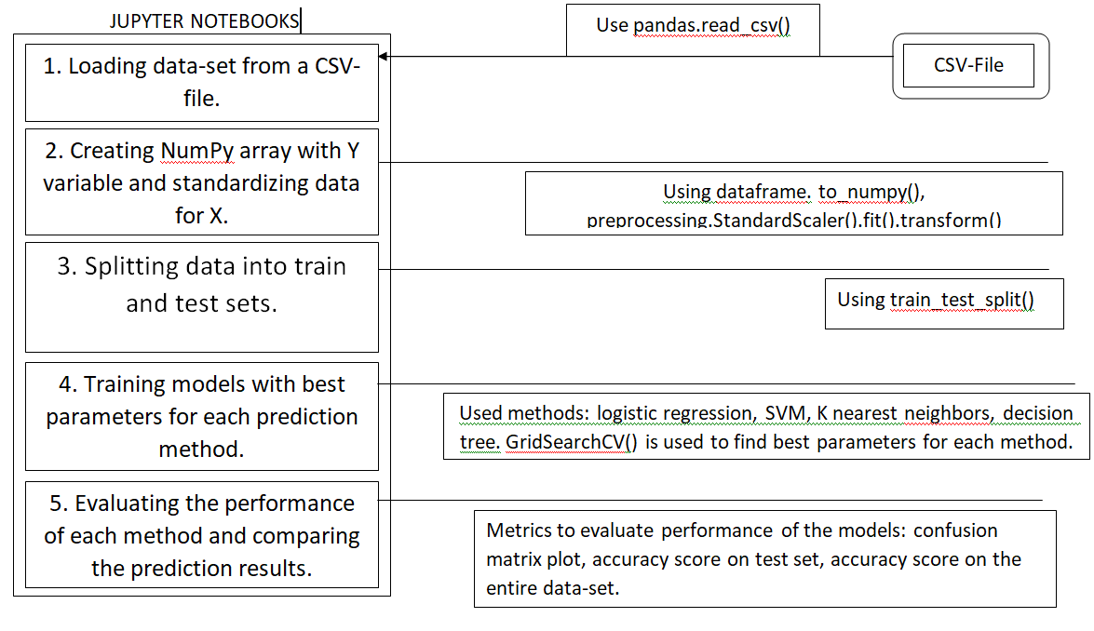
Predictive analysis (Classification)
Perform exploratory Data Analysis and determine Training Labels:
create a column for the class.
Standardize the data.
Split into training data and test data -Find best Hyperparameter for SVM, Classification Trees and Logistic Regression.
Finding the method performs best using test data.
https://github.com/anyatha92/Capstone-/blob/master/notebook_7._Machine_Learning_Prediction_PMQ_iMUld.ipynb

Slide 16
Results
Exploratory data analysis results
Interactive analytics demo in screenshots
Predictive analysis results

Slide 17
EDA with Visualization

Slide 18
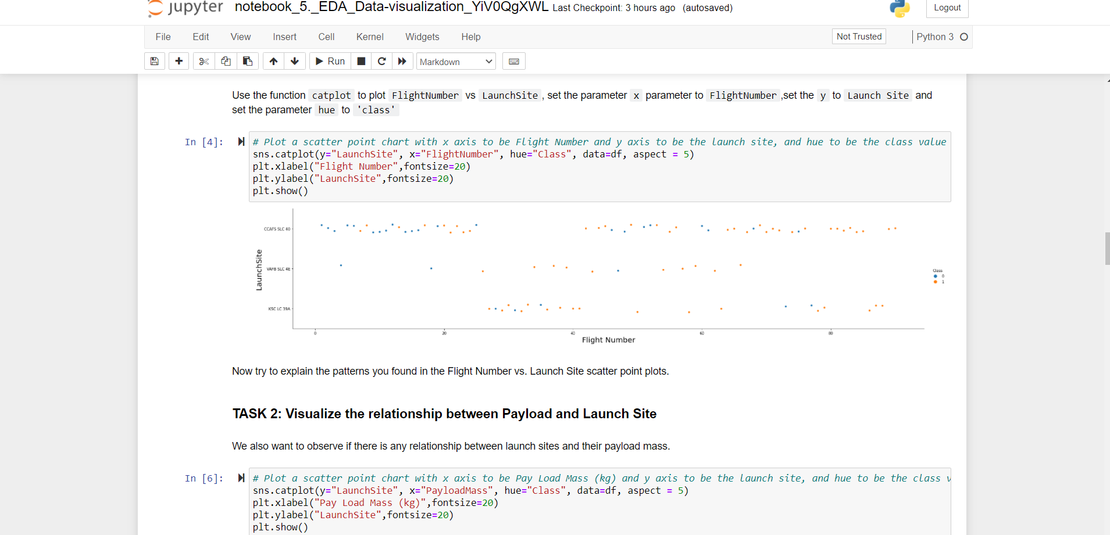
Flight Number vs. Launch Site
CCAFS SLC 40 launch site is used the most time.
CCAFS SLC 40 launch site has the highest number of failed Launches at the beginning.
Starting with Flight Number 78 all launches on all launch sites were successful.

Slide 19
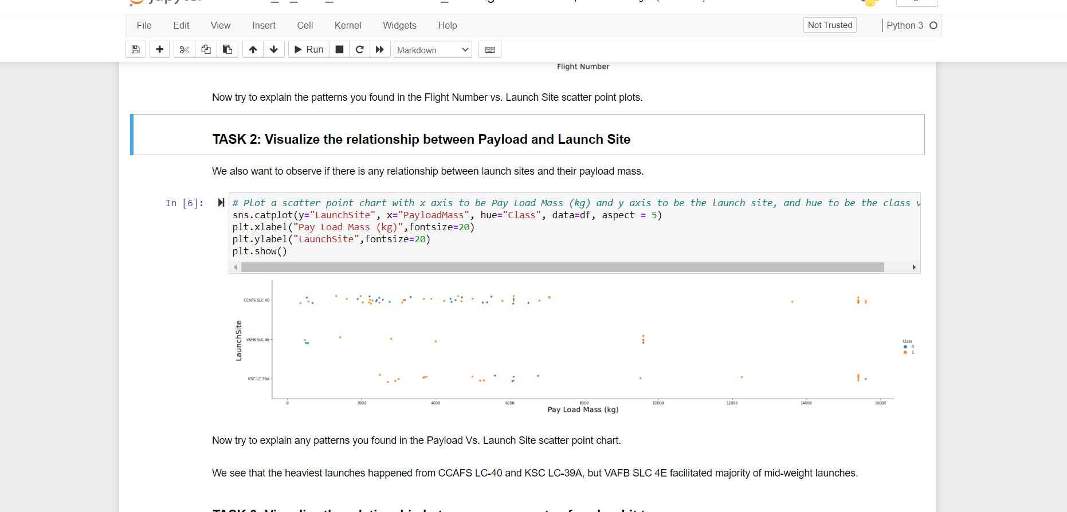
Payload vs. Launch Site
For every launch site the higher the payload mass is the higher is the success rate.
KSC LC 39A launch site has the highest general success rate, but it has problems for payload mass in range from 5000 to 7000 kg.
Most of unsuccessful launches had payload mass under 7000 kg.

Slide 20
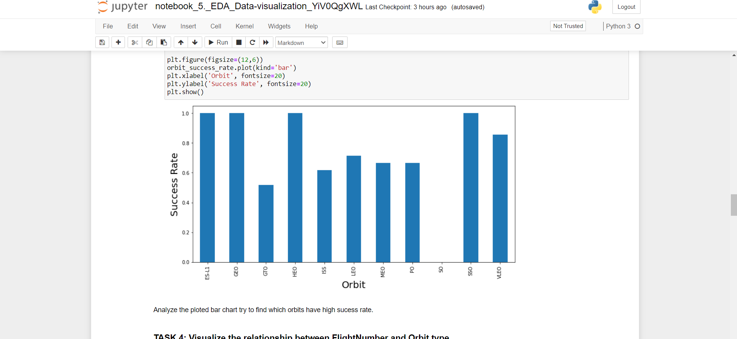
Success rate vs. Orbit type
ES-L1, GEO, HEO and SSO have 100% success rate.
SO has 0% success rate.
VLEO has success rate above 80%.
GTO, ISS, LEO, MEO, PO have success rate in range from 50% to 80%.

Slide 21
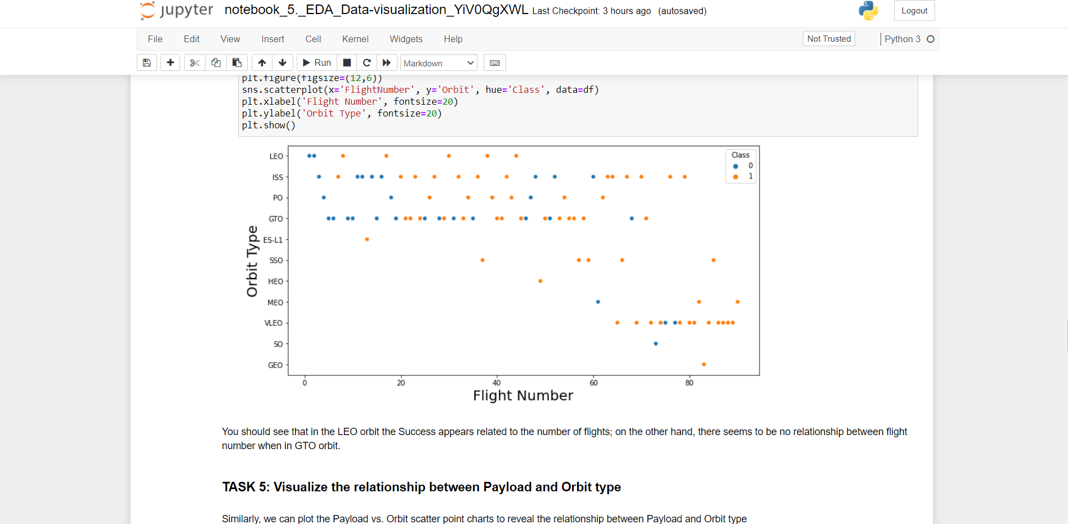
Flight Number vs. Orbit type
In the LEO orbit the Success is related to the number of flights.
No relationship between flight number for GTO orbit.
Launches to VLEO orbit were performed late: after flight #60.

Slide 22
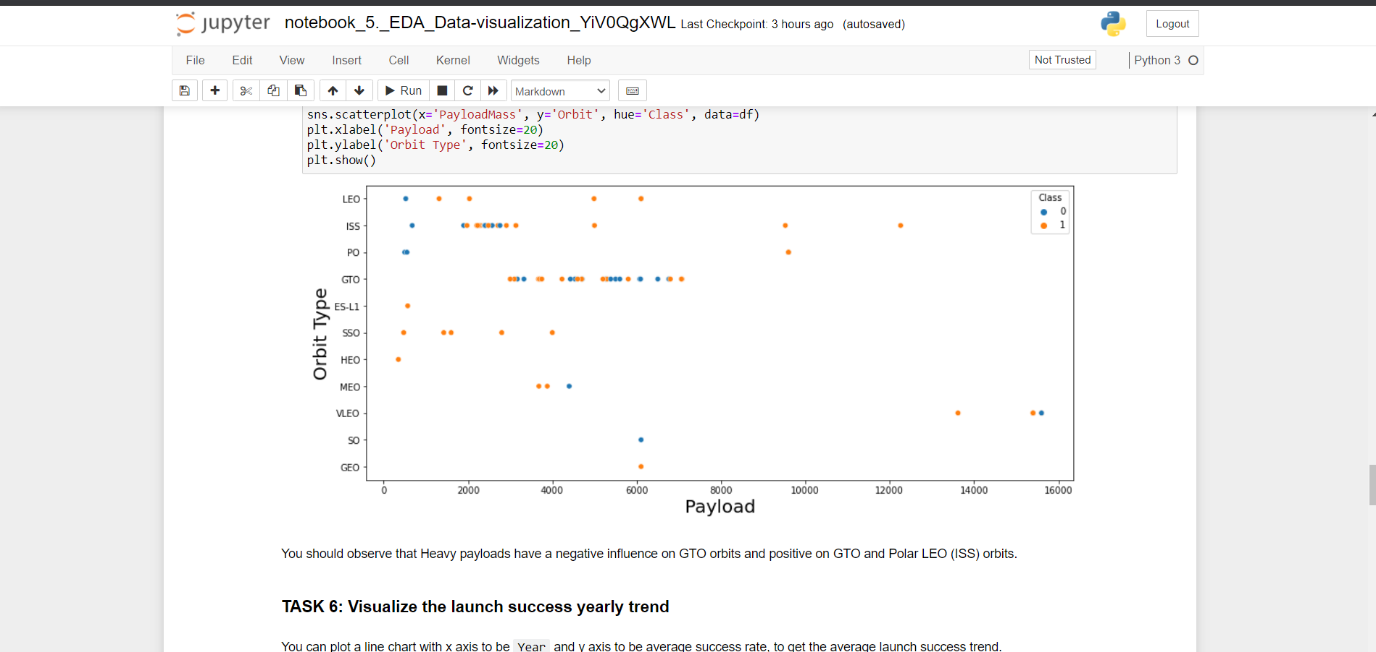
Payload vs. Orbit type
Heavy payloads have a negative influence on GTO orbits.
Heavy payloads have a positive influence on LEO and ISS (Polar LEO) orbits.

Slide 23
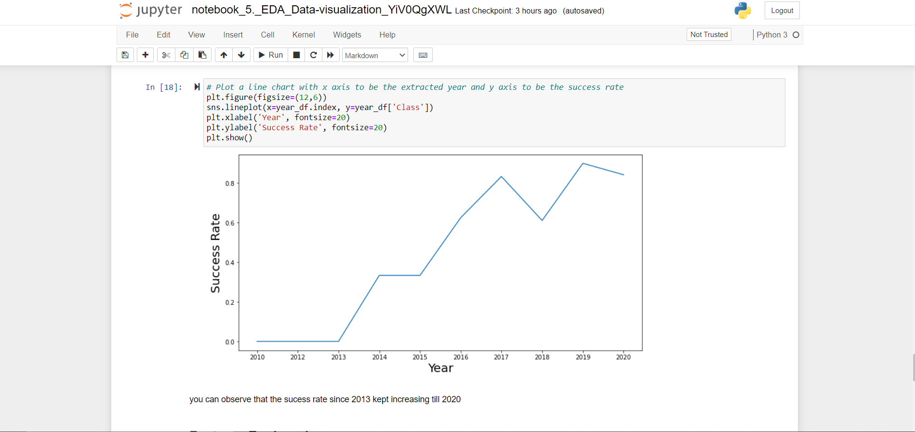
Launch success yearly trend
The success rate since 2013 kept increasing till 2020.

Slide 24
EDA with SQL

Slide 25
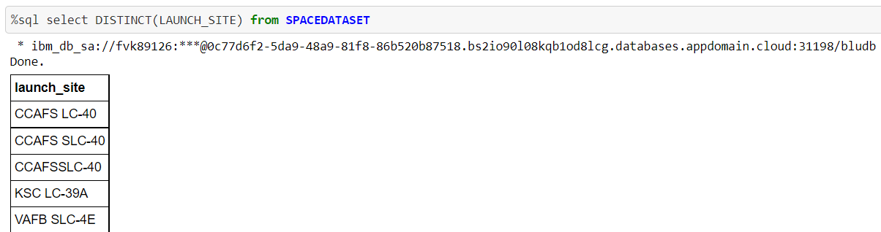
All Unique launch site names
There are 5 unique launch sites.

Slide 26
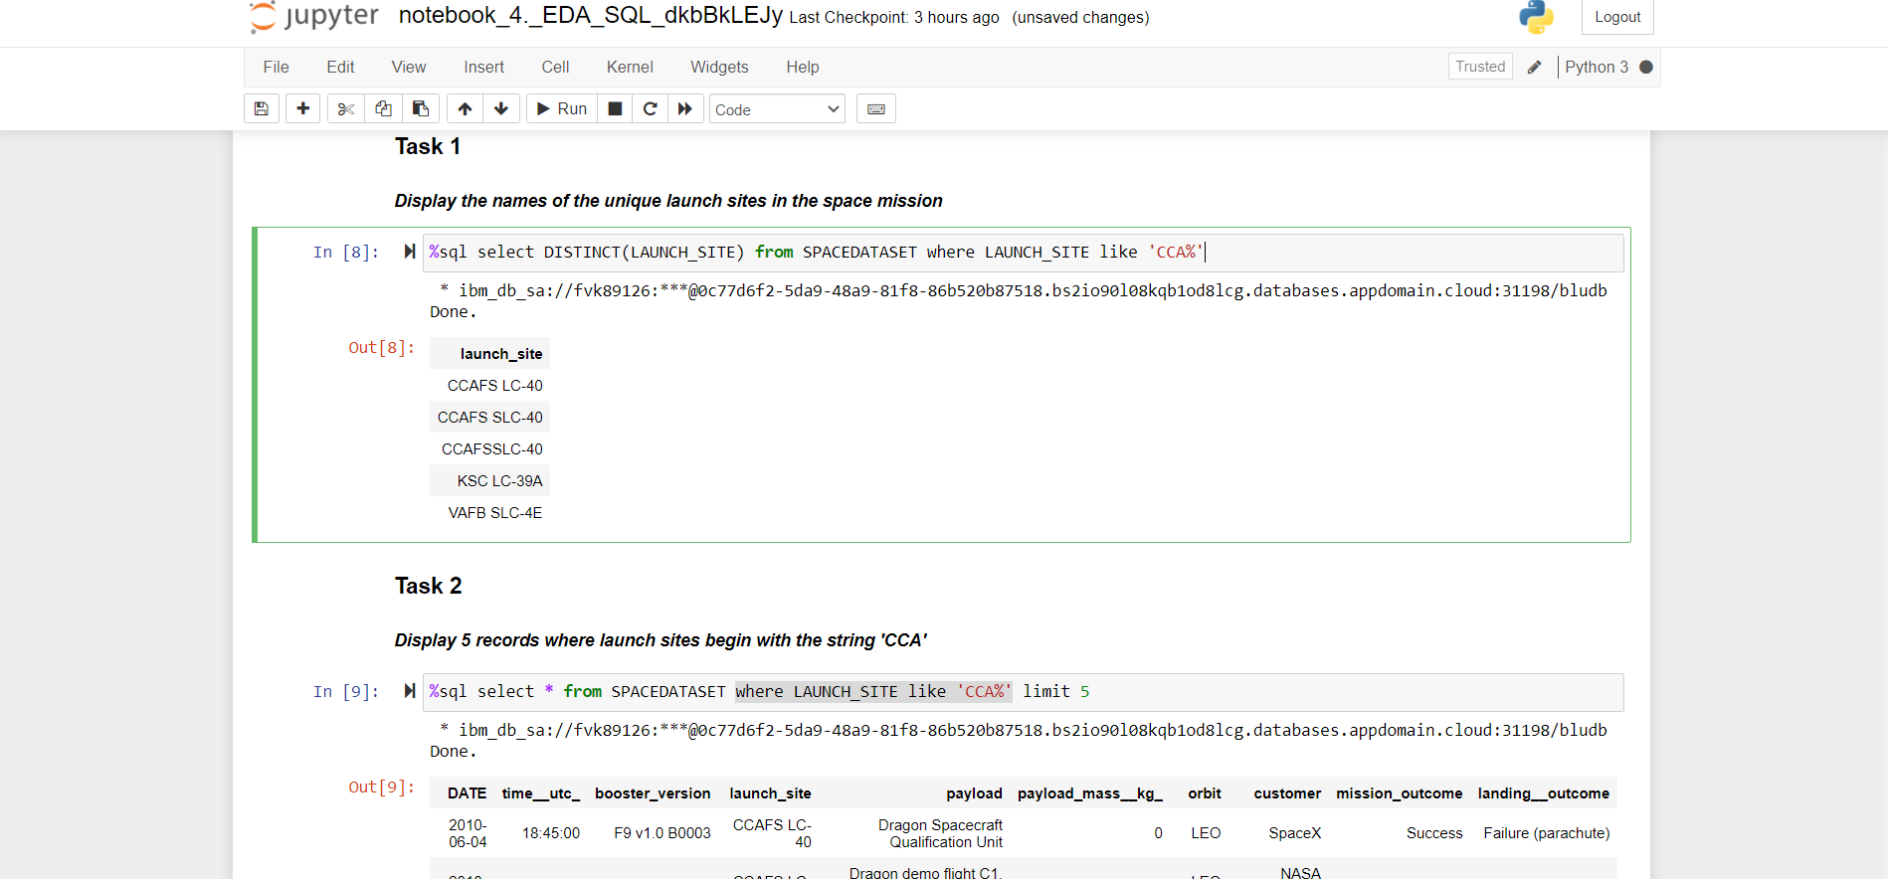
Launch site names begin with `CCA`
3 unique launch sites have names starting with ‘CCA’.

Slide 27
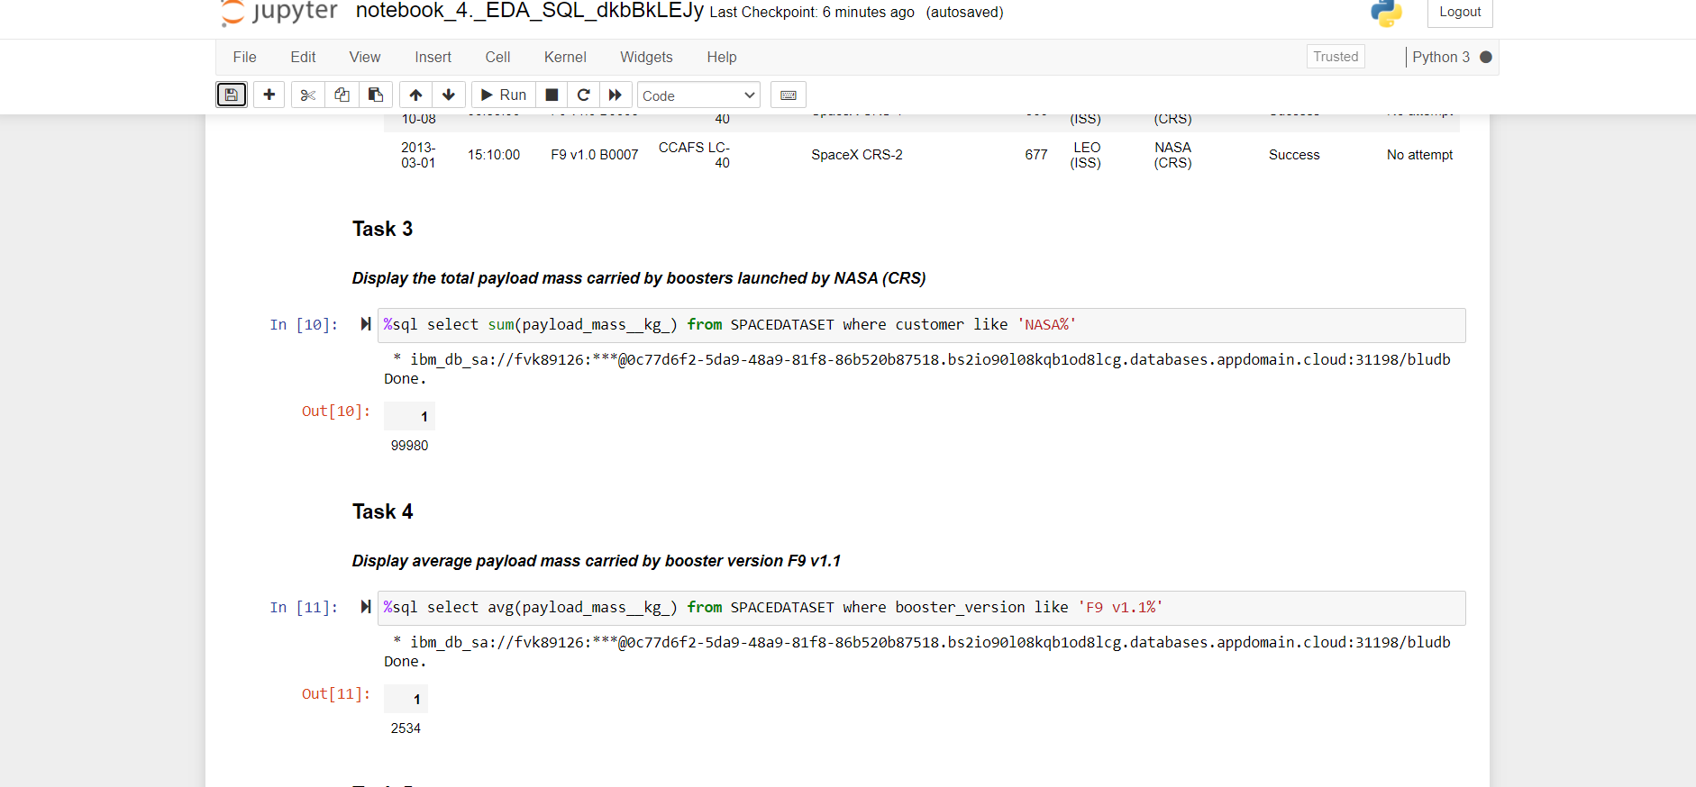
Total payload mass
Total payload carried by boosters launched by NASA (CRS) is 45 596 kilogram.

Slide 28
Average payload mass by F9 v1.1
Average payload mass carried by F9 v1.1 is 2 534 kilogram.

Slide 29
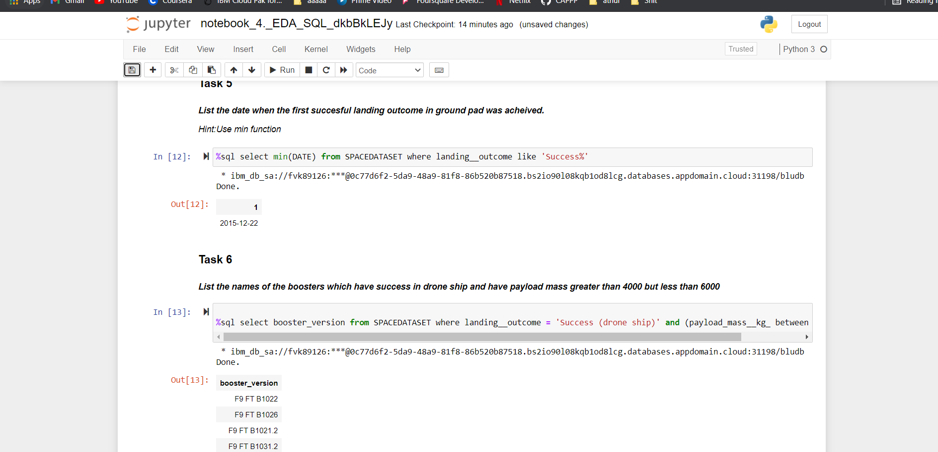
First successful ground landing date
First successful landing on ground pad was achieved on the 22nd of December 2015.

Slide 30
Successful drone ship landing with payload between 4000 and 6000
There are 4 boosters which have success in drone ship and have payload mass greater than 4000 but less than 6000.

Slide 31
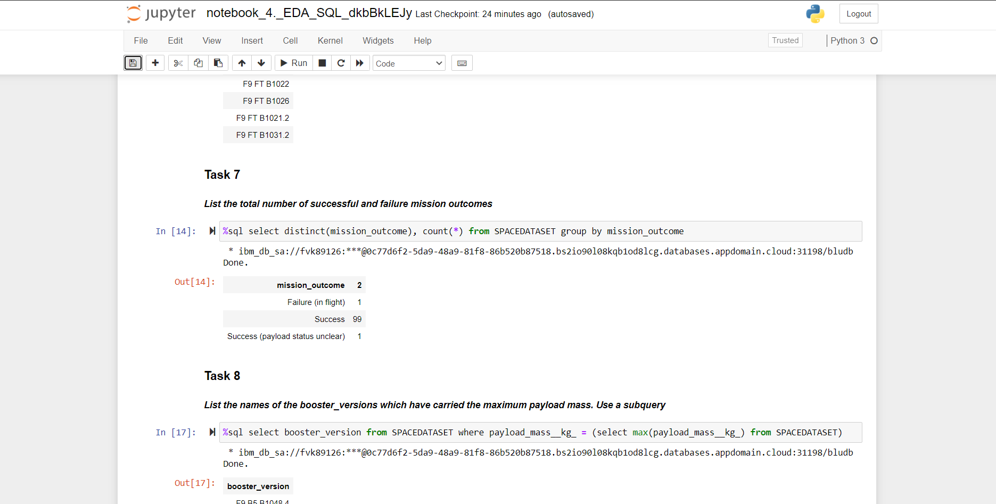
Total number of successful and failure mission outcomes
There are 100 Successful outcomes and 1 failure mission outcome.

Slide 32
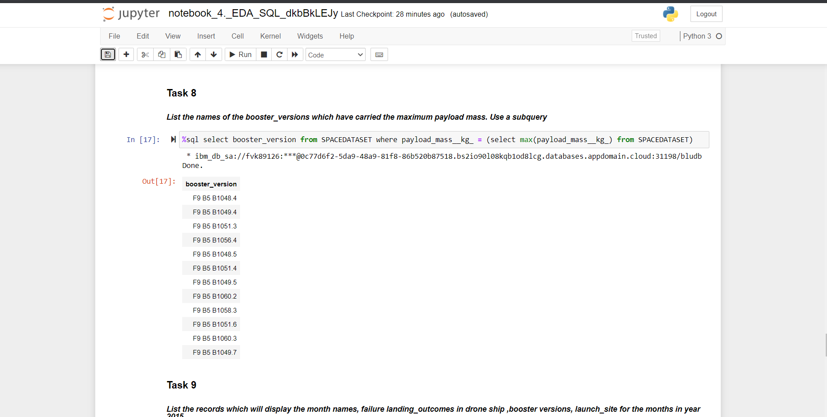
Boosters carried maximum payload
12 boosters carried maximum payload mass.

Slide 33
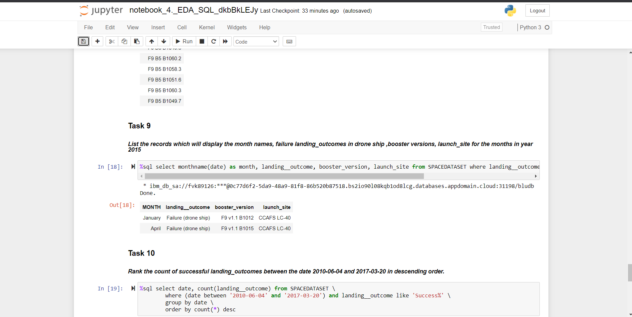
2015 launch records
Total of 2 records, one for January and one for April.

Slide 34
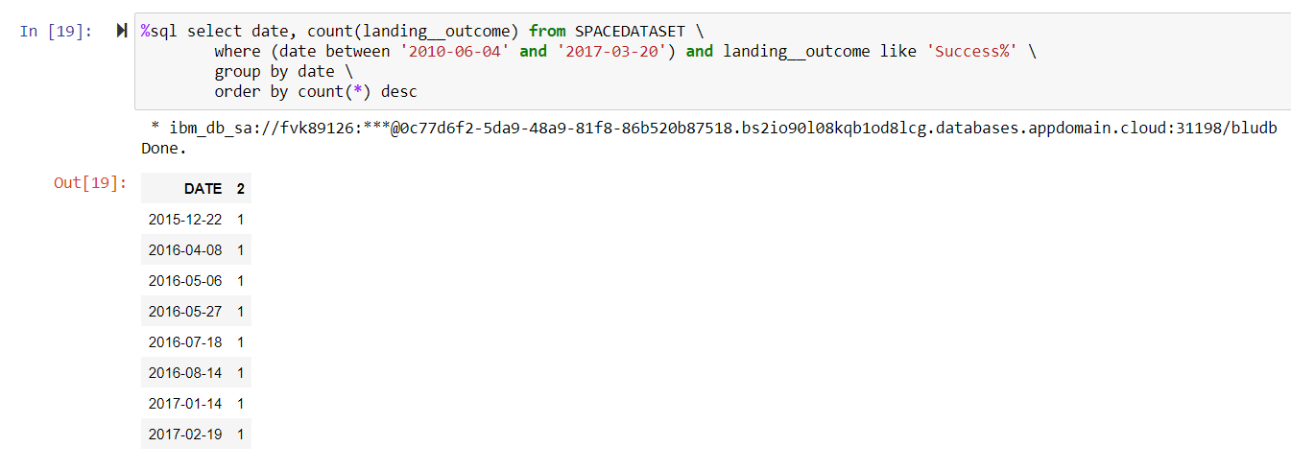
Rank success count between 2010-06-04 and 2017-03-20
Count of success outcomes: 8.

Slide 35
Interactive map with Folium

Slide 36
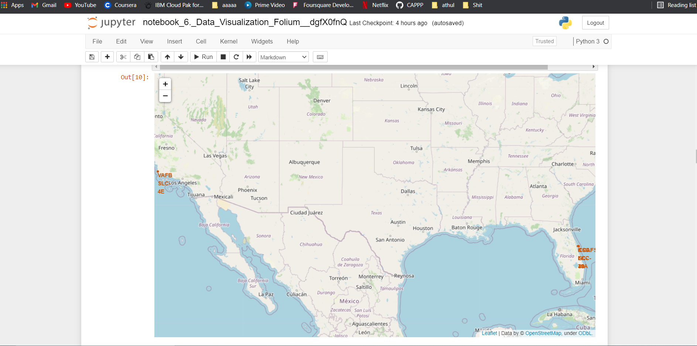
<Marked Launch Sites>
When launch sites in proximity to the Equator line:
When a spacecraft is launched into orbit, it should end up spinning around the Earth quickly enough not to be pulled back in by the Earth's gravity.
The huge rockets used in launching a spaceship help this to happen by giving a huge amount of thrust, enough to achieve escape velocity.
However, the spin of the Earth itself can help give it a push as well.
Anything on the surface of the Earth at the equator is already moving at 1670 kilometers per hour.
If a ship is launched from the equator it goes up into space, and it is also moving around the Earth at the same speed it was moving before launching.
This is because of inertia.
This speed will help the spacecraft keep up a good enough speed to stay in orbit.
When launch sites in very close proximity to the coast:
It will minimize the risk of having any debris dropping or exploding near people.

Slide 37
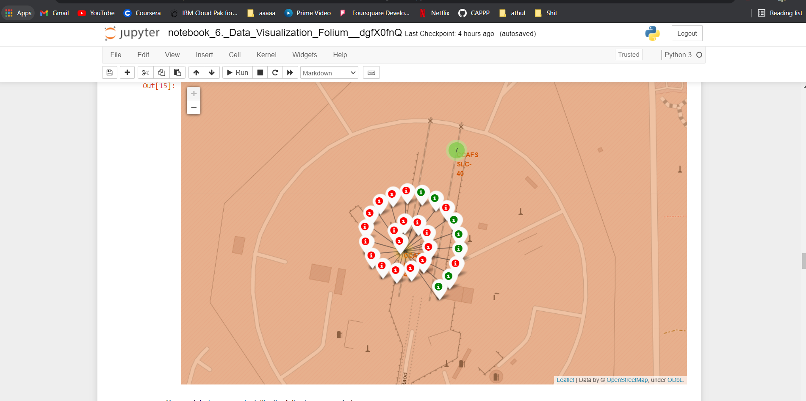
Success/failed launches site CCAFS LC-40
From the color-labeled markers in marker clusters, it is seen that at the launch site CCAFS LC-40 have relatively low success rates.

Slide 38
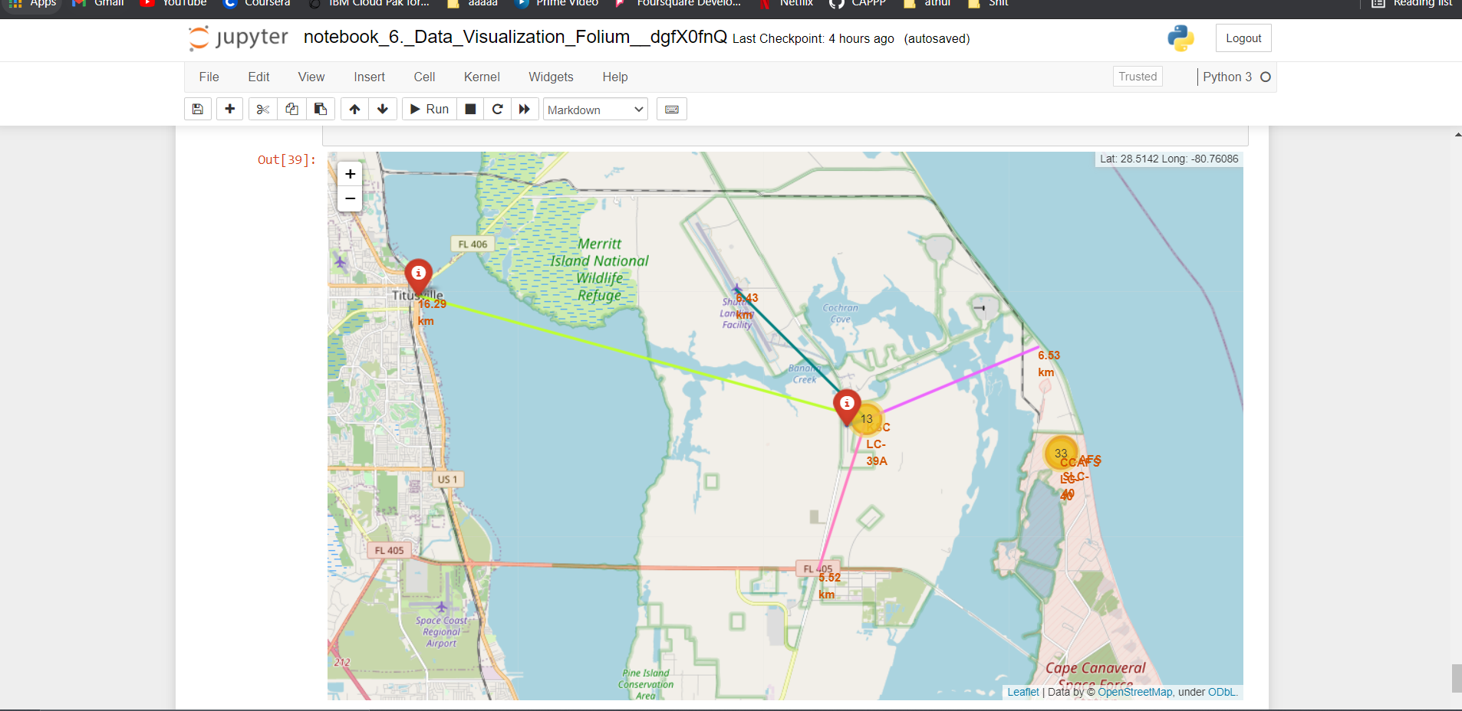
Distances between a launch site to its proximities
Launch site is built close to major bodies of water to ensure that no components are shed over populated areas.
Launch site is built next to railways/highways to provide convinient transpotation of space-craft parts, cargos and stuff.
A rocket launch site is built as far as possible away from major population centers in order to mitigate risk to bystanders should a rocket experience a catastrophic failure.

Slide 39
Build a Dashboard with Plotly Dash

Slide 40
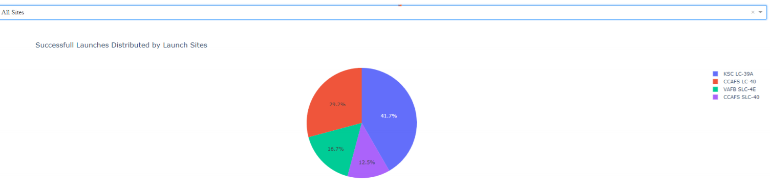
All sites success counts
Most of successful launches were made on KSC LC-39A launch site.

Slide 41
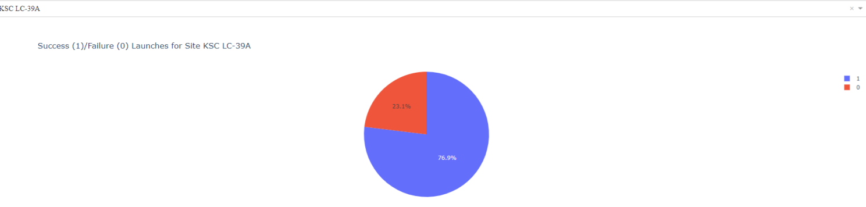
Success/Failure Rate For KSC LC-39A Launch Site
KSC LC-39A launch site has the highest success rate (76.9%).

Slide 42
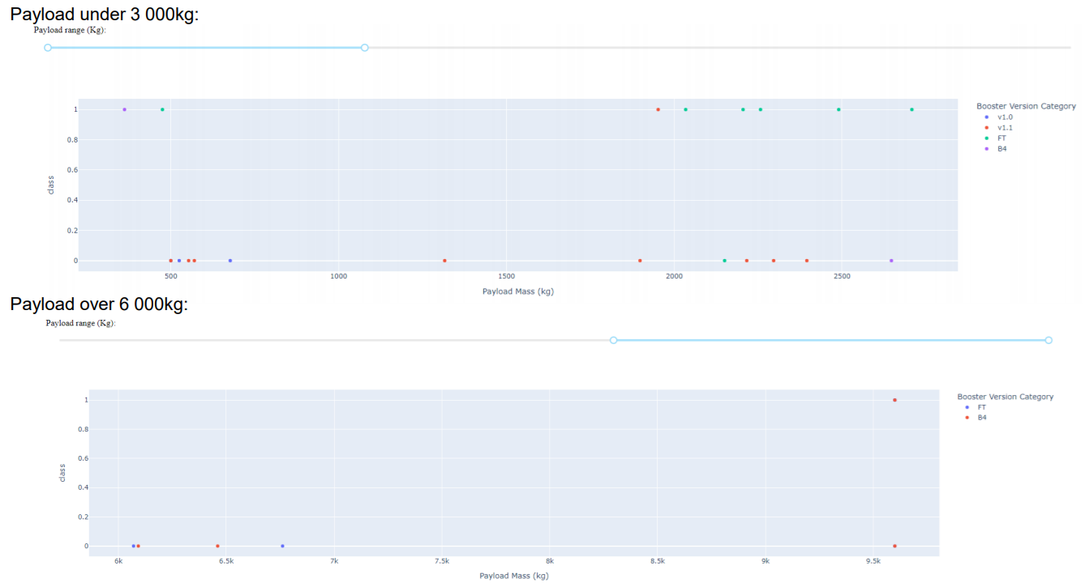
Payload vs. Launch Outcome (Different Payload Ranges), All Launch Sites

Slide 43
Predictive analysis (Classification)

Slide 44
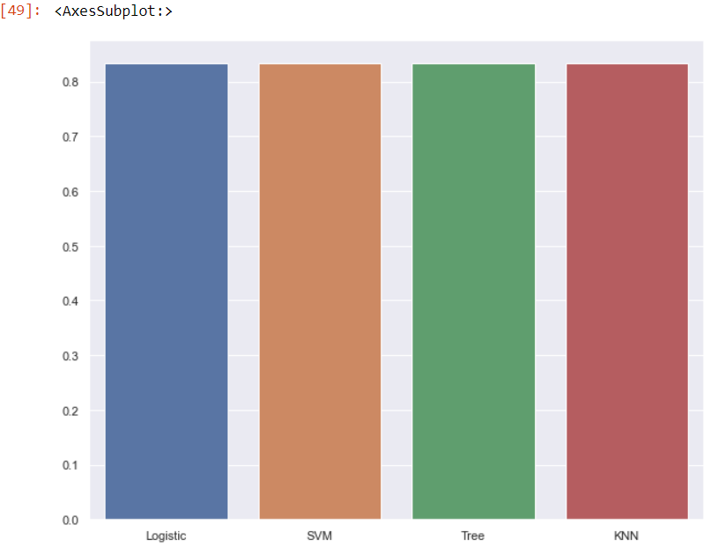
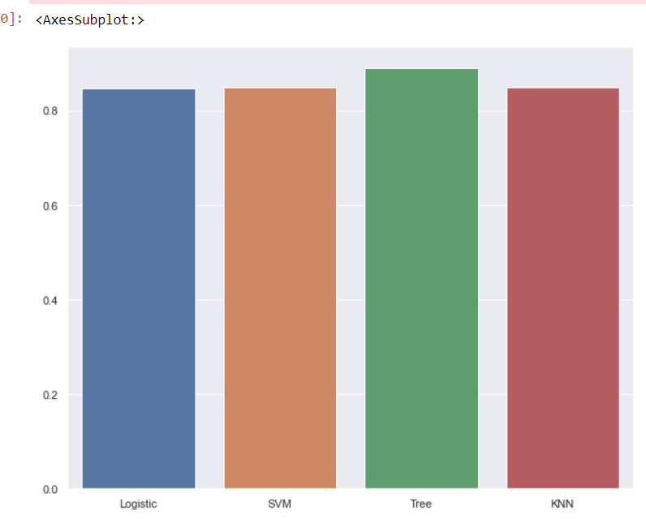
Classification Accuracy
Score of each model:
Accuracy of each model:
Find the method performs best:
We see that on the knn, logistic regression and svm perform the same on the test set and very similar on the train set.

Slide 45
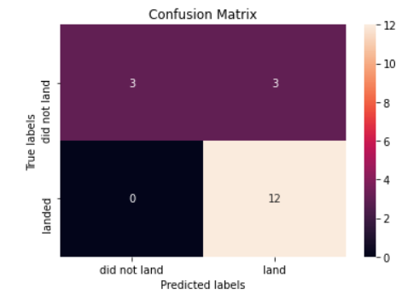
Confusion Matrix
Examining the confusion matrix, we see that logistic regression can distinguish between the different classes.
We see that the major problem is false positives.
SVM method can distinguish between the different classes.
False positives is the point for improvement of the prediction accuracy

Slide 46

CONCLUSION
Gathered datasets provide a good basis both for prediction if the Falcon 9 Space Rocket first stage will land successfully and for EDA concerning Space X rocket launches.
Various EDA techniques show that a list of different factors affect the success of first stage landing.
High accuracy score (over 80%) could be achieved for predictions based on gathered datasets.
SVM method can distinguish between the different classes.
False positives is the point for improvement of the prediction accuracy.

Slide 47

APPENDIX
Include any relevant assets like Python code snippets, SQL queries, charts, Notebook outputs, or data sets that you may have created during this project

