Slide 1
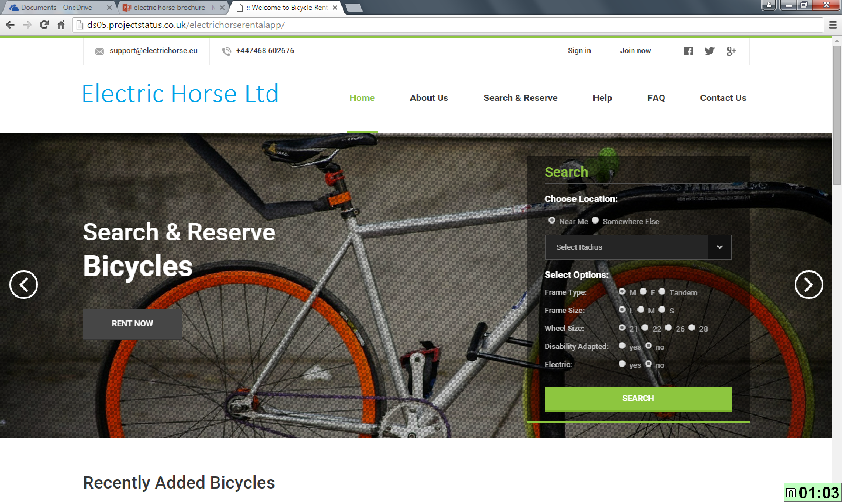
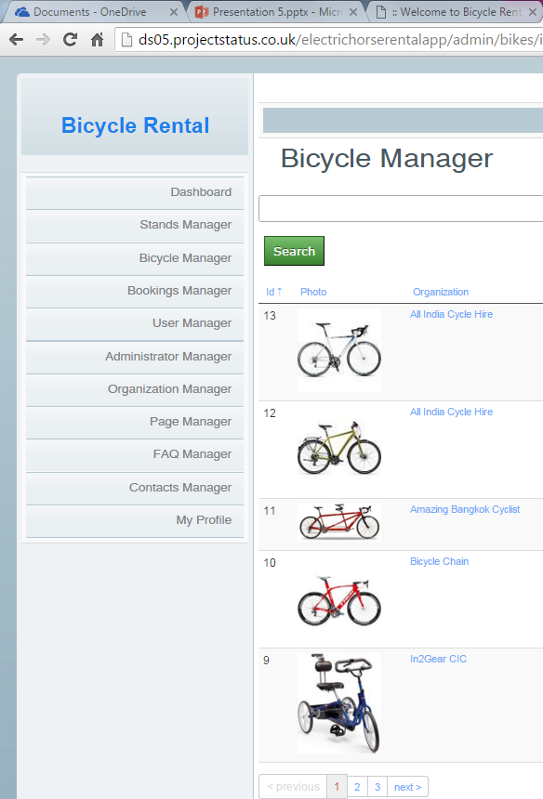
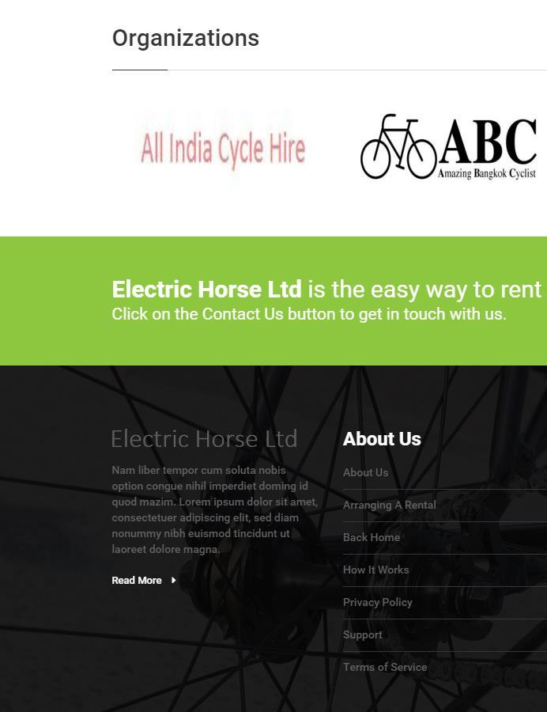
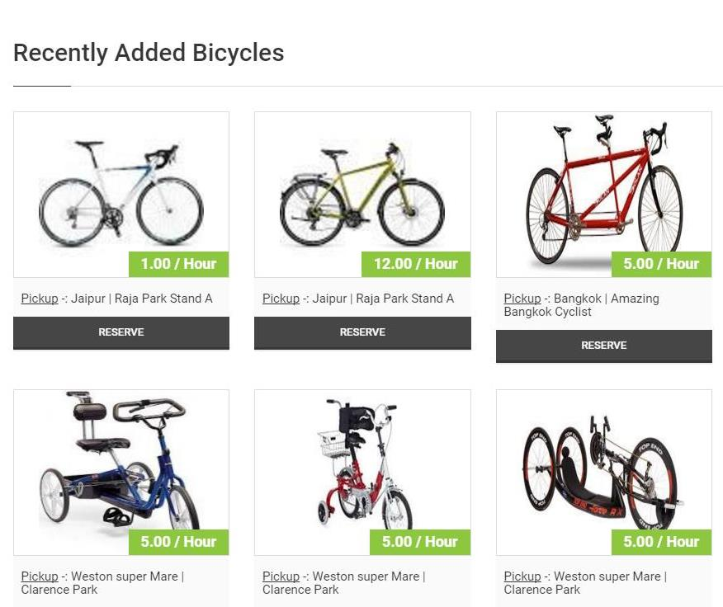
We’re offering you a simple way to rent and manage your bicycles through our service
“We use Electric Horse to manage our disabled bicycle rental scheme and it does what it says on the tin!”
Try our service free for 30 days at electrichorse.eu
Electric Horse Bicycle Rental Service
electrichorse.eu
Martin Thomas
In2Gear C.I.C www.in2gear.biz
Notes:
To change this brochure, replace our sample content with your own. Or, if you'd rather start from a clean slate, press the New Slide button on the Home tab to insert a new page. Now enter your text and pictures in the empty placeholders. If you need more placeholders for titles, subtitles or body text, copy any of the existing placeholders, then drag the new one into place.
And did you notice we made fold marks for you? They are really light, but if you don’t like them showing on your brochure, select and delete them before you print.

Slide 2
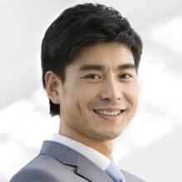

Global in scope
Our bicycle rental service manages all your bicycles and stands and allows users to reserve and pay online for bicycle rentals from you.
Through their account, they can add or change bookings, make group bookings, request accessories and manage the whole rental process themselves.
Your administrator dashboard shows your revenue at a glance, all your bookings, users, bicycles and stands.
It’s free for all your users and there is a modest monthly charge for administrators, plus a booking fee, if payments are taken through our web site.
You can also choose your own payment gateway and payment methods and we can help you with this.
If you don’t already use a cycle rental system, why not try our 30-day free trial?
App to search and reserve your bicycles
Rental manager allows you to administer your bicycles
Dashboard to show your daily rental revenue
Contact us
Mike Hitchens
Operations Director
96 Drove Road
Weston super Mare
BS23 3NW
Local in focus
Larger organisations
support@electrichorse.eu
What do you need to do ?
Just register as an administrator by sending us your details to sales@electrichorse.eu
We will create a microsite for you and send you all your details
You can customise your microsite including pages, bicycles and stands as necessary
You can link the microsite to your current web site or send customers directly to it using email, text or social media.
You already have a bicycle rental service . We can provide a service gateway to your cycle hire system, so that your bicycle details are replicated onto our service.
How does this help you?
Wider visibility for your users
More prospects for your bicycles
Less churn and more customer loyalty
We will arrange all necessary connections for a small monthly charge.
Shana Lloyd-Jones
Sales Director
96 Drove Road
Weston super Mare
BS23 3NW
sales@electrichorse.eu
www.electrichorse.eu
07468 602676

