Slide 1

Explanation for some scores that can cause some disagreement. The reason is that the distribution of the spots is not balanced along the leaf. Usually they are concentrated in some areas, which, usually are on the bottom part, close to the stem, or at the up part, which is more exposed.

Slide 2
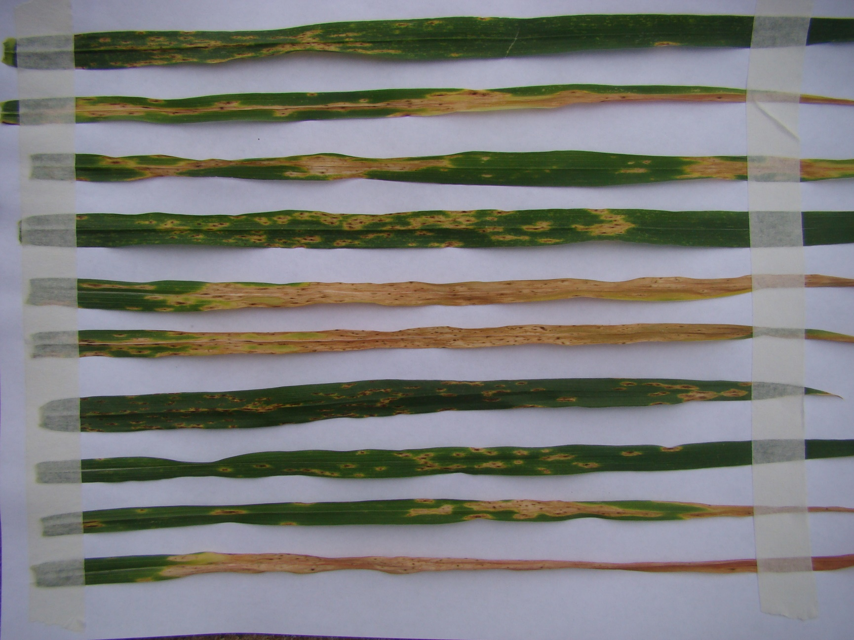
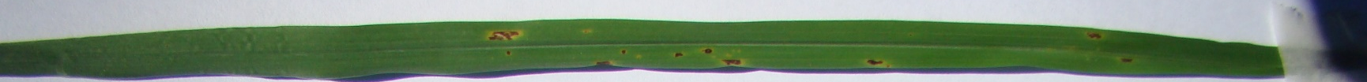

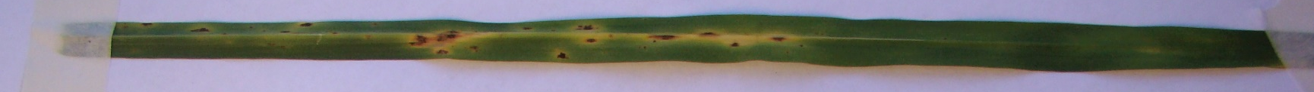
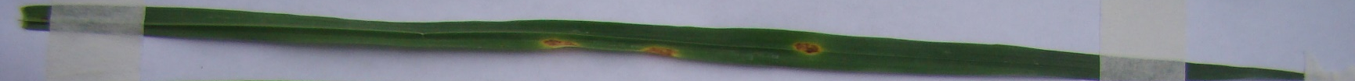
This is a typical score 5= Several spots, evident chlorosis or necrosis coalescents (S)
This is a typical score 4 = Small spots, evident chlorosis or necrosis, some coalescents (MS)
This is a typical score 3 = Small spots, evident chlorosis or necrosis (MR a MS)
This is a typical score 2 = Small spots, few chlorosis and necrosis (MR)
This is a typical score 1 = Small spots, no chlorosis or necrosis (R)
This could be 5= Several spots, evident chlorosis or necrosis coalescents (S). However the extension is less the half leaf. So I give score 4
This could be 4 = Small spots, evident chlorosis or necrosis, some coalescents (MS). However the extension is less the half leaf. So I give score 3
This could be 3 = Small spots, evident chlorosis or necrosis (MR a MS). However the extension is less the half leaf. So I give score 2.

