Slide 1
Writing Advanced Scripts
Notes:
Schedule: Timing Topic
30 minutes Lecture
20 minutes Practice
50 minutes Total

Slide 2
Objectives
After completing this appendix, you should be able
to do the following:
Describe the types of problems that are solved by using SQL to generate SQL
Write a script that generates a script of DROP TABLE statements
Write a script that generates a script of INSERT INTO statements
Notes:
Lesson Aim
In this appendix, you learn how to write a SQL script to generates a SQL script.

Slide 3
Using SQL to Generate SQL
Data
dictionary
SQL
SQL script
  SQL can be used to generate scripts in SQL
  The data dictionary
    Is a collection of tables and views that contain database information
    Is created and maintained by the Oracle server
Notes:
Using SQL to Generate SQL
SQL can be a powerful tool to generate other SQL statements. In most cases this involves writing a script file. You can use SQL from SQL to:
Avoid repetitive coding
Access information from the data dictionary
Drop or re-create database objects
Generate dynamic predicates that contain run-time parameters
The examples used in this lesson involve selecting information from the data dictionary. The data dictionary is a collection of tables and views that contain information about the database. This collection is created and maintained by the Oracle Server. All data dictionary tables are owned by the SYS user. Information stored in the data dictionary includes names of the Oracle Server users, privileges granted to users, database object names, table constraints, and audition information. There are four categories of data dictionary views. Each category has a distinct prefix that reflects its intended use.

Slide 4
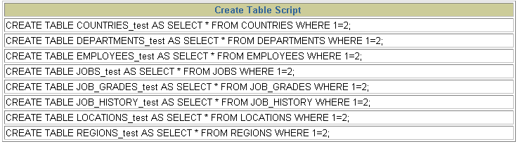
Creating a Basic Script
SELECT 'CREATE TABLE ' || table_name || '_test '
|| 'AS SELECT * FROM ' || table_name
||' WHERE 1=2;'
AS "Create Table Script"
FROM user_tables;
Notes:
A Basic Script
The example in the slide produces a report with CREATE TABLE statements from every table you own. Each CREATE TABLE statement produced in the report includes the syntax to create a table using the table name with a suffix of _test and having only the structure of the corresponding existing table. The old table name is obtained from the TABLE_NAME column of the data dictionary view USER_TABLES.
The next step is to enhance the report to automate the process.
Note: You can query the data dictionary tables to view various database objects that you own. The data dictionary views frequently used include:
USER_TABLES: Displays description of the user’s own tables
USER_OBJECTS: Displays all the objects owned by the user
USER_TAB_PRIVS_MADE: Displays all grants on objects owned by the user
USER_COL_PRIVS_MADE: Displays all grants on columns of objects owned by the user

Slide 5
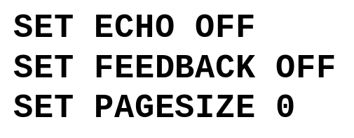
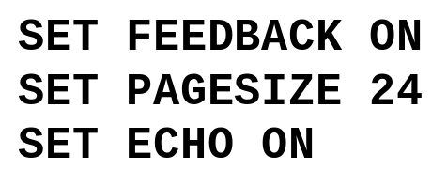
Controlling the Environment
SPOOL dropem.sql
SPOOL OFF
Set system variables to appropriate values.
SQL STATEMENT
Set system variables back to the default value.
Notes:
Controlling the Environment
In order to execute the SQL statements that are generated, you must capture them in a spool file that can then be run. You must also plan to clean up the output that is generated and make sure that you suppress elements such as headings, feedback messages, top titles, and so on. You can accomplish all of this by using iSQL*Plus commands.

Slide 6
The Complete Picture
SET ECHO OFF
SET FEEDBACK OFF
SET PAGESIZE 0
SELECT 'DROP TABLE ' || object_name || ';'
FROM user_objects
WHERE object_type = 'TABLE'
/
SET FEEDBACK ON
SET PAGESIZE 24
SET ECHO ON
Notes:
The Complete Picture
The output of the command on the slide is saved into a file called dropem.sql using the File Output option in iSQL*Plus. This file contains the following data. This file can now be started from the iSQL*Plus by locating the script file, loading it, and executing it.
Note: By default, files are spooled into the ORACLE_HOME\ORANT\BIN folder in Windows NT.
Instructor Note:
In iSQL*Plus version 9.0.1.0.1, the output file may contain html tags. This is a documented bug.

Slide 7
Dumping the Contents of a Table to a File
SET HEADING OFF ECHO OFF FEEDBACK OFF
SET PAGESIZE 0
SELECT
'INSERT INTO departments_test VALUES
(' || department_id || ', ''' || department_name ||
''', ''' || location_id || ''');'
AS "Insert Statements Script"
FROM departments
/
SET PAGESIZE 24
SET HEADING ON ECHO ON FEEDBACK ON
Notes:
Dumping Table Contents to a File
Sometimes it is useful to have the values for the rows of a table in a text file in the format of an INSERT INTO VALUES statement. This script can be run to populate the table, in case the table has been dropped accidentally.
The example in the slide produces INSERT statements for the DEPARTMENTS_TEST table, captured in the data.sql file using the File Output option in iSQL*Plus.
The contents of the data.sql script file are as follows:
INSERT INTO departments_test VALUES
(10, 'Administration', 1700);
INSERT INTO departments_test VALUES
(20, 'Marketing', 1800);
INSERT INTO departments_test VALUES
(50, 'Shipping', 1500);
INSERT INTO departments_test VALUES
(60, 'IT', 1400);
...

Slide 8
Dumping the Contents of a Table to a File
Source
'''X'''
''''
''''||department_name||''''
''', '''
''');'
Result
'X'
'
'Administration'
','
');
Notes:
Dumping Table Contents to a File (continued)
You may have noticed the large number of single quotes in the slide on the previous page. A set of four single quotes produces one single quote in the final statement. Also remember that character and date values must be surrounded by quotes.
Within a string, to display one single quote, you need to prefix it with another single quote. For example, in the fifth example in the slide, the surrounding quotes are for the entire string. The second quote acts as a prefix to display the third quote. Thus the result is one single quote followed by the parenthesis followed by the semicolon.

Slide 9
Generating a Dynamic Predicate
COLUMN my_col NEW_VALUE dyn_where_clause
SELECT DECODE('&&deptno', null,
DECODE ('&&hiredate', null, ' ',
'WHERE hire_date=TO_DATE('''||'&&hiredate'',''DD-MON-YYYY'')'),
DECODE ('&&hiredate', null,
'WHERE department_id = ' || '&&deptno',
'WHERE department_id = ' || '&&deptno' ||
' AND hire_date = TO_DATE('''||'&&hiredate'',''DD-MON-YYYY'')'))
AS my_col FROM dual;
SELECT last_name FROM employees &dyn_where_clause;
;
Notes:
Generating a Dynamic Predicate
The example in the slide generates a SELECT statement that retrieves data of all employees in a
department who were hired on a specific day. The script generates the WHERE clause dynamically.
Note: Once the user variable is in place, you need to use the UNDEFINE command to delete it.
The first SELECT statement prompts you to enter the department number. If you do not enter any department number, the department number is treated as null by the DECODE function, and the user is then prompted for the hire date. If you do not enter any hire date, the hire date is treated as null by the DECODE function and the dynamic WHERE clause that is generated is also a null, which causes the second SELECT statement to retrieve all rows from the EMPLOYEES table.
Note: The NEW_V[ALUE]variable specifies a variable to hold a column value. You can reference the variable in TTITLE commands. Use NEW_VALUE to display column values or the date in the top title. You must include the column in a BREAK command with the SKIP PAGE action. The variable name cannot contain a pound sign (#). NEW_VALUE is useful for master/detail reports in which there is a new master record for each page.
Instructor Note
To explain the example, run the script demo\dyn.sql.

Slide 10
Hidden Slide
Notes:
Generating a Dynamic Predicate (continued)
Note: Here, the hire date must be entered in DD-MON-YYYY format.
The SELECT statement in the previous slide can be interpreted as follows:
IF (<<deptno>> is not entered) THEN
IF (<<hiredate>> is not entered) THEN
return empty string
ELSE
return the string ‘WHERE hire_date = TO_DATE('<<hiredate>>', 'DD-MON-YYYY')’
ELSE
IF (<<hiredate>> is not entered) THEN
return the string ‘WHERE department_id = <<deptno>> entered'
ELSE
return the string ‘WHERE deparment_id = <<deptno>> entered
AND hire_date = TO_DATE(' <<hiredate>>', 'DD-MON-YYYY')’
END IF
The returned string becomes the value of the variable DYN_WHERE_CLAUSE, that will be used in the second SELECT statement.
When the first example on the slide is executed, the user is prompted for the values for DEPTNO and HIREDATE:
The following value for MY_COL is generated:
When the second example on the slide is executed, the following output is generated:

Slide 11
Summary
In this appendix, you should have learned the
following:
You can write a SQL script to generate another SQL script.
Script files often use the data dictionary.
You can capture the output in a file.
Notes:
Summary
SQL can be used to generate SQL scripts. These scripts can be used to avoid repetitive coding, drop or re-create objects, get help from the data dictionary, and generate dynamic predicates that contain run-time parameters.
iSQL*Plus commands can be used to capture the reports generated by the SQL statements and clean up the output that is generated, such as suppressing headings, feedback messages, and so on.

Slide 12
Practice D Overview
This practice covers the following topics:
Writing a script to describe and select the data from your tables
Writing a script to revoke user privileges
Notes:
Practice D Overview
In this practice, you gain practical experience in writing SQL to generate SQL.

Slide 13
Hidden Slide
Notes:
Practice D
1. Write a script to describe and select the data from your tables. Use CHR(10) in the select list with the concatenation operator ( || ) to generate a line feed in your report Save the output of the script into my_file1.sql. To save the file, select File option for the output and execute the code. Remember to save the file with a .sql extension. To execute the my_file1.sql, browse to locate the script, load the script, and execute the script.
2. Use SQL to generate SQL statements that revoke user privileges. Use the data dictionary views USER_TAB_PRIVS_MADE and USER_COL_PRIVS_MADE.
a. Execute the script \Lab\privs.sql to grant privileges to the user SYSTEM.
b. Query the data dictionary views to check the privileges. In the sample output shown, note that the data in the GRANTOR column can vary depending on who the GRANTOR is. Also the last column that has been truncated is the GRANTABLE column.

Slide 14
Hidden Slide
Notes:
Practice D (continued)
c. Produce a script to revoke the privileges. Save the output of the script into my_file2.sql. To save the file, select the File option for the output, and execute the code. Remember to save the file with a .sql extension. To execute the my_file2.sql, browse to locate the script, load the script, and execute the script.

